Slide 1
SOFTWARE ENGINEERING
UNIT –II (Chapter-2)
SOFTWARE REQUIREMENTS
Text Book: Software Engineering, A practitioner’s approach
Roger s. Pressman 6th Edition -McGraw-Hill

Slide 2
Objectives
Requirements Engineering Definition
Functional & Non functional requirements
Domain requirements
User requirements
System requirements
Interface specification
The software requirements document

Slide 3
Requirements Engineering
The process of establishing the services that the customer requires from a system and the constraints under which it operates and is developed.
The requirements themselves are the descriptions of the system services and constraints that are generated during the requirements engineering process.

Slide 4
What is a requirement?
It may range from a high-level abstract statement of a service or of a system constraint to a detailed mathematical functional specification
This is inevitable as requirements may serve a dual function
May be the basis for a bid for a contract - therefore must be open to interpretation
May be the basis for the contract itself - therefore must be defined in detail
Both these statements may be called requirements

Slide 5
Types of requirement
User requirements
• Statements in natural language plus diagrams of the services the system provides and its operational constraints. Written for customers
System requirements
• A structured document setting out detailed descriptions of the system services. Written as a contract between client and contractor
Software specification
• A detailed software description which can serve as a basis for a design or implementation. Written for developers

Slide 6
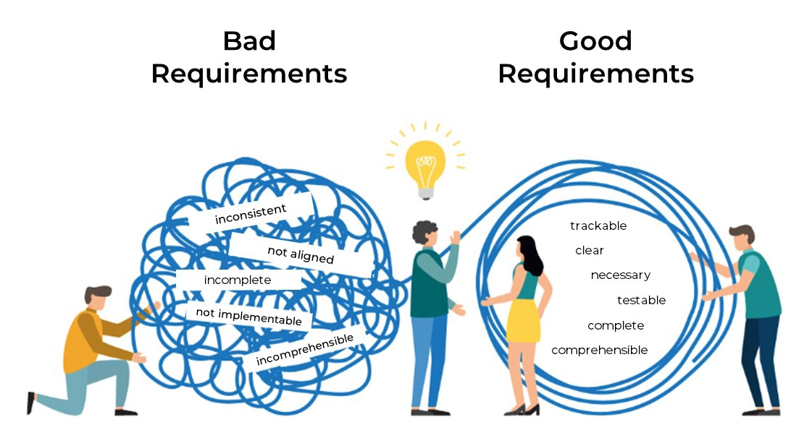
Definitions and specifications
Requirements definition The software must provide a means of representing and accessing external files created by other tools.

Slide 7
Definitions and specifications
Requirements specification
The user should be provided with facilities to define the type of external files. Each external file type may have an associated tool which may be applied to the file.
Each external file type may be represented as a specific icon on the user’s display.
Facilities should be provided for the icon representing an external file type to be defined by the user.
When a user selects an icon representing an external file, the effect of that selection is to apply the tool associated with the type of the external file to the file represented by the selected icon.

Slide 8
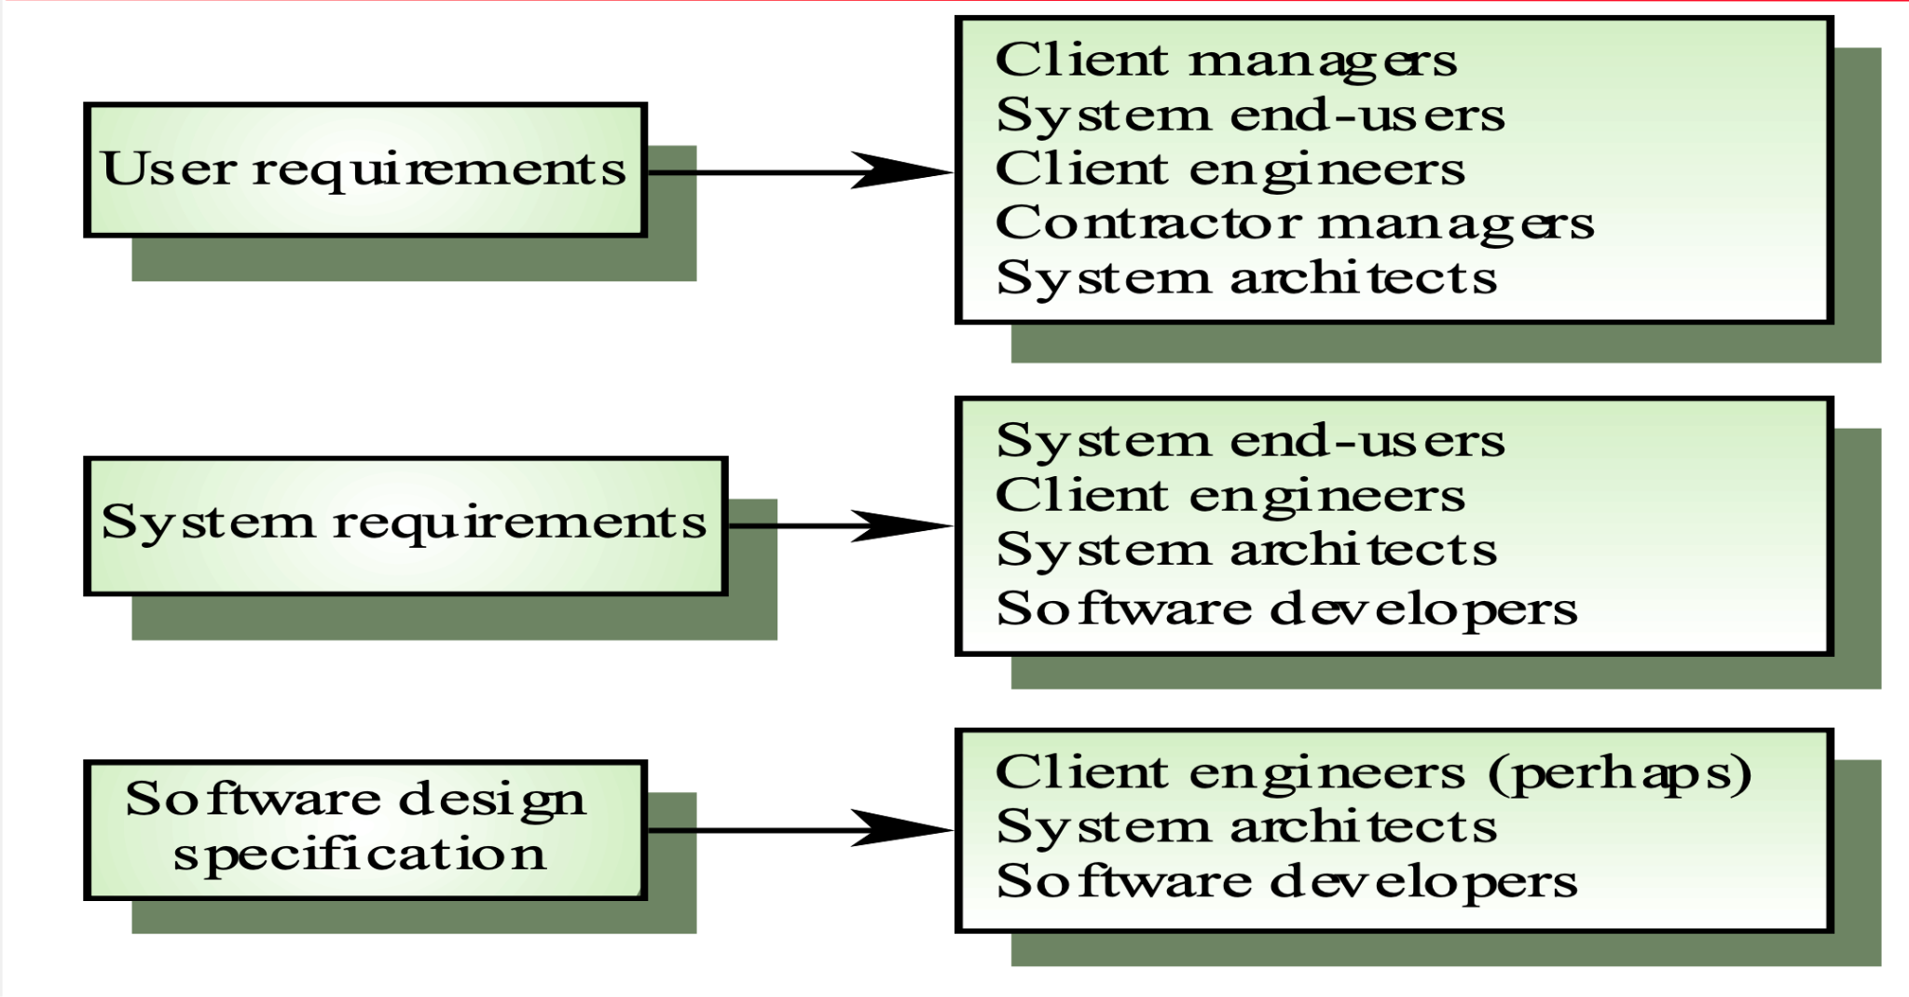
Requirements readers

Slide 9
Functional and non-functional requirements
Functional requirements
Statements of services the system should provide, how the system should react to particular inputs and how the system should behave in particular situations.
Non-functional requirements
constraints on the services or functions offered by the system such as timing constraints, constraints on the development process, standards, etc.
Domain requirements
Requirements that come from the application domain of the system and that reflect characteristics of that domain

Slide 10
Functional requirements
Describe functionality or system services
Depend on the type of software, expected users and the type of system where the software is used
Functional requirements may be high-level statements of what the system should do but functional system requirements should describe the system services in detail

Slide 11
Examples of functional requirements
The user shall be able to search either all of the initial set of databases or select a subset from it.
The system shall provide appropriate viewers for the user to read documents in the document store.
Every order shall be allocated a unique identifier (ORDER_ID) which the user shall be able to copy to the account’s permanent storage area.

Slide 12
Requirements completeness and consistency
In principle requirements should be both complete and consistent
Complete
They should include descriptions of all facilities required
Consistent
There should be no conflicts or contradictions in the descriptions of the system facilities
In practice, it is impossible to produce a complete and consistent requirements document

Slide 13
Non-functional requirements
Define system properties and constraints e.g. reliability, response time and storage requirements. Constraints are I/O device capability, system representations etc.
Process requirements may also be specified mandating a particular CASE system, programming language or development method
Non-functional requirements may be more critical than functional requirements. If these are not met, the system is useless

Slide 14
Non-functional classifications
Product requirements
Requirements which specify that the delivered product must behave in a particular way e.g. execution speed, reliability, etc.
Organisational requirements
Requirements which are a consequence of organisational policies and procedures e.g. process standards used, implementation requirements, etc.
External requirements
Requirements which arise from factors which are external to the system and its development process e.g. interoperability requirements, legislative requirements, etc.

Slide 15
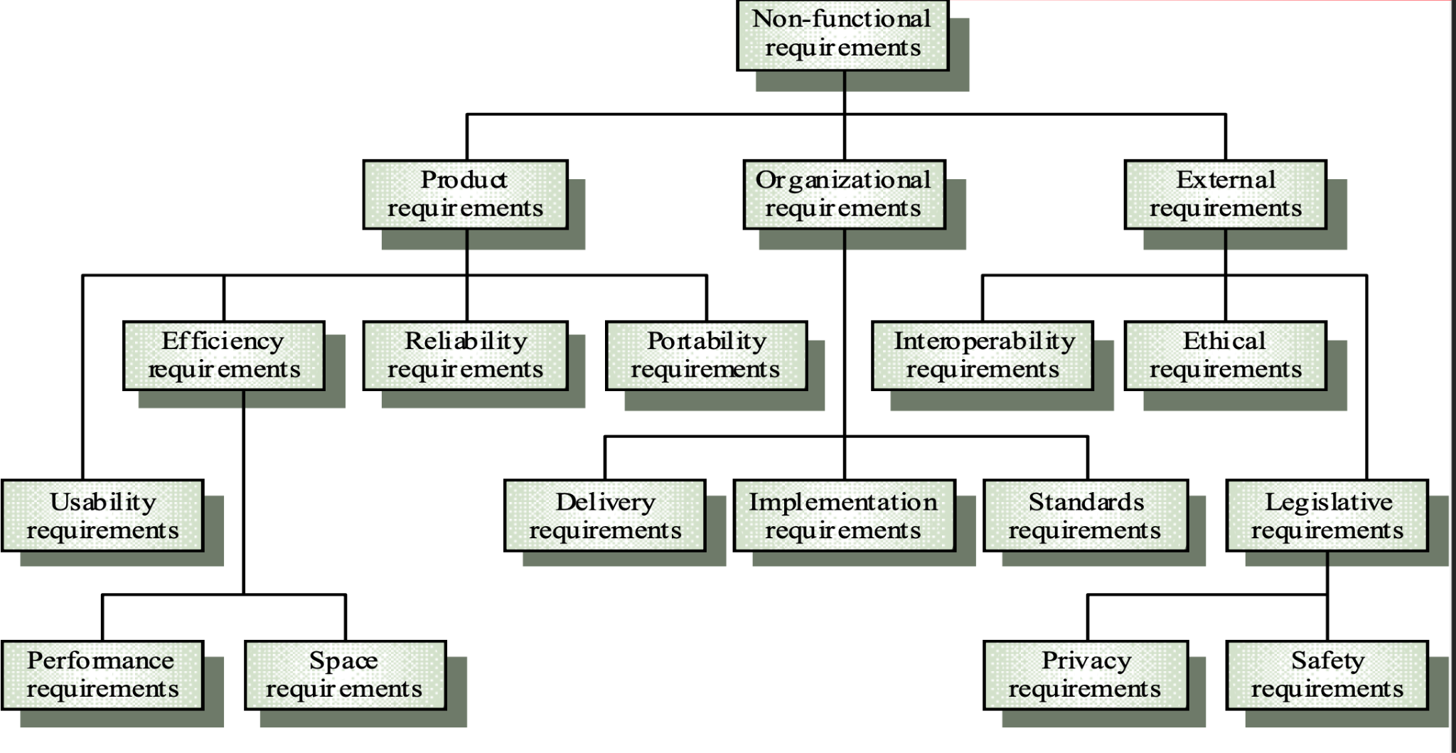
Non-functional requirement types

Slide 16
Non-functional requirements examples
Product requirement
It shall be possible for all necessary communication between the Developer and the user to be expressed in the standard Ada character set
Organisational requirement
The system development process and deliverable documents shall conform to the process and deliverables defined in XYZCo-SP-STAN-95
External requirement
The system shall not disclose any personal information about customers apart from their name and reference number to the operators of the system.

Slide 17
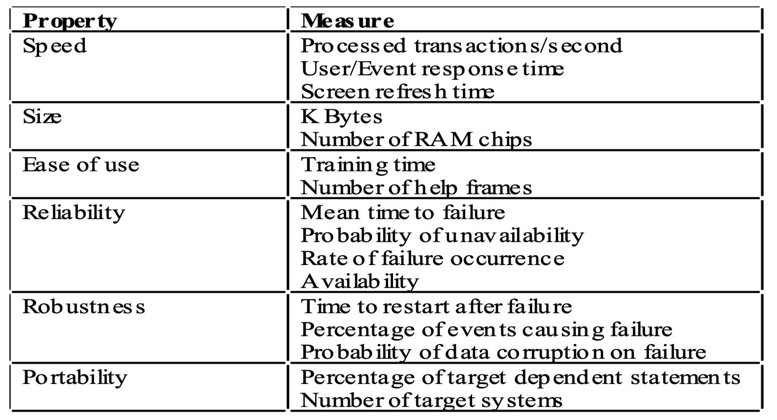
Requirements measures

Slide 18
Domain requirements
Derived from the application domain and describe system characteristics and features that reflect the domain
May be new functional requirements, constraints on existing requirements or define specific computations
If domain requirements are not satisfied, the system may be unworkable

Slide 19
Domain requirements problems
Understandability
Requirements are expressed in the language of the application domain
This is often not understood by software engineers developing the system
Implicitness • Domain specialists understand the area so well that they do not think of making the domain requirements explicit

Slide 20
User requirements
Should describe functional and non-functional requirements so that they are understandable by system users who don’t have detailed technical knowledge
User requirements are defined using natural language, tables and diagrams

Slide 21
Problems with natural language
Lack of clarity
• Precision is difficult without making the document difficult to read
Requirements confusion
• Functional and non-functional requirements tend to be mixed-up
Requirements amalgamation
• Different requirements may be expressed together

Slide 22
Guidelines for writing requirements
Invent a standard format and use it for all requirements
Use language in a consistent way. Use shall for mandatory requirements, should for desirable requirements
Use text highlighting to identify key parts of the requirement
Avoid the use of computer jargon

Slide 23
System requirements
More detailed specifications of user requirements
Serve as a basis for designing the system
May be used as part of the system contract
System requirements may be expressed using system models

Slide 24
Requirements and design
In principle, requirements should state what the system should do and the design should describe how it does this
In practice, requirements and design are inseparable
A system architecture may be designed to structure the requirements
The system may inter-operate with other systems that generate design requirements
The use of a specific design may be a domain requirement

Slide 25
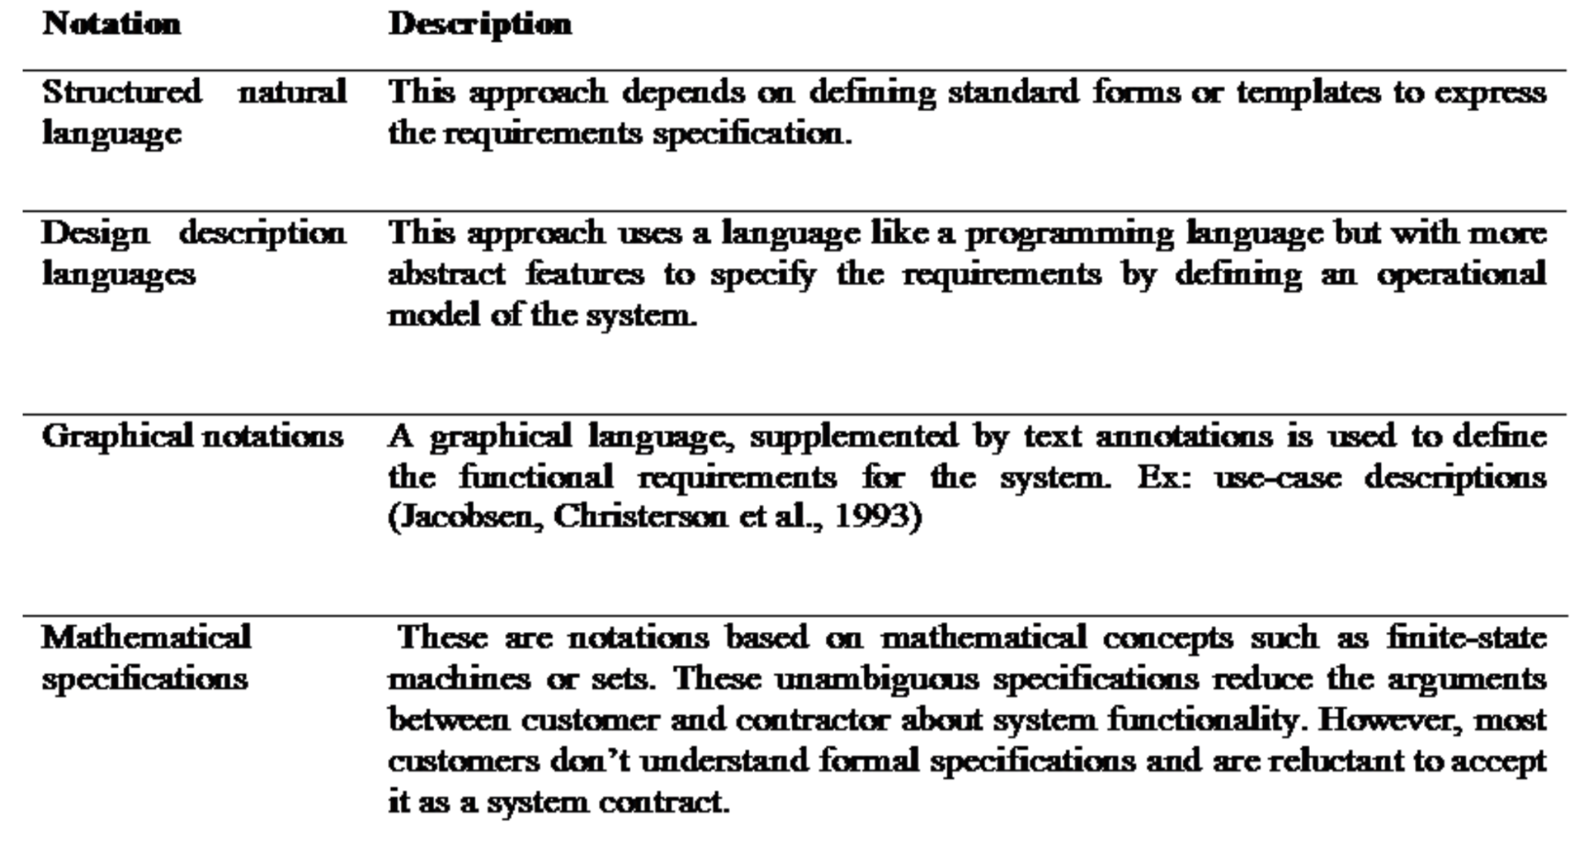
Alternatives to NL specification

Slide 26
Structured language specifications
A limited form of natural language may be used to express requirements
This removes some of the problems resulting from ambiguity and flexibility and imposes a degree of uniformity on a specification
Often best supported using a forms-based approach

Slide 27
Form-based specifications
Definition of the function or entity
Description of inputs and where they come from
Description of outputs and where they go to
Indication of other entities required
Pre and post conditions (if appropriate)
The side effects (if any)

Slide 28
Form-based node specification

Slide 29
PDL-based requirements definition
Requirements may be defined operationally using a language like a programming language but with more flexibility of expression
Most appropriate in two situations
Where an operation is specified as a sequence of actions and the order is important
When hardware and software interfaces have to be specified

Slide 30
PDL disadvantages
PDL may not be sufficiently expressive to express the system functionality in an understandable way
Notation is only understandable to people with programming language knowledge
The requirement may be taken as a design specification rather than a model to help understand the system

Slide 31
Interface specification
Most systems must operate with other systems and the operating interfaces must be specified as part of the requirements
Three types of interface may have to be defined
Procedural interfaces
Data structures
Data representations
Formal notations are an effective technique for interface specification

Slide 32
PDL interface description

Slide 33
The Requirements Document
The requirements document is the official statement of what is required of the system developers
Should include both a definition and a specification of requirements
It is NOT a design document. As far as possible, it should set of WHAT the system should do rather than HOW it should do it

Slide 34
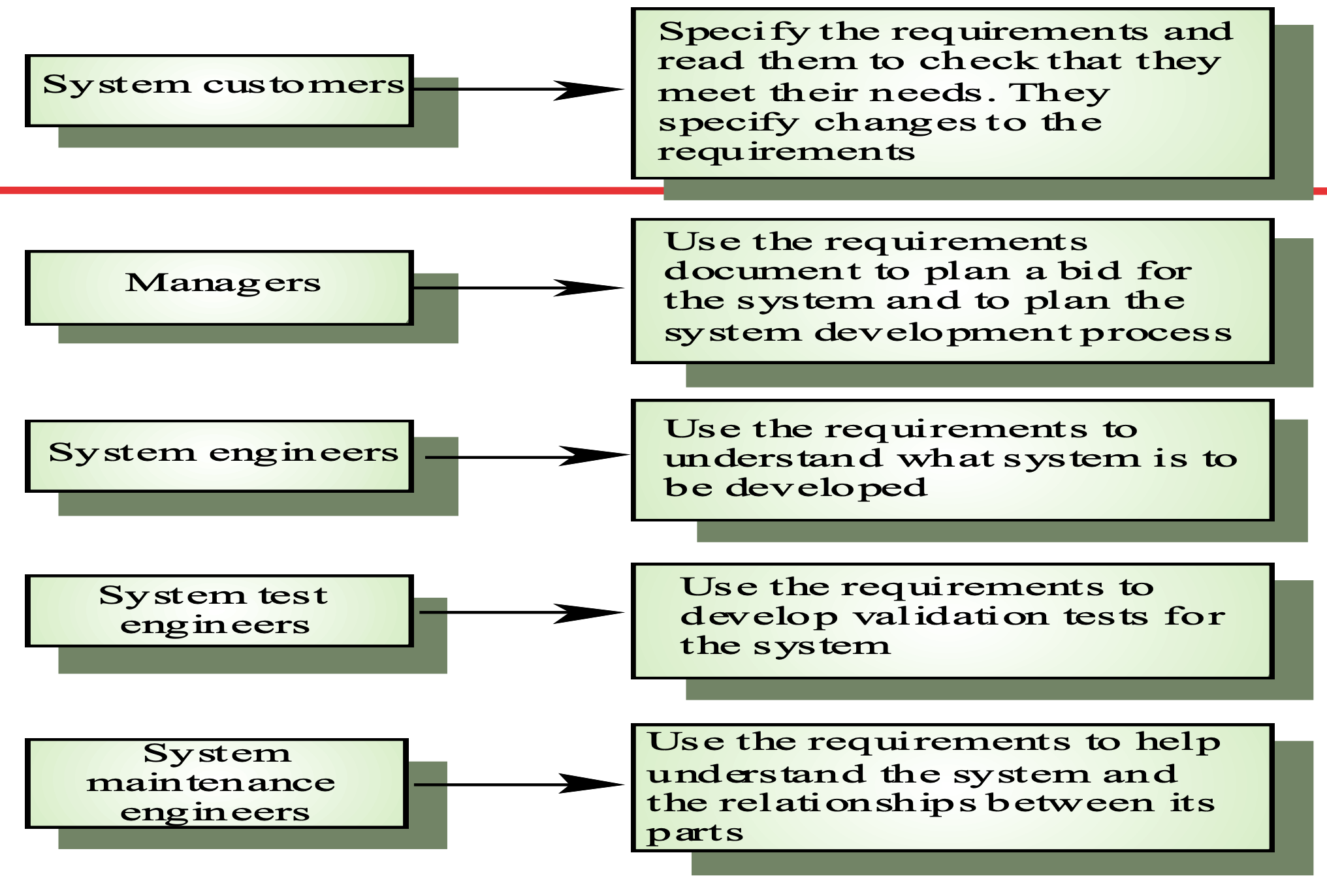
The Requirements Document

Slide 35
Requirements document requirements
Specify external system behaviour
Specify implementation constraints
Easy to change
Serve as reference tool for maintenance
Record forethought about the life cycle of the system i.e. predict changes
Characterise responses to unexpected events

Slide 36
Requirements Document Structure
Preface
Introduction
Glossary
User requirements definition
System architecture
System requirements specification
System models
System evolution
Appendices
Index

Slide 37
Any questions?

Slide 38
Thank you

Slide 39
Scan The QR for More Info

