Slide 1

SOFTWARE ENGINEERING
UNIT –II (Chapter-1)
PROCESS MODELS
Text Book: Software Engineering, A practitioner’s approach
Roger s. Pressman 6th Edition -McGraw-Hill

Slide 2
Process Model
A simplified representation of a software process presented from a specific perspective
Prescriptive Models
Prescriptive process models advocate an orderly approach to software engineering
That leads to a few questions …
If prescriptive process models strive for structure and order, are they inappropriate for a software world that thrives on change?
Yet, if we reject traditional process models (and the order they imply) and replace them with something less structured, do we make it impossible to achieve coordination and coherence in software work?

Slide 3
Process Models
Waterfall Model (Linear Sequential Model)
Incremental Model
Rapid Application Development Model (RAD)
Prototype Model
Boehm Spiral Model
Agile Process Model
In all models core activities Communication, Planning, Modeling, Construction and Deployment are common. However their execution differs from model to model.

Slide 4
The Waterfall Model
Used when requirements are well understood in the beginning
Also called classic life cycle
A systematic, sequential approach to Software development
Begins with customer specification of Requirements and progresses through planning, modeling, construction and deployment

Slide 5
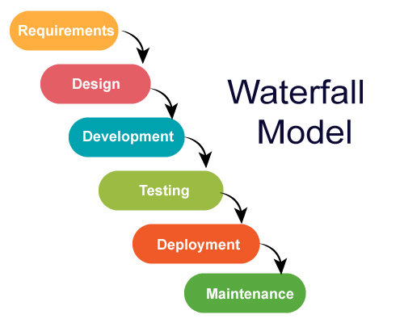
The Waterfall Model
This Model suggests a systematic, sequential approach to Software development that begins at the system level and progresses through analysis, design, code and testing.

Slide 6
Problems with Waterfall Model
Real projects rarely follow the sequential flow since they are always iterative.
Difficult to state the all the requirements by the customer.
The model requires requirements to be explicitly spelled out in the beginning, which is often difficult.
The customer must have patience because the working programs will be available only at the end.
A working model is not available until late in the project time plan.

Slide 7
Incremental Process models
Linear sequential model is not suited for projects which are iterative in nature
Incremental model suits such projects
Used when initial requirements are reasonably well- defined and compelling need to provide limited functionality quickly
Functionality expanded further in later releases
Software is developed in increments
Two Models are:
The Incremental Model
The Rapid Application Development (RAD) Model

Slide 8
Incremental Process models
Linear sequential model is not suited for projects which are iterative in nature
Incremental model suits such projects
Used when initial requirements are reasonably well- defined and compelling need to provide limited functionality quickly
Functionality expanded further in later releases
Software is developed in increments
Two Models are:
The Incremental Model
The Rapid Application Development (RAD) Model

Slide 9
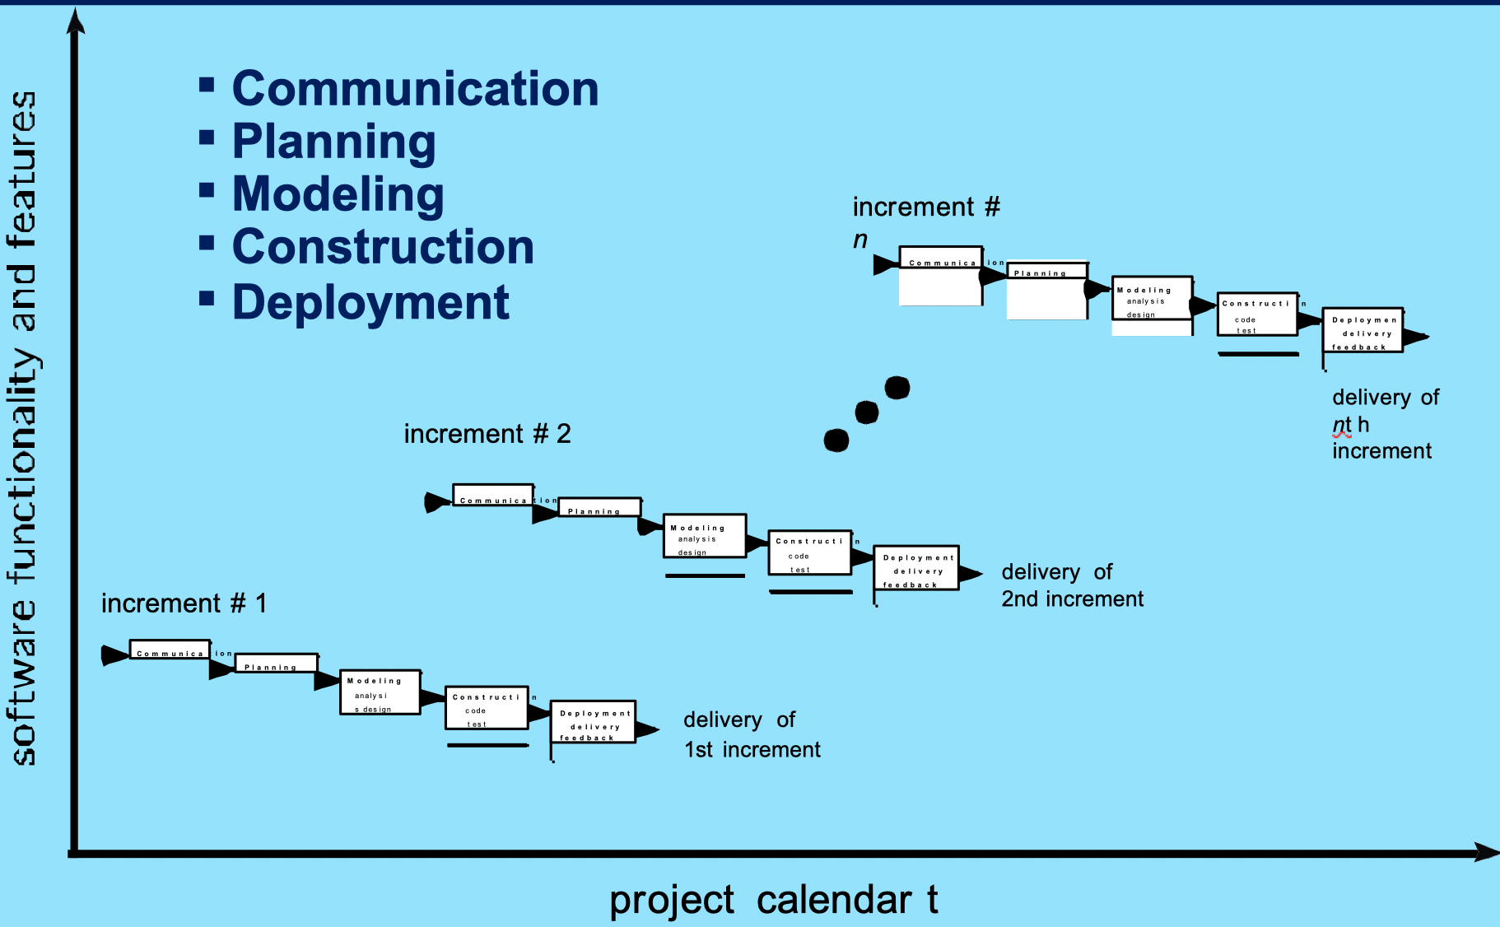
The Incremental Model

Slide 10
The Incremental Model
Software releases in increments
1st increment constitutes Core product which address and satisfies basic requirements
Core product undergoes detailed evaluation by the customer
As a result, plan is developed for the next increment
Plan addresses the modification of core product to better meet the needs of customer
Process is repeated until the complete product is produced

Slide 11
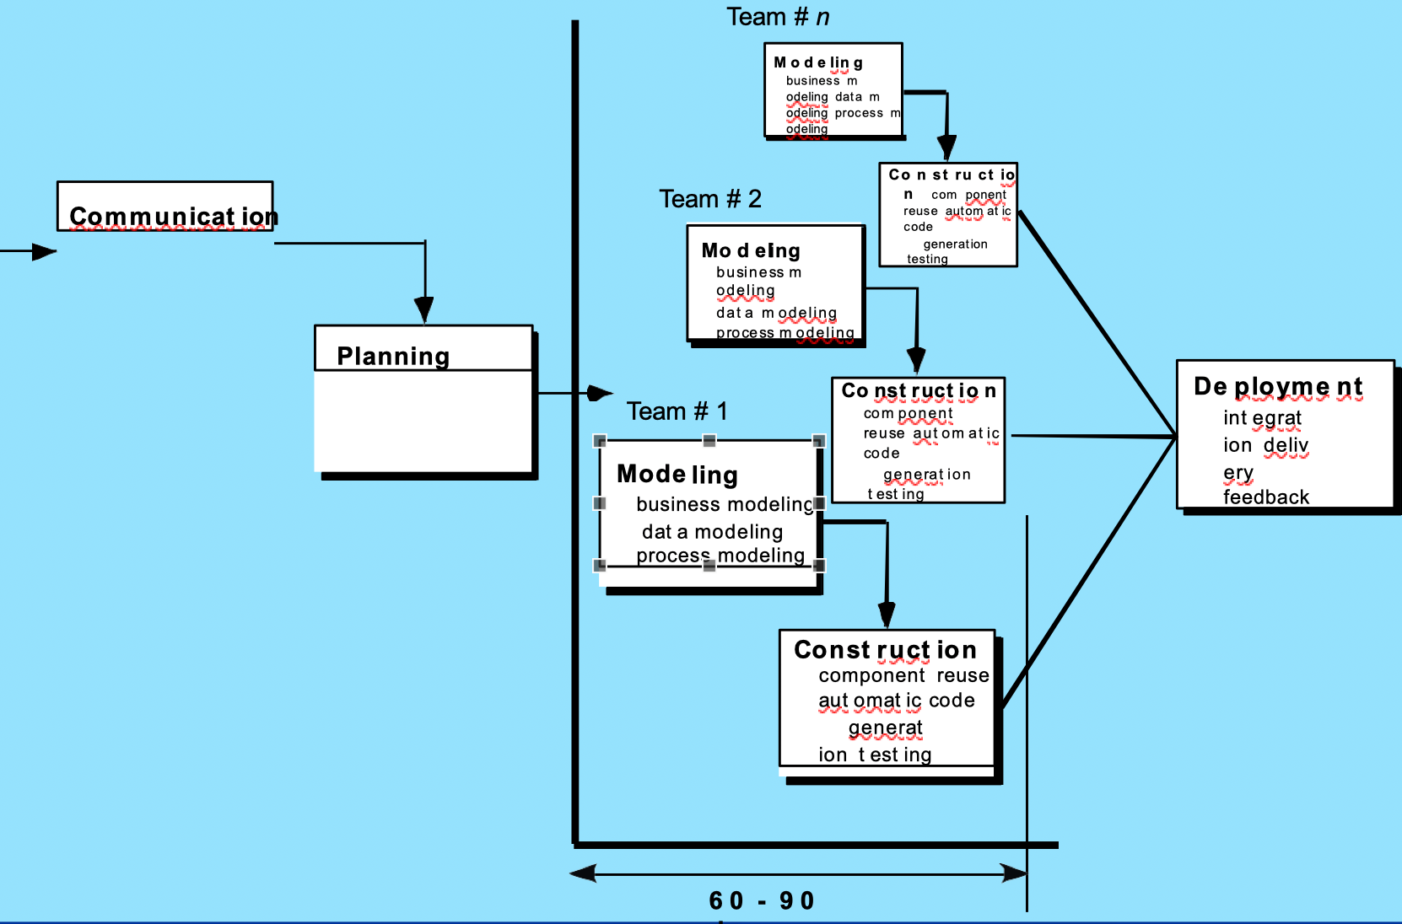
The RAD Model

Slide 12
The RAD Model
An incremental software process model
Having a short development cycle
High-speed adoption of the waterfall model using a component based construction approach
Creates a fully functional system within a very short span time of 60 to 90 days

Slide 13
The RAD Model
Multiple software teams work in parallel on different functions
Modeling encompasses three major phases: Business modeling, Data modeling and process modeling
Construction uses reusable components, automatic code
generation and testing
Problems with RAD Model
Requires a number of RAD teams
Requires commitment from both developer and customer for rapid-fire completion of activities
Requires modularity
Not suited when technical risks are high

Slide 14
Evolutionary Process Models
Software evolves over a period of time
Business and product requirements often change as development proceeds making a straight-line path to an end product unrealistic
Evolutionary models are iterative and as such are applicable to modern day applications
Types of evolutionary models
Prototyping Model
Spiral Model
Concurrent development Model

Slide 15
Evolutionary Process Models
Software evolves over a period of time
Business and product requirements often change as development proceeds making a straight-line path to an end product unrealistic
Evolutionary models are iterative and as such are applicable to modern day applications
Types of evolutionary models
Prototyping Model
Spiral Model
Concurrent development Model

Slide 16
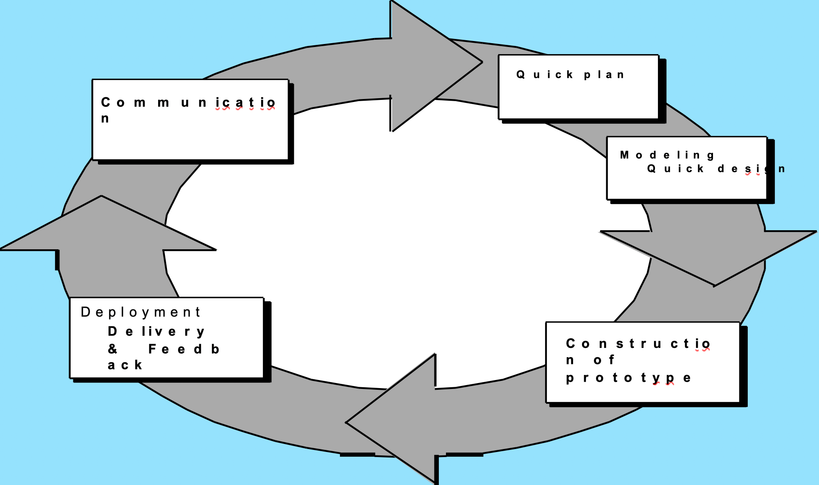
Prototyping Model

Slide 17
Prototyping Model
Mock up or model (throw away version) of a software product
Used when customer defines a set of objective but does not identify input, output or processing requirements
Developer is not sure of:
Efficiency of an algorithm
Adaptability of an Operating System
Human/Machine interaction

Slide 18
Prototyping Model
Begins with requirement gathering
Identify whatever requirements are known
Outline areas where further definition is mandatory
A quick design occur
Quick design leads to the construction of prototype
Prototype is evaluated by the customer
Requirements are refined
Prototype is turned to satisfy the needs of customer

Slide 19
Limitations of Prototyping Model
In a rush to get it working, overall software quality or long term maintainability are generally overlooked
Use of inappropriate Operating System or Programming Languages
Use of inefficient algorithm

Slide 20
The Spiral Model
Realistic approach to the development of large scale system and software
Software evolves as process progresses
Better understanding between developer and customer
The first circuit might result in the development of a product specification
Subsequent circuits develop a prototype and sophisticated version of software

Slide 21
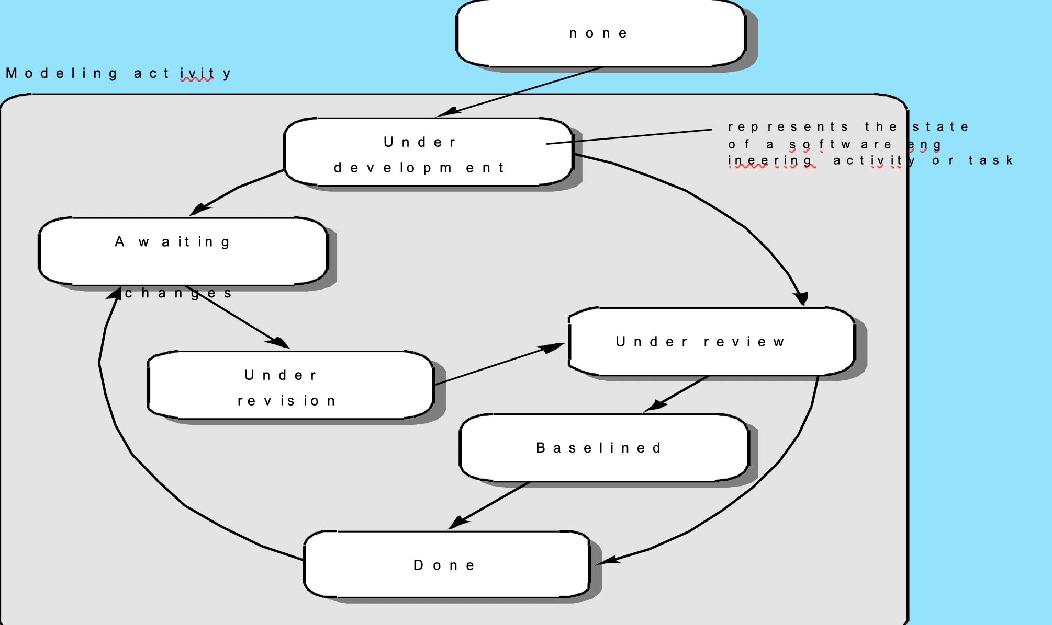
Concurrent Development Model

Slide 22
Concurrent Development Model
Constitutes a series of framework activities, software engineering action, tasks and their associated states
All activities exist concurrently but reside in different states
Applicable to all types of software development
Event generated at one point in the process trigger transitions among the states.

Slide 23
Other Process Models
Component based development—the process to apply when reuse is a development objective
Formal methods—emphasizes the mathematical
specification of requirements
Unified Process—a “use-case driven, architecture-centric, iterative and incremental” software process closely aligned with the Unified Modeling Language (UML)

Slide 24
Comment on Evolutionary Process Models
Difficult in project planning
Speed of evolution is not known
Does not focus on flexibility and extensibility (more emphasis on high quality)
Requirements are balanced between high quality, flexibility and extensibility

Slide 25
The Unified Process (UP) Model
Combines the best features of Object Oriented models
Adopts additional features proposed by other experts
Resulted in Unified Modeling Language(UML)
Unified process developed by Rumbaugh and Booch
A framework for Object-Oriented Software Engineering using UML

Slide 26
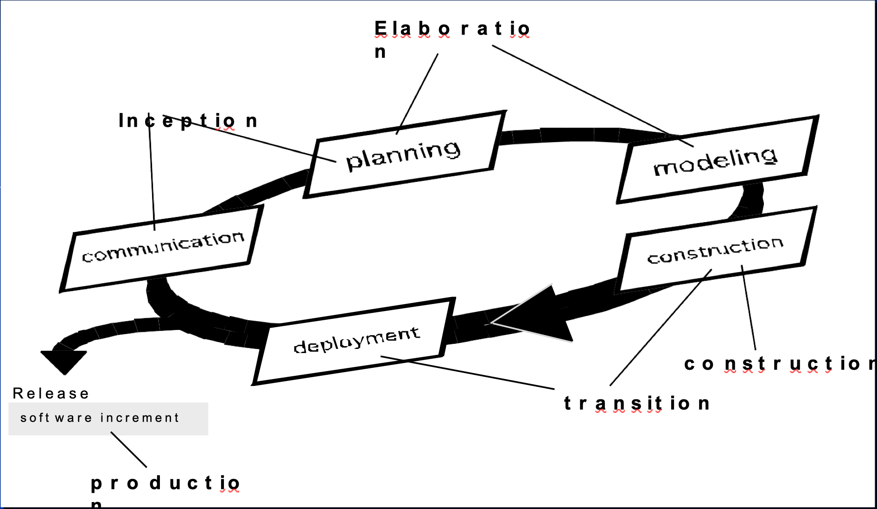
The Unified Process (UP) Model

Slide 27
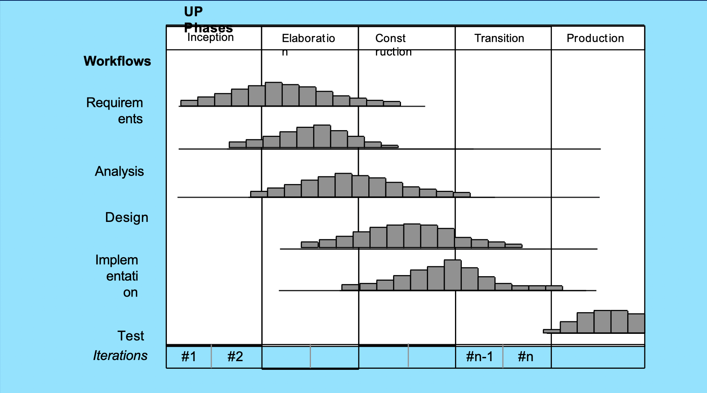
UP Phases

Slide 28
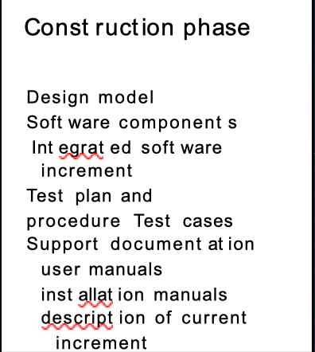
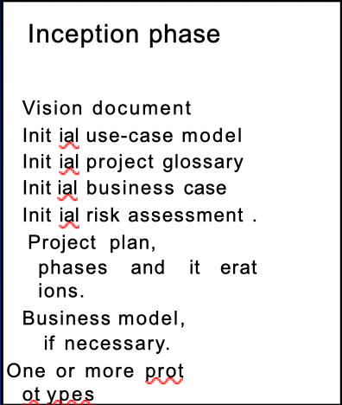
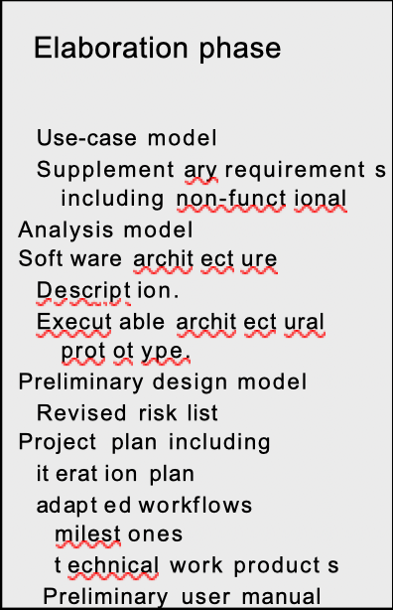
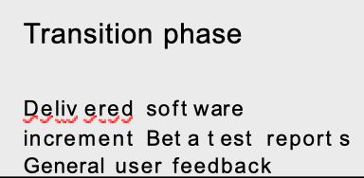
UP Work Products

Slide 29
Agile Development

Slide 30
The Manifesto for Agile Software Development
We are uncovering better ways of developing software by doing it and helping others do it. Through this work we have come to value:
Individuals and interactions over processes and tools
Working software over comprehensive documentation
Customer collaboration over contract negotiation
Responding to change over following a plan

Slide 31
What is “Agility”?
Effective (rapid and adaptive) response to change
Effective communication among all stakeholders
Drawing the customer onto the team
Organizing a team so that it is in control of the work performed
Yielding …
Rapid, Incremental delivery of software

Slide 32
An Agile Process
Is driven by customer descriptions of what is required (scenarios)
Recognizes that plans are short-lived
Develops software iteratively with a heavy emphasis on construction activities
Delivers multiple ‘Software Increments’
Adapts as changes occur.

Slide 33
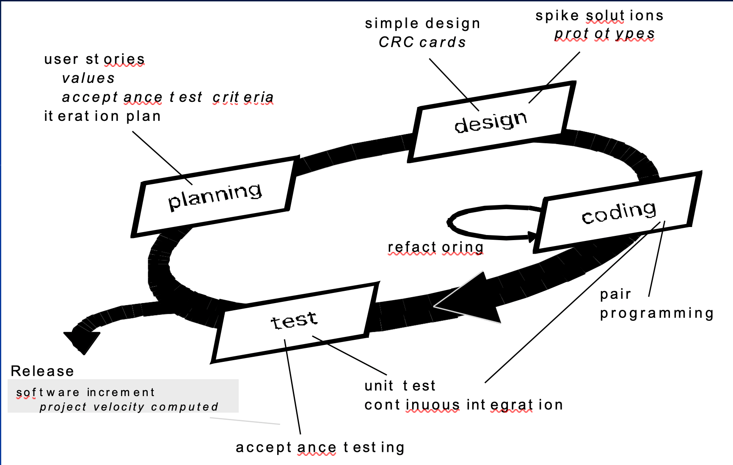
Extreme Programming (XP)

Slide 34
Extreme Programming (XP)
The most widely used agile process, originally proposed by Kent Beck
XP Planning
Begins with the creation of “user stories”
Agile team assesses each story and assigns a cost
Stories are grouped to for a deliverable increment
A commitment is made on delivery date
After the first increment “project velocity” is used to help define subsequent delivery dates for other increments

Slide 35
Extreme Programming (XP)
XP Design
  Follows the KIS(Keep it simple) principle
  For difficult design problems, suggests the creation of “spike solutions”—a design prototype
  Encourages “refactoring”—an iterative refinement of the internal program design
XP Coding
  Recommends the construction of a unit test for a store before coding commences
  Encourages “pair programming”
XP Testing
  All unit tests are executed daily
  “Acceptance tests” are defined by the customer and executed to assess customer visible functionality

Slide 36
Any questions?

Slide 37
Thank you

Slide 38

Scan The QR for More Info

