Slide 1

SOFTWARE ENGINEERING
UNIT – V (Part - 2)
Risk Management
Text Book: Software Engineering, A practitioner’s approach
Roger s. Pressman 6th Edition -McGraw-Hill

Slide 2
Introduction
Risk is uncertainty
  We don’t know whether a particular event will occur or not, but if it does has a negative impact on a project
Risk can be defined as a:
  Risk is the “possibility of loss or injury”
  Risk provides an opportunity to develop the project better Risk exposure= Size(loss) * Probability of (loss)
Difference between Risk and Problem
  Problem is some event which has already occurred but risk is something that is unpredictable

Slide 3
Risk Strategies
Reactive
Software team does nothing about risks until something goes wrong
“fire fighting mode”
At best, monitors the projects
for likely risks
Majority of the software teams and managers rely on this approach
Proactive
Begins long before technical work is initiated
Identification of potential risks (studies of probability, impact and priorities)
Objective: AVOID RISK Responds are in a controlled
and effective manner
Our Concern

Slide 4
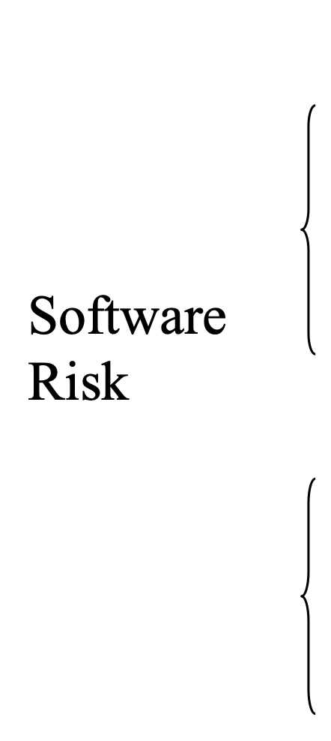
Risk Categorization
• Project Risks (budgetary, schedule, personnel, resource, customer)
• Technical Risks (design, implementation, interfacing, verification)
• Business Risks (market, strategic, management, budget)
• Known risks (Ex: unrealistic delivery date) • Predictable risks (Ex: Past turnover)
• Unpredictable risks

Slide 5
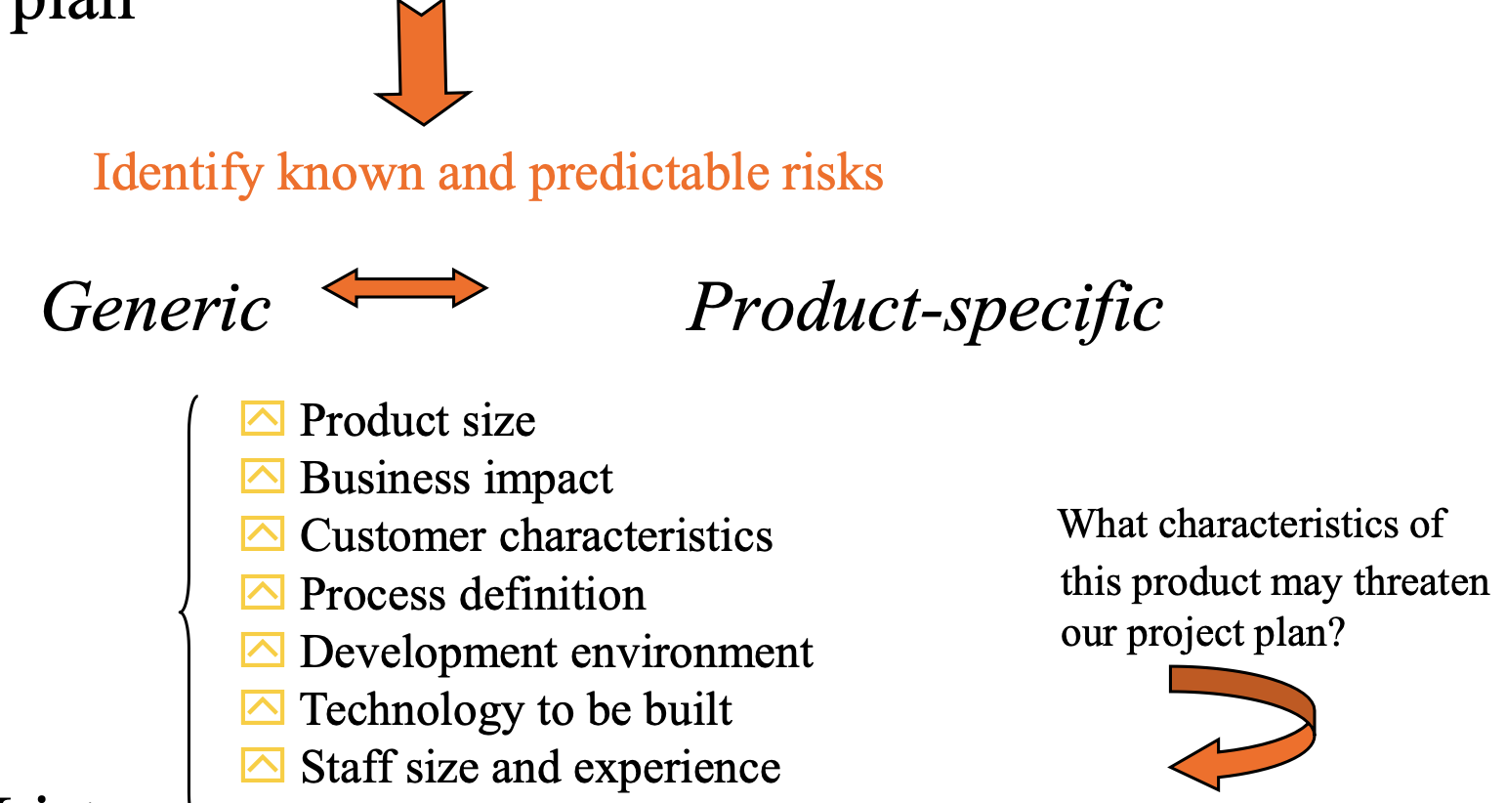
Risk Identification
Risk identification is a systematic attempt to specify threats to the project plan
Risk Item List

Slide 6
Risk Identification
Product Size Risk :
  Estimated size of the product in LOC or FP?
  Percentage deviation in size of product from average for previous products?
  Number of users/projected changes to the requirements for the product?
  Amount of reused software?
Business Impact risks:
  Effect of this product on the company revenue?
  Visibility of this product to senior management?
  Amount & quality of product documentation to be produced?
  Governmental constraints on the construction of the product?

Slide 7
Risk Identification
Customer related risks: (needs, personalities, contradictions, associations)
  Have you worked with the customer in the past?
  Does the customer have a solid idea of what is required?
  Will the customer agree to have meetings?
  Is the customer technically sophisticated in the product area?
  Does the customer understand the software process?
Technology Risks:
  Is the technology to be built new to your organization?
  Does the SW interface with new or unproven HW/SW?
  Do requirements demand creation of new components ?
  Do requirements impose excessive performance constraints ?

Slide 8
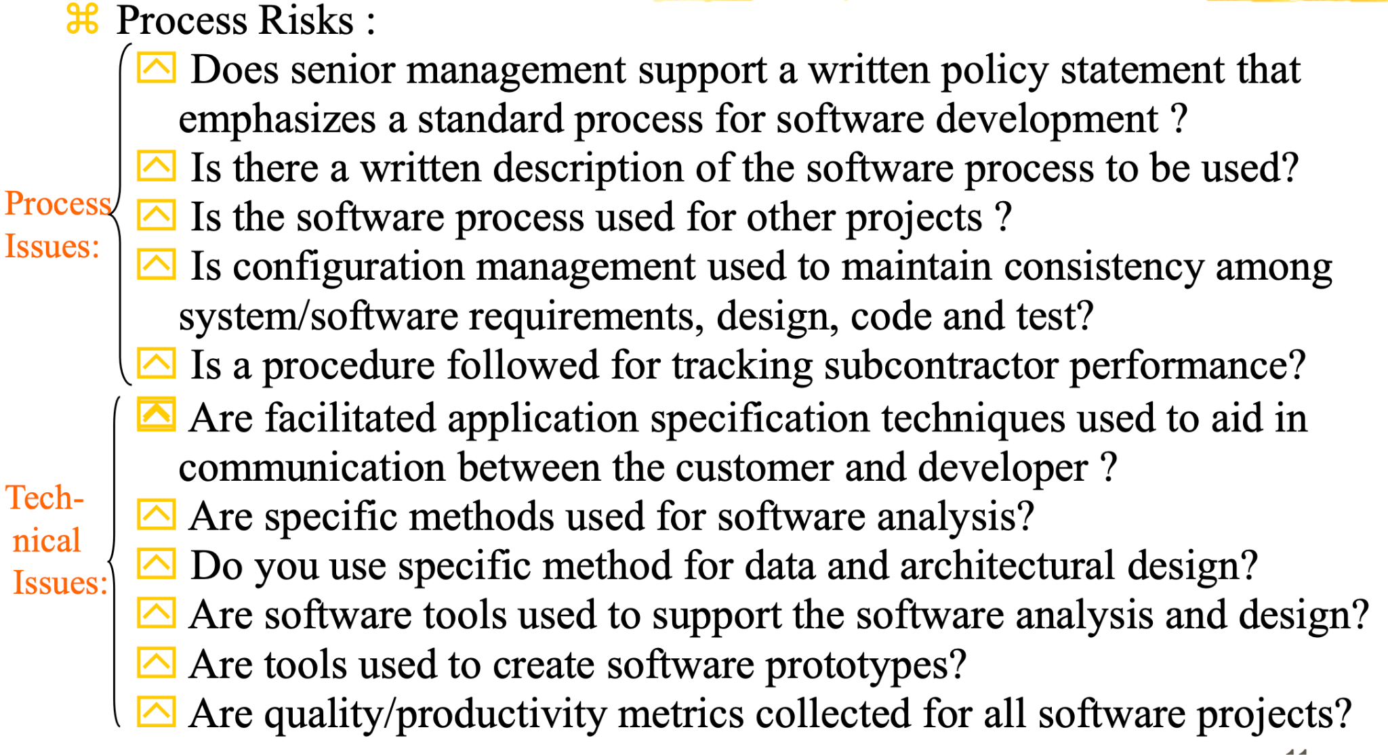
Risk Identification

Slide 9
Risk Identification
Development Environment Risks:
  Is a software project/process management tool available?
  Are tools for analysis and design available?
  Are testing tools available and appropriate for the product?
  Are all SW tools integrated with one another?
  Have members of the project team received training in each of the tools?
Risk Associated with Staff Size and Experience:
  Are the best people available?
  Do the people have the right combination of skills?
  Are staff committed for entire duration of the project?
  Do staff have the right expectations about the job at hand?
  Will turnover among staff be low enough to allow continuity?

Slide 10
Risk Identification
Risk Components and Drivers
  Performance risk: the degree of uncertainty that the product will meet its requirements and be fit for its intended use
  Cost risk: the degree of uncertainty that the project budget will be maintained
  Support risk:the degree of uncertainty that the software will be easy to correct, adapt and enhance
  Schedule risk: the degree of uncertainty that the project schedule will be maintained

Slide 11
Risk Projection
Also called risk estimation, attempts to rate each risk in two ways:
  Likelihood (probability)
  Consequences
    Develop a risk table: A risk table provides a project
    manager with a simple technique for risk projection
    For each identified risk, list likelihood, consequence and impact
    Risk Assessment: Examine the accuracy of the estimates that were made during risk projection. A risk referent level must be defined and the referent point or break point should be established

Slide 12
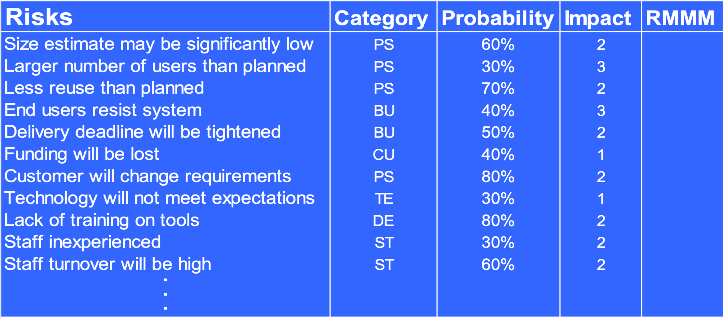
Risk Projection

Slide 13
Risk Mitigation, Monitoring and Management (RMMM)
An effective strategy must consider three issues:
  Risk Mitigation / Avoidance
  Risk Monitoring and
  Risk Management and Contingency planning.
A proactive approach to risk avoidance is the best strategy. Develop a plan for risk mitigation. For example: assume that high staff turnover is noted as a project risk r1, some of the possible steps to be taken are these:
meet with current staff to determine causes for turnover
assume turnover will occur and develop techniques to ensure continuity when people leave.
define a backup staff member for every critical technologies.

Slide 14
Risk Mitigation, Monitoring and Management
As the project proceeds, the following factors can be monitored:
  general attitude of team members based on project pressures
  the degree to which the team has come together
  interpersonal relationship among team members
  availability of jobs within the company and outside it
In addition of these factors, the project manager should monitor the effectiveness of risk mitigation steps.
Risk management and contingency planning assumes that mitigation efforts have failed and that the risk has become reality.

Slide 15
Safety Risks and Hazards
Software safety and hazard analysis are software quality assurance activities that focus on the identification and assessment of potential hazard that may impact software negatively and cause an entire system to fail.
If hazards can be identified early in the software engineering process, software design features can be specified that will either eliminate or control potential hazards.

Slide 16
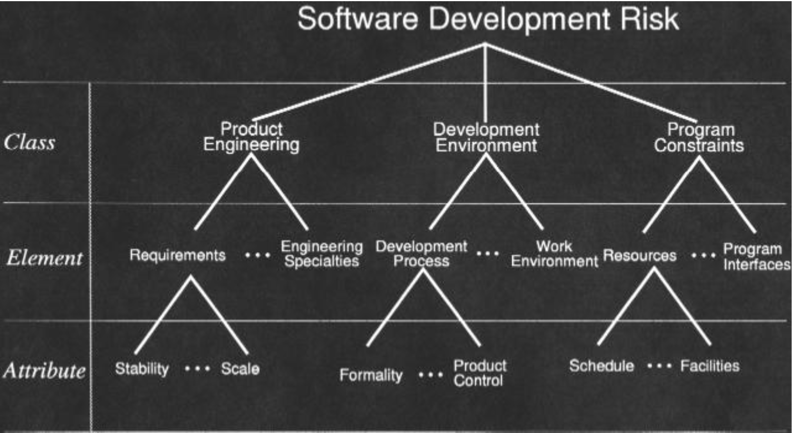
SEI Software Development Risk

Slide 17
Summary
Risk analysis is an important part of most software projects.
Risk analysis requires a significant amount of project planning effort.
Understanding risk helps you know where to commit your resources.
If you don’t actively attack the risks, they will actively attack you.
Major projects should all have a risk management plan..

Slide 18
Any questions?

Slide 19
Thank you

Slide 20

Scan The QR for More Info

