Slide 1

SOFTWARE ENGINEERING
UNIT – V (Part - 1)
Quality Management
Text Book: Software Engineering, A practitioner’s approach
Roger s. Pressman 6th Edition -McGraw-Hill

Slide 2
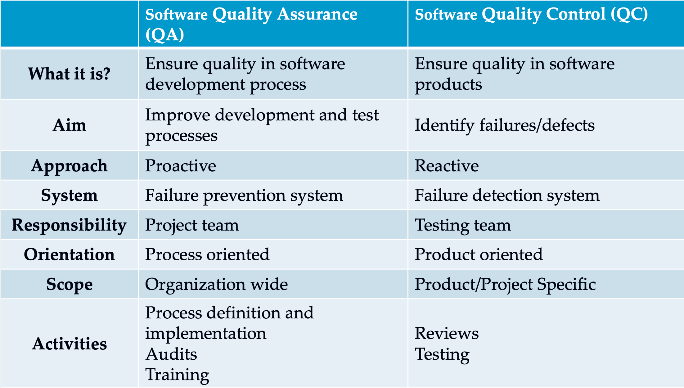
Quality Assurance Vs Quality Control

Slide 3
Quality
For software, two kinds of quality may be encountered:
Quality of design
  encompasses requirements, specifications and the design of the system.
Quality of conformance is an issue focused primarily on implementation.
User Satisfaction = compliant product + good quality + delivery within budget and schedule

Slide 4
Software Quality
Conformance to explicitly stated functional and performance requirements development standards,
And explicitly documented implicit that are expected of all professionally developed software.

Slide 5
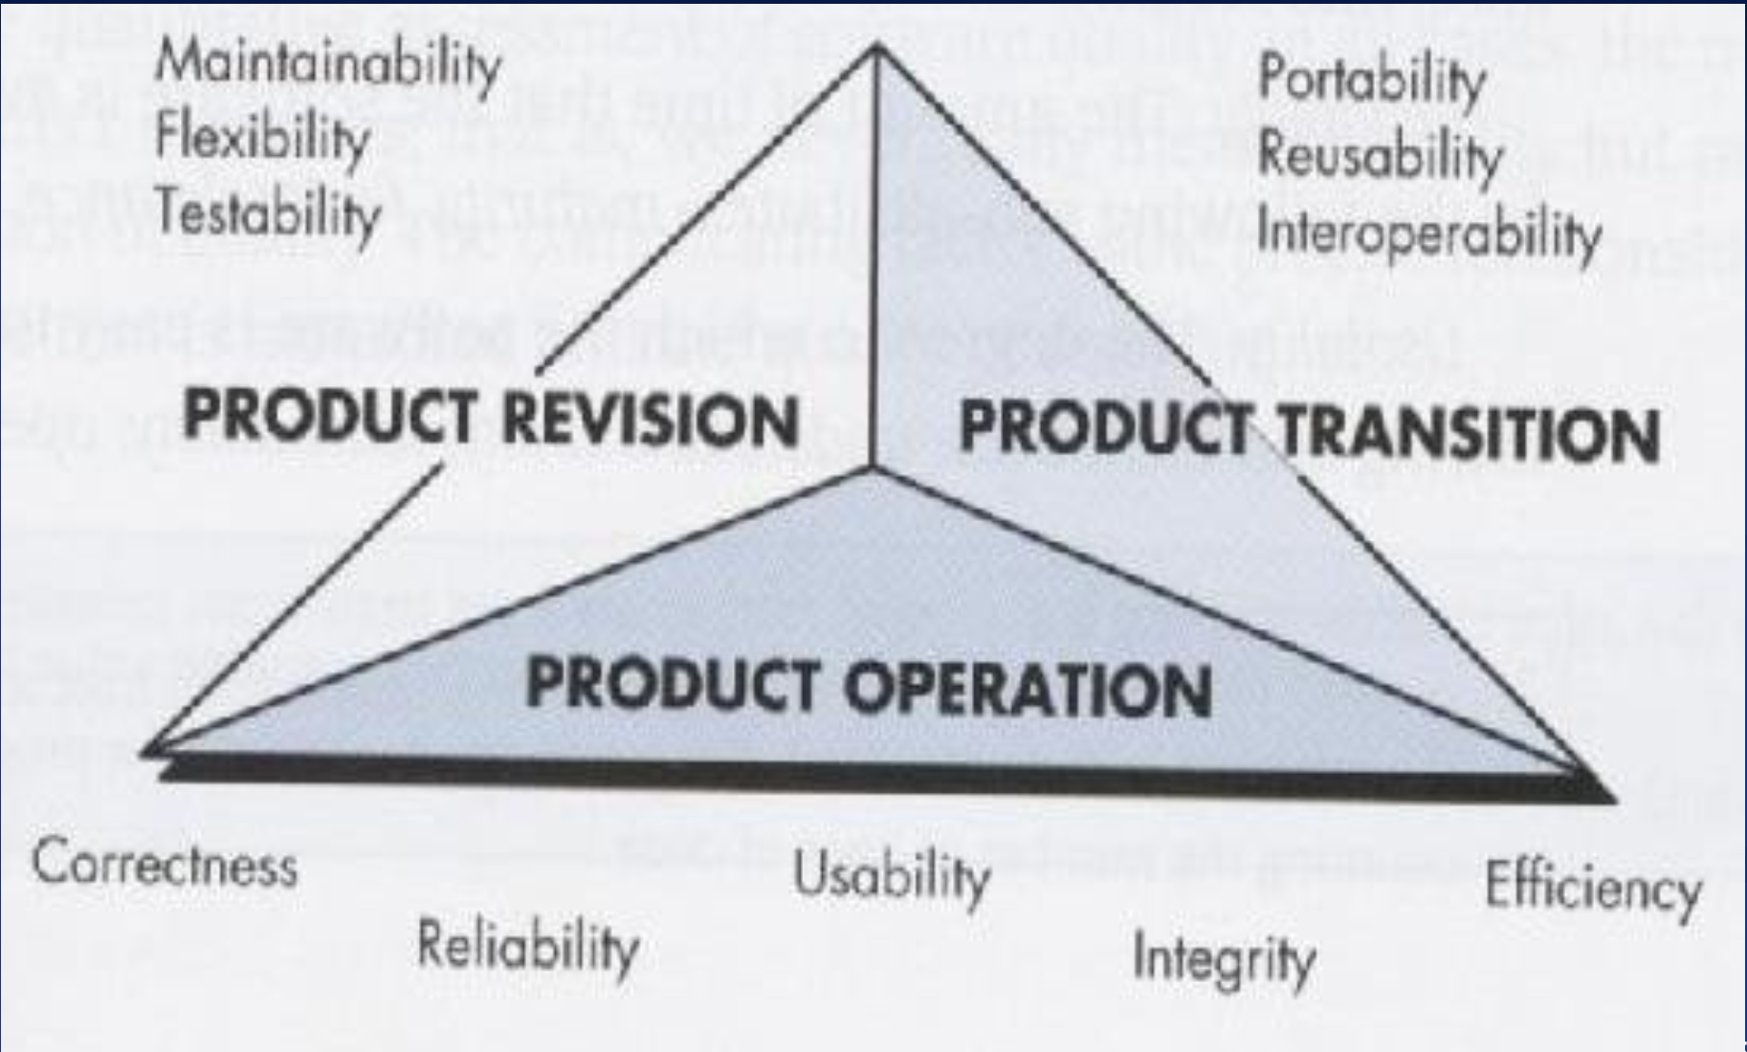
McCall’s Quality Factors

Slide 6
Cost of Quality
Prevention costs include
  Quality planning
  Formal technical reviews
  Test equipment
  Training
Internal failure costs include
  Failure mode analysis
  Rework
  Repair
External failure costs are
  Complaint resolution
  Product return and replacement
  Help line support
  Warranty work
Appraisal Costs
  are Product Condition (in process & inter process Communication)

Slide 7
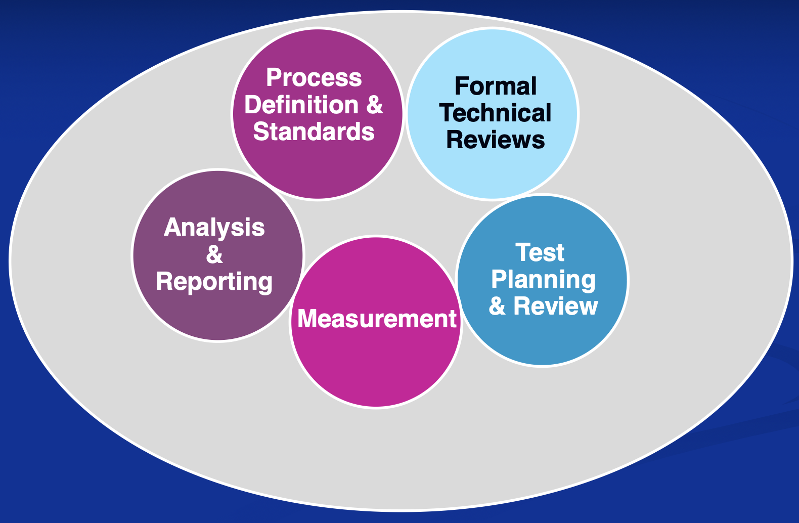
Software Quality Assurance

Slide 8
Role of the SQA Group I
Prepares an SQA plan for a project
  The plan identifies
    evaluations to be performed
    audits and reviews to be performed
    standards that are applicable to the project procedures for error reporting and tracking
    documents to be produced by the SQA group
    amount of feedback provided to the software project team

Slide 9
Role of the SQA Group I
Participates in the development of the project’s software process description
The SQA group reviews the process description for compliance with organizational policy, internal software standards, externally imposed
standards (eg: ISO-9001) and other parts of the software project plan.

Slide 10
Role of the SQA Group
Reviews software engineering activities to verify compliance with the defined software process
◼ identifies, documents and tracks deviations from the process and verifies that corrections have been made.
◼ Audits designated software work products to verify compliance with those defined as part of the software process
reviews selected work products; identifies, documents and tracks deviations; verifies that corrections have been made
◼ periodically reports the results of its work to the project manager.◼ Ensures that deviations in software work and work products are
documented and handled according to a documented procedure◼ Records any noncompliance and reports to senior management
Non-compliance items are tracked until they are resolved

Slide 11
What Are Reviews?
Meeting conducted by technical people for technical people
Technical assessment of a work product created during the software engineering process
Software quality assurance mechanism a training ground
What Are Reviews Are Not?
A project summary or progress assessment
A meeting intended solely to impart information
A mechanism for political or personal reprisal!

Slide 12
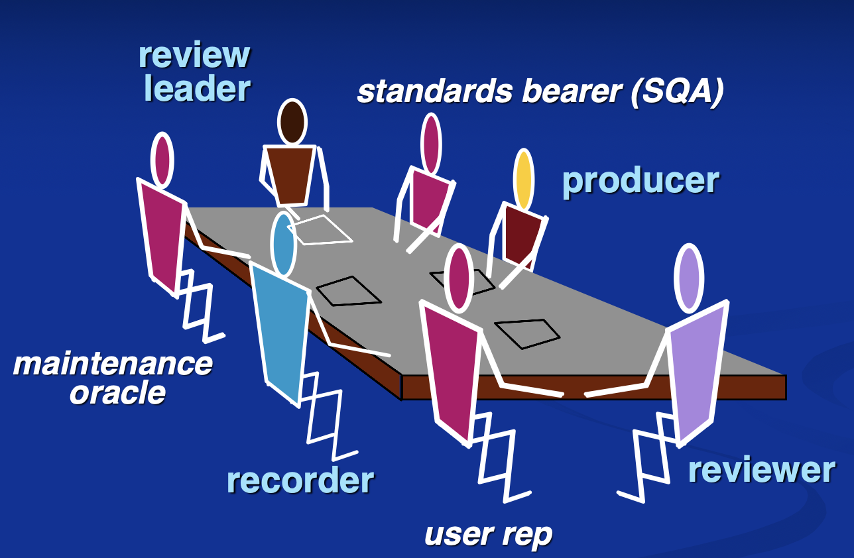
The Players

Slide 13
Review Guidelines
Review the product, not the Producer
Set an agenda and maintain it
Limit debate and rebuttal
Enunciate problem areas, but don’t attempt to solve every problem noted
Take written notes
Limit the number of participants and insist upon advance preparation
Develop a checklist for each product that is likely to be reviewed
Allocate resources and schedule time for FTRs Conduct meaningful training for all reviewers Review your early reviews

Slide 14
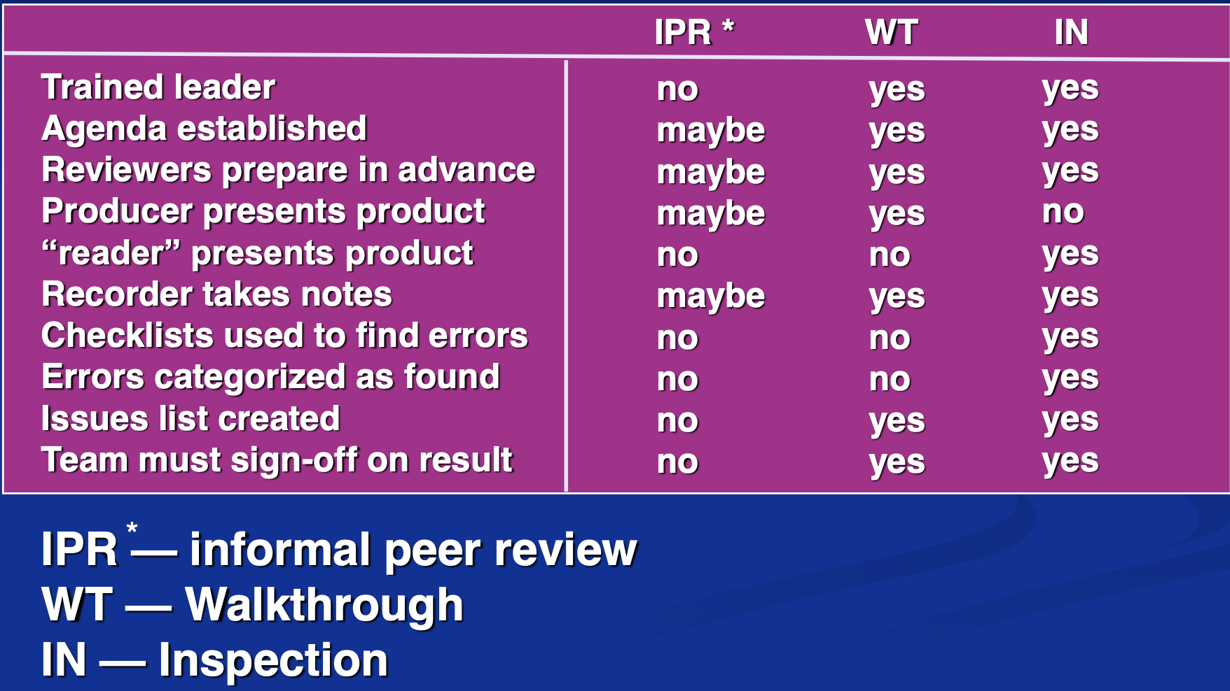
Review Options Matrix

Slide 15
Metrics Derived from Reviews
inspection time per page of documentation
inspection time per KLOC or FP
inspection effort per KLOC or FP
errors uncovered per reviewer hour
errors uncovered per preparation hour
errors uncovered per SE task (e.g., design)
number of minor errors (e.g., typos)
number of major errors (e.g., nonconformance to req.)
number of errors found during preparation

Slide 16
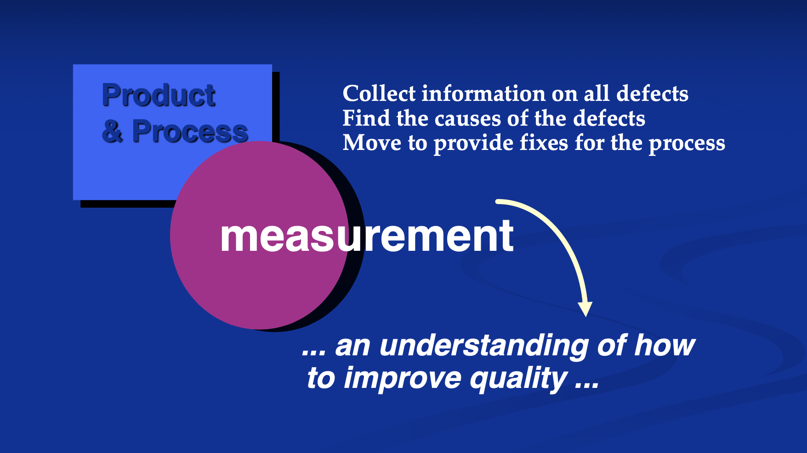
Statistical SQA

Slide 17
Six - Sigma for Software Engineering
The term “six sigma” is derived from six standard deviations 3,4 instances (defects) per million occurrences — implying an extremely high quality standard.
The Six Sigma methodology defines five core steps:
  Define customer requirements and deliverables and project goals via well defined methods of customer communication
  Measure the existing process and its output to determine current quality
  performance (collect defect metrics)
  Analyze defect metrics and determine the vital few causes
  Improve the process by eliminating the root causes of defects.
  Control the process to ensure that future work does not reintroduce the causes of defects.

Slide 18
Software Reliability
Software Reliability is the Probability of failure free operation of a computer program in a specified environment for a specified time.
◼ A simple measure of reliability is where mean-time-between-failure(MTBF),
MTBF = MTTF + MTTR
◼ The acronyms MTTF and MTTR are mean-time-to-failure and mean- time-to-repair, respectively.
Software availability is the probability that a program is operating according to requirements at a given point in time and is defined as
Availability = [MTTF/(MTTF + MTTR)] x 100%

Slide 19
Software Safety
Software safety is a software quality assurance activity that focuses on the identification and assessment of potential hazards that may affect software negatively and cause an entire system to fail.
If hazards can be identified early in the software process, software design features can be specified that will either eliminate or control potential hazards.

Slide 20
ISO 9001:2000 Standard
ISO 9001:2000 is the quality assurance standard that applies to software engineering.
The standard contains 20 requirements that must be
present for an effective quality assurance system.
The requirements delineated by ISO 9001:2000 address topics such as
  management responsibility, quality system, contract review, design control, document and data control, product identification and traceability, process control, inspection and testing, corrective and preventive action, control of quality records, internal quality audits, training, servicing and statistical techniques.

Slide 21
Specific Class-oriented Metrics
Weighted methods per class
– The normalized complexity of the methods in a class
– Indicates the amount of effort to implement and test a class
Depth of the inheritance tree
  – The maximum length from the derived class (the node) to the base class (the root)
  – Indicates the potential difficulties when attempting to predict the behavior of a class because of the number of inherited methods
Number of children (i.e., subclasses)
– As the number of children of a class grows
• Re usability increases
• Theabstractionrepresentedbytheparentclasscanbedilutedby inappropriate children
• The amount of testing required will increase

Slide 22
Specific Class-oriented Metrics (continued)
Coupling between object classes
  – Measures the number of collaborations a class has with any other classes
  – Higher coupling decreases the reusability of a class
  – Higher coupling complicates modifications and testing
  – Coupling should be kept as low as possible
Response for a class
  – This is the set of methods that can potentially be executed in a class in response to a public method call from outside the class
  – As the response value increases, the effort required for testing also increases as does the overall design complexity of the class
Lack of cohesion in methods
  – This measures the number of methods that access one or more of the same instance variables (i.e., attributes) of a class
  – If no methods access the same attribute, then the measure is zero
  – As the measure increases, methods become more coupled to one another via attributes, thereby increasing the complexity of the class design

Slide 23
Metrics for Source Code
Complexity metrics
– Measure the logical complexity of source code (can also be applied to component-level design)
Length metrics
– Provide an indication of the size of the software
“These metrics can be used to assess source code complexity, maintainability and testability among other characteristics”

Slide 24
Metrics for Testing
• Statement and branch coverage metrics
– Lead to the design of test cases that provide program coverage
• Defect-related metrics
– Focus on defects (i.e., bugs) found, rather than on the tests themselves
• Testing effectiveness metrics
– Provide a real-time indication of the effectiveness of tests that have been conducted
• In-process metrics
– Process related metrics that can be determined as testing is conducted

Slide 25
Metrics for Maintenance
• Software maturity index (SMI)
– Provides an indication of the stability of a software product based on changes that occur for each release
• SMI=[MT -(Fa +Fc +Fd)]/MT
where
MT = #modules in the current release
Fa = #modules in the current release that have been added
Fc = #modules in the current release that have been changed Fd = #modules from the preceding release that were deleted in
the current release
As the SMI (i.e., the fraction) approaches 1.0, the software product begins to stabilize
The average time to produce a release of a software product can be correlated with the SMI

Slide 26
Any questions?

Slide 27
Thank you

Slide 28

Scan The QR for More Info

