Slide 1
SOFTWARE ENGINEERING
UNIT –IV
PRODUCT METRICS
Text Book: Software Engineering, A practitioner’s approach
Roger s. Pressman 6th Edition -McGraw-Hill

Slide 2
Syllabus
Software Quality
Metrics for Analysis Model
Metrics for Design Model
Metrics for source code
Metrics for testing
Metrics for maintenance

Slide 3
Software Quality
• Software quality functional and performance requirements is Conformance to explicitly stated,explicitly implicit documented development standards characteristics that are expected of all professionally
developed software
• Three important points in this definition
– Explicit software requirements are the foundation from which quality is measured. Lack of conformance to requirements is lack of quality
– Specific standards define a set of development criteria that guide the manner in which software is engineered. If the criteria are not followed, lack of quality will most surely result
– There is a set of implicit requirements that often goes unmentioned (e.g., ease of use). If software conforms to its explicit requirements but fails to meet implicit requirements, software quality is suspect

Slide 4
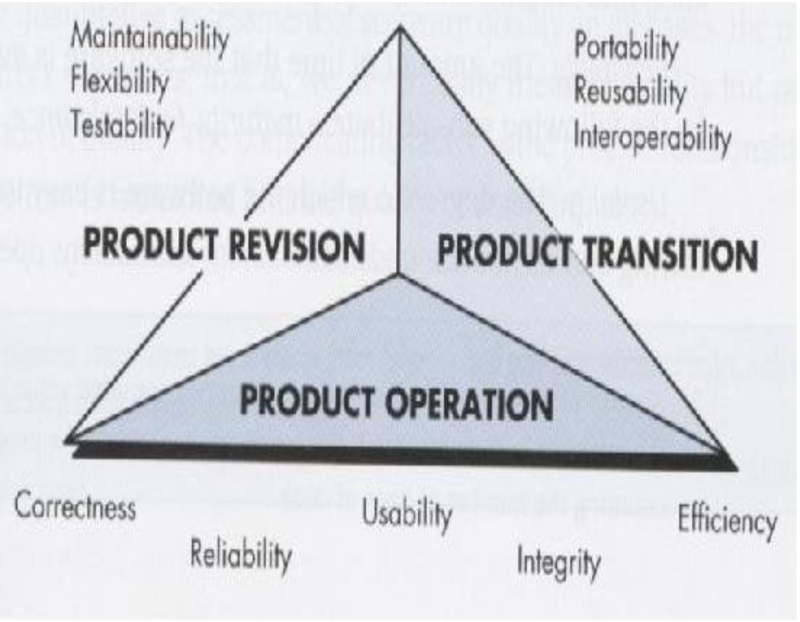
McCall’s Quality Factors

Slide 5
ISO 9126 Software Quality Factors
• Functionality – The degree to which the software satisfies stated needs
• Reliability – The amount of time that the software is available for use
• Usability – The degree to which the software is easy to use
• Efficiency – The degree to which the software makes optimal use of system resources
• Maintainability
– The ease with which repair and enhancement may be made to the software
• Portability
– The ease with which the software can be transposed from one environment to another

Slide 6
Product metrics
Product metrics for computer software helps us to assess quality.
Measures
Provides a quantitative indication of the extent, amount, dimension, capacity or size of some attribute of a product or process
Metrics
A quantitative measure of the degree to which a system, component or process possess a given attribute
Indicator
A metric or a combination of metrics that provide insight into the software process, a software project or a product itself

Slide 7
Metrics for the Analysis Model
Function Points

Slide 8
Introduction to Function Points
First proposed by Albrecht in 1979
Can be used effectively as a means for measuring the functionality delivered by a system
Using historical data, function points can be used to
– Estimate the cost or effort required to design, code and test the software
– Predict the number of errors that will be encountered during testing
– Forecast the number of components and/or the number of projected source code lines in the implemented system Derived using an empirical relationship based on
1) Countable (direct) measures of the software’s information domain
2) Assessments of the software’s complexity

Slide 9
Information Domain Values
First proposed by Albrecht in 1979
Can be used effectively as a means for measuring the functionality delivered by a system
Using historical data, function points can be used to
Estimate the cost or effort required to design, code and test the software
Predict the number of errors that will be encountered during testing
Forecast the number of components and/or the number of projected source code lines in the implemented system
Derived using an empirical relationship based on
1) Countable (direct) measures of the software’s information domain
2) Assessments of the software’s complexity

Slide 10
Information Domain Values
Number of external inputs
– Each external input originates from a user or is transmitted from another application
– They provide distinct application-oriented data or control information
– They are often used to update internal logical files
– They are not inquiries (those are counted under another category)
Number of external outputs
– Each external output is derived within the application and provides information to the user
– This refers to reports, screens, error messages, etc.
– Individual data items within a report or screen are not counted separately

Slide 11
Information Domain Values (continued)
Number of external inquiries
– An external inquiry is defined as an online input that results in the generation of some immediate software response
– The response is in the form of an on-line output
Number of internal logical files
– Each internal logical file is a logical grouping of data that resides within the
application’s boundary and is maintained via external inputs • Number of external interface files
– Each external interface file is a logical grouping of data that resides external to the application but provides data that may be of use to the application

Slide 12
Function Point Computation
Identify/collect the information domain values Complete the table shown below to get the count total
Associate a weighting factor (i.e., complexity value) with each count based on criteria established by the software development organization
Evaluate and sum up the adjustment factors (see the next two slides) “Fi” refers to 14 value adjustment factors, with each ranging in value from 0 (not important) to 5 (absolutely essential)
Compute the number of function points (FP)
FP = count total * [0.65 + 0.01 * sum(Fi)]

Slide 13
Value Adjustment Factors
1) Does the system require reliable backup and recovery?
2) Are specialized data communications required to transfer information to or from the application?
3) Are there distributed processing functions?
4) Is performance critical?
5) Will the system run in an existing, heavily utilized operational environment?
6) Does the system require online data entry?
7) Does the online data entry require the input transaction to be built over multiple screens or operations?

Slide 14
Value Adjustment Factors (continued)
8) Are the internal logical files updated on-line?
9) Are the inputs, outputs, files, or inquiries complex?
10) Is the internal processing complex?
11) Is the code designed to be reusable?
12) Are conversion and installation included in the design?
13) Is the system designed for multiple installations in different organizations?
14) Is the application designed to facilitate change and for ease of use by the user? These questions is answered using a scale that ranges from 0(not Important) to 5(Essential).

Slide 15
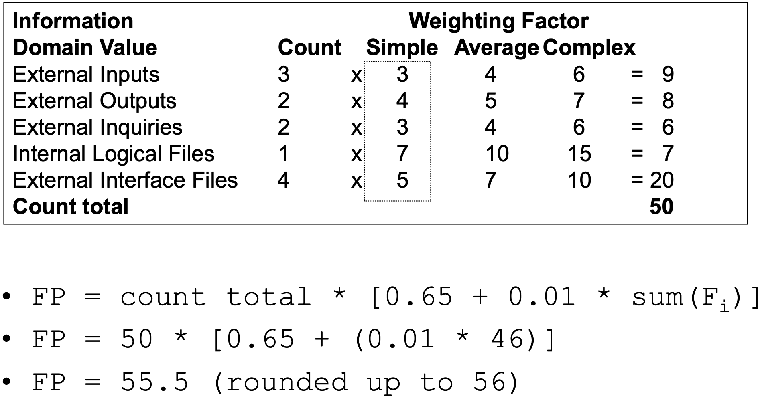
Function Point Example

Slide 16
Interpretation of the FP Number
Assume that past project data for a software development group indicates that
– One FP translates into 60 lines of object-oriented source code
– 12 FPs are produced for each person-month of effort
– An average of three errors per function point are found during analysis and design reviews
– An average of four errors per function point are found during unit and integration testing
This data can help project managers revise their earlier estimates
This data can also help software engineers estimate the overall implementation size of their code and assess the completeness of their review and testing activities

Slide 17
Metrics for the Design Model

Slide 18
Metrics for the Design Model
• Architectural metrics – Provide an indication of the quality of the architectural design
• Component-level metrics
– Measure the complexity of software components and other characteristics that have a bearing on quality
• Interface design metrics – Focus primarily on usability
• Specialized object-oriented design metrics
– Measure characteristics of classes and their communication and collaboration characteristics

Slide 19
Architectural Design Metrics
These metrics place emphasis on the architectural structure and effectiveness of modules or components within the architecture
They are “black box” in that they do not require any knowledge of the inner workings of a particular software component

Slide 20
Hierarchical Architecture Metrics
Fan out: the number of modules immediately subordinate to the module i, that is, the number of modules directly invoked by module i
Structural complexity – S(i) = f2out(i), where fout(i) is the “fan out” of module i
Data complexity – D(i) = v(i)/[fout(i) + 1], where v(i) is the number of input and output variables that are passed to and from module i
System complexity – C(i) = S(i) + D(i)
As each of these complexity values increases, the overall architectural complexity of the system also increases
This leads to greater likelihood that the integration and testing effort will also increase
Shape complexity
– size = n + a, where n is the number of nodes and a is the number of arcs
– Allows different program software architectures to be compared in a straightforward manner

Slide 21
Metrics for Object-Oriented Design
• Size
– Population: a static count of all classes and methods
– Volume: a dynamic count of all instantiated objects at a given time
– Length: the depth of an inheritance tree • Coupling – The number of collaborations between classes or the number of methods called between objects • Cohesion – The cohesion of a class is the degree to which its set of properties is part of the problem or design domain

Slide 22
Specific Class-oriented Metrics
Weighted methods per class – The normalized complexity of the methods in a class – Indicates the amount of effort to implement and test a class
Depth of the inheritance tree
– The maximum length from the derived class (the node) to the base class (the root)
– Indicates the potential difficulties when attempting to predict the behavior of a class because of the number of inherited methods
Number of children (i.e., subclasses) – As the number of children of a class grows • Re usability increases • Theabstractionrepresentedbytheparentclasscanbedilutedby inappropriate children • The amount of testing required will increase

Slide 23
Specific Class-oriented Metrics (continued)
Coupling between object classes
– Measures the number of collaborations a class has with any other classes
– Higher coupling decreases the reusability of a class
– Higher coupling complicates modifications and testing
– Coupling should be kept as low as possible
Response for a class
– This is the set of methods that can potentially be executed in a class in response to a public method call from outside the class
– As the response value increases, the effort required for testing also increases as does the overall design complexity of the class
Lack of cohesion in methods
– This measures the number of methods that access one or more of the same instance variables (i.e., attributes) of a class
– If no methods access the same attribute, then the measure is zero
– As the measure increases, methods become more coupled to one another via attributes, thereby increasing the complexity of the class design

Slide 24
Metrics for Source Code
Complexity metrics – Measure the logical complexity of source code (can also be applied to component-level design)
Length metrics
– Provide an indication of the size of the software
“These metrics can be used to assess source code complexity, maintainability and testability among other characteristics”

Slide 25
Metrics for Testing
• Statement and branch coverage metrics – Lead to the design of test cases that provide program coverage
• Defect-related metrics – Focus on defects (i.e., bugs) found, rather than on the tests themselves
• Testing effectiveness metrics
– Provide a real-time indication of the effectiveness of tests that have been conducted
• In-process metrics – Process related metrics that can be determined as testing is conducted

Slide 26
Metrics for Maintenance
• Software maturity index (SMI)
– Provides an indication of the stability of a software product based on changes that occur for each release
• SMI=[MT -(Fa +Fc +Fd)]/MT
where MT = #modules in the current release Fa = #modules in the current release that have been added Fc = #modules in the current release that have been changed Fd = #modules from the preceding release that were deleted in
the current release
As the SMI (i.e., the fraction) approaches 1.0, the software product begins to stabilize
The average time to produce a release of a software product can be correlated with the SMI

Slide 27
Any questions?

Slide 28
Thank you

Slide 29
Scan The QR for More Info

