Slide 1
SOFTWARE ENGINEERING
UNIT –III (Part - 1)
Component-Level Design
Text Book: Software Engineering, A practitioner’s approach
Roger s. Pressman 6th Edition -McGraw-Hill

Slide 2
What is a Component?
OMG Unified Modeling Language Specification [OMG01] defines a component as “... a modular, deployable, and replaceable part of a system that encapsulates implementation and exposes a set of interfaces.”
OO view: a component contains a set of collaborating classes
Conventional view: logic, the internal data structures that are required to implement the processing logic, and an interface that enables the component to be invoked and data to be passed to it.

Slide 3
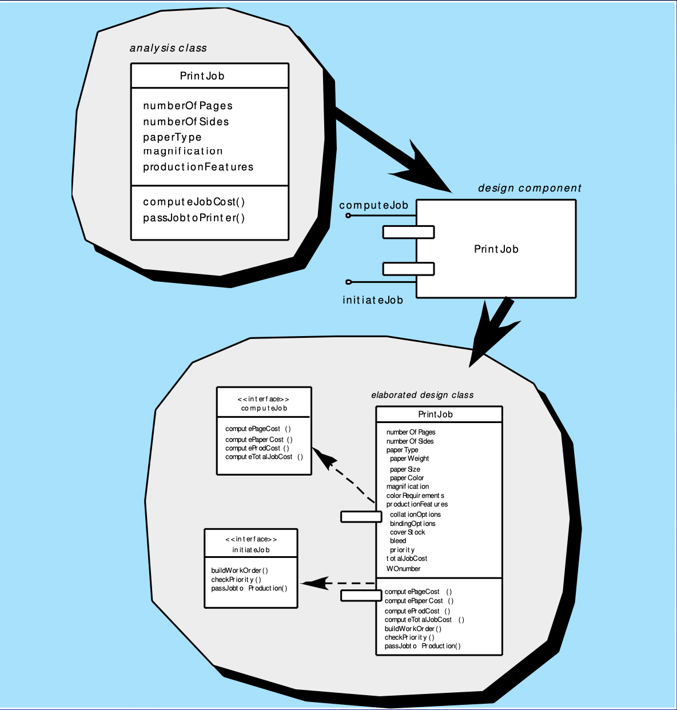
OO Component

Slide 4
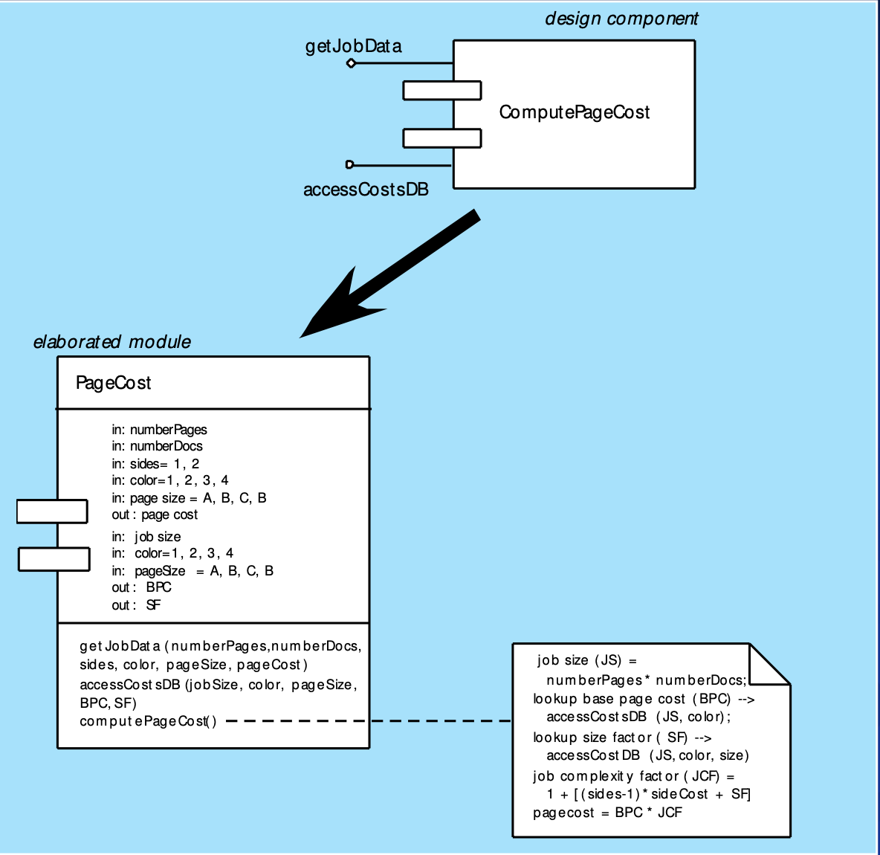
Conventional Component

Slide 5
Design Guidelines
Components
Naming conventions should be established for components that are specified as part of the architectural model and then refined and elaborated as part of the component-level model
Interfaces Interfaces provide important information about communication and collaboration
Dependencies and Inheritance
It is a good idea to model dependencies from left to right and inheritance from bottom (derived classes) to top (base classes).

Slide 6
Cohesion
Conventional view: the “single-mindedness” of a module
OO view:
cohesion implies that a component or class encapsulates only attributes and operations that are closely related to one another and to the class or component itself
Levels of cohesion Functional
Layer
Communicational
Sequential
Procedural
Temporal
utility

Slide 7
Coupling
Conventional view: The degree to which a component is connected to other components and to the external world
OO view:
a qualitative measure of the degree to which classes are connected to one another
Level of coupling
Content
Common
Control
Stamp
Data
Routine call
Type use
Inclusion or import
External

Slide 8
Component Level Design-I
Step 1. Identify all design classes that correspond to the problem domain.
Step 2. Identify all design classes that correspond to the
infrastructure domain.
Step 3. Elaborate all design classes that are not acquired as reusable components.
Step 3a. Specify message details when classes or component collaborate.
Step 3b. Identify appropriate interfaces for each component.

Slide 9
Component-Level Design-II
Step 3c. Elaborate attributes and define data types and data structures required to implement them.
Step 3d. Describe processing flow within each operation in detail.
Step 4. Describe persistent data sources (databases and files) and identify the classes required to manage them.
Step 5. Develop and elaborate behavioral representations for a class or component.
Step 6. Elaborate deployment diagrams to provide additional implementation detail.
Step 7. Factor every component-level design representation and always consider alternatives.

Slide 10
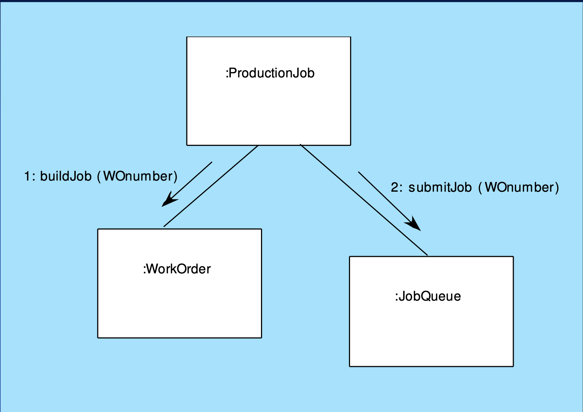
Collaboration Diagram

Slide 11
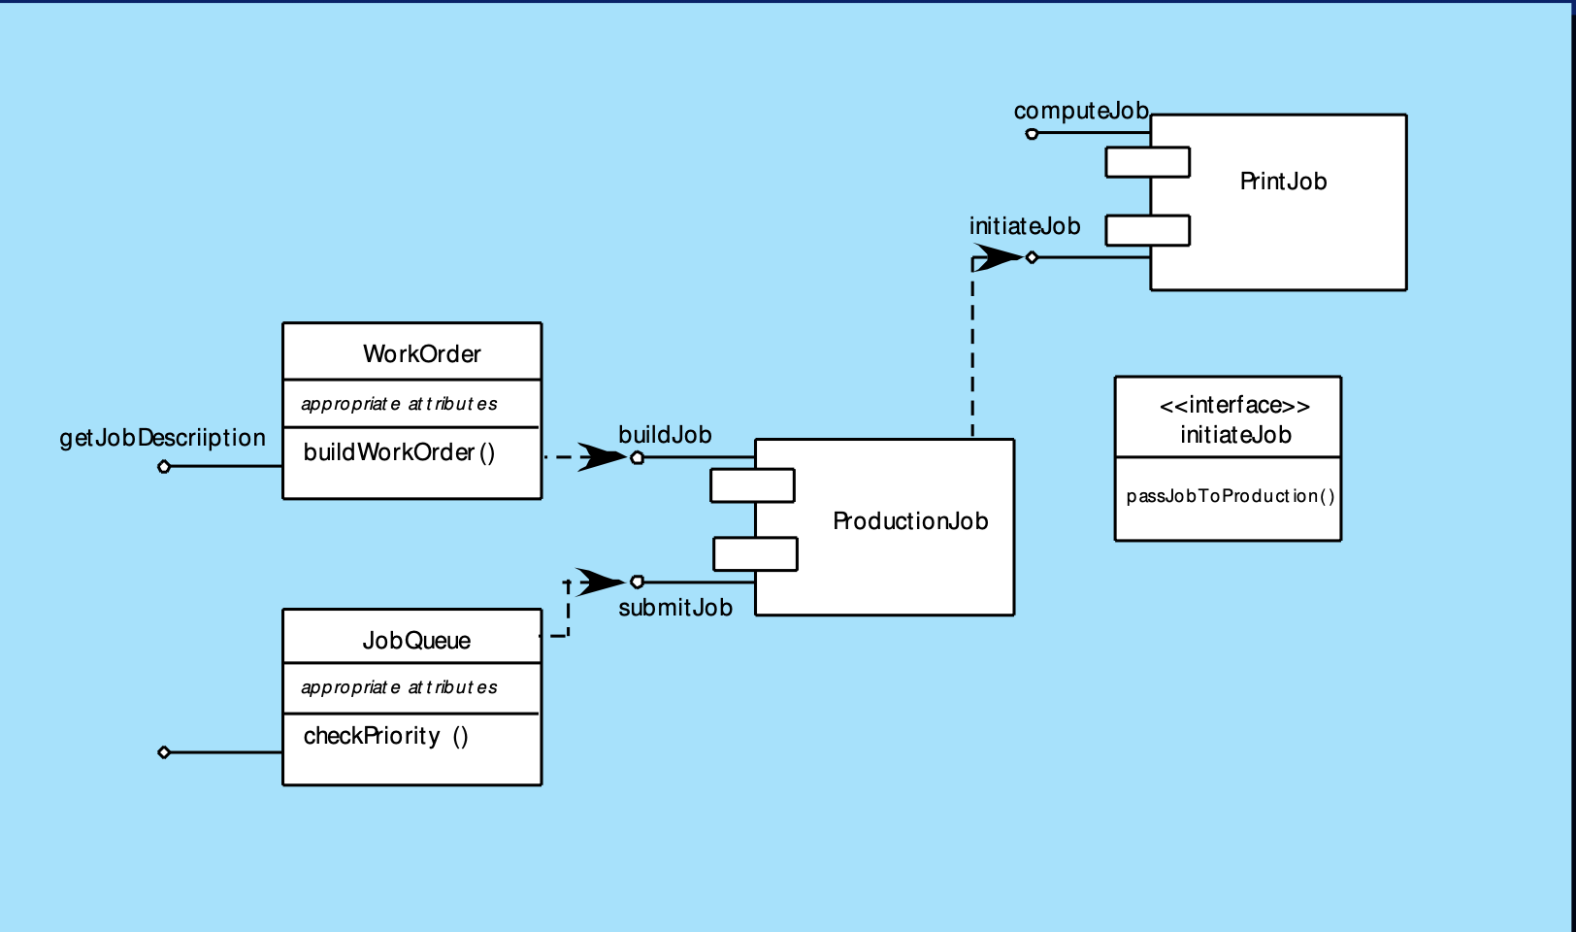
Refactoring

Slide 12
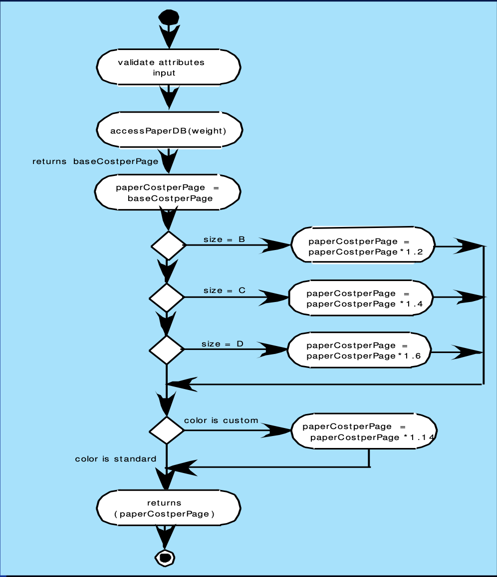
Activity Diagram

Slide 13
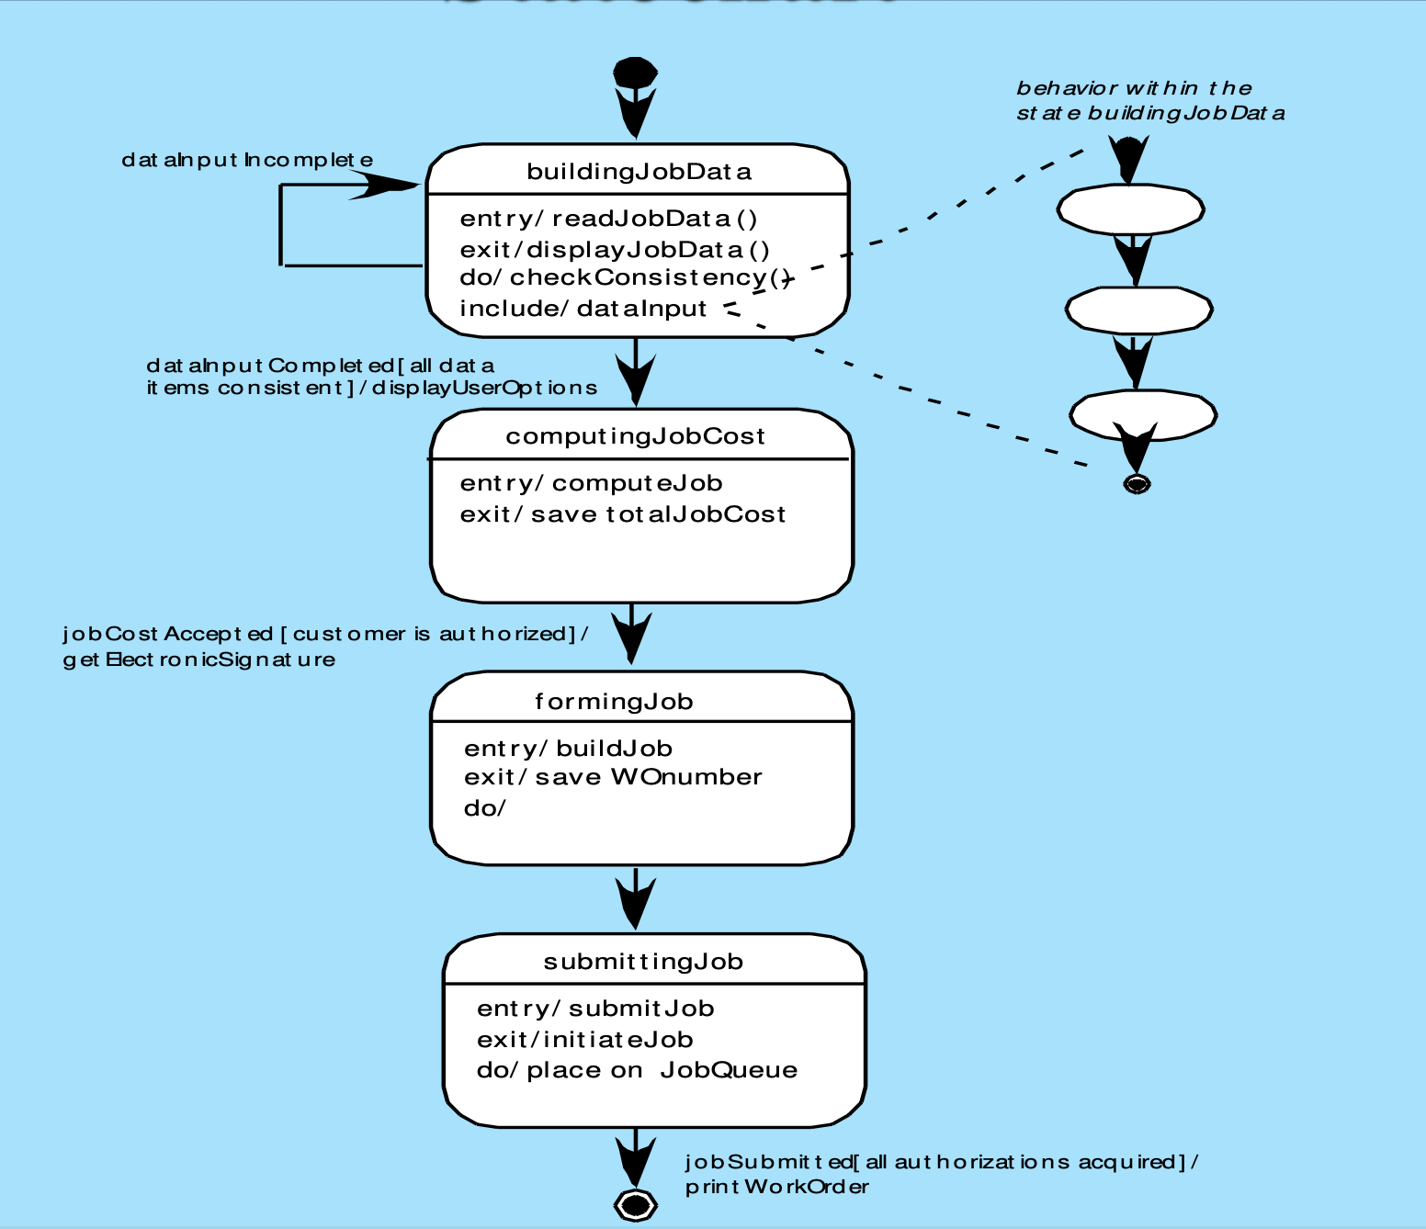
Statechart

Slide 14
Object Constraint Language (OCL)
complements UML by allowing a software engineer to use a formal grammar and syntax to construct unambiguous statements about various design model elements
simplest OCL language statements are constructed in four
parts:
(1) a context that defines the limited situation in which the statement is valid;
(2) a property that represents some characteristics of the context (e.g., if the context is a class, a property might be an attribute)
(3) an operation (e.g., arithmetic, set-oriented) that manipulates or qualifies a property, and
(4) keywords (e.g., if, then, else, and, or, not, implies) that are used to specify conditional expressions.

Slide 15
OCL Example

Slide 16
Algorithm Design
the closest design activity to coding
the approach:
review the design description for the component
use stepwise refinement to develop algorithm use structured programming to implement
procedural logic
use‘formalmethods’toprovelogic

Slide 17
Stepwise Refinement

Slide 18
Algorithm Design Model
represents the algorithm at a level of detail that can be reviewed for quality
Options:
graphical (e.g. flowchart, box diagram)
pseudocode (e.g., PDL) ... choice of many programming language
decision table
conduct walkthrough to assess quality

Slide 19
Structured Programming for Procedural Design
uses a limited set of logical constructs:
sequence
conditional — if-then-else, select-case
Loops — do-while, repeat until
leads to more readable, testable code
can be used in conjunction with ‘proof of correctness’
important for achieving high quality, but not enough

Slide 20
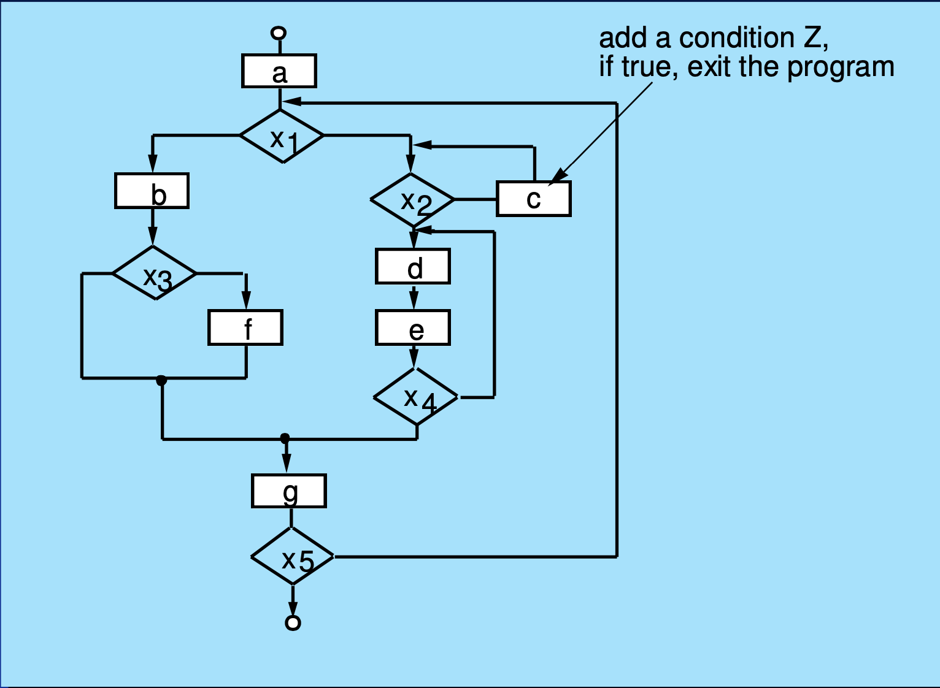
A Structured Procedural Design

Slide 21
Program Design Language (PDL)

Slide 22
Any questions?

Slide 23
Thank you

Slide 24
Scan The QR for More Info

