Slide 1

SOFTWARE ENGINEERING
UNIT –II (Chapter-2)
REQUIREMENTS ENGINEERING PROCESS
Text Book: Software Engineering, A practitioner’s approach
Roger s. Pressman 6th Edition -McGraw-Hill

Slide 2
Objectives
Requirements Engineering Process
Feasibility studies
Requirements elicitation and analysis
Requirements validation
Requirements management

Slide 3
Requirements engineering processes
The process used for RE vary widely depending on the application domain, the people involved and the organisation developing the requirements
However, there are a number of generic activities common to all process
  Feasibility Study
  Requirements elicitation
  Requirements analysis
  Requirements validation
  Requirements management

Slide 4
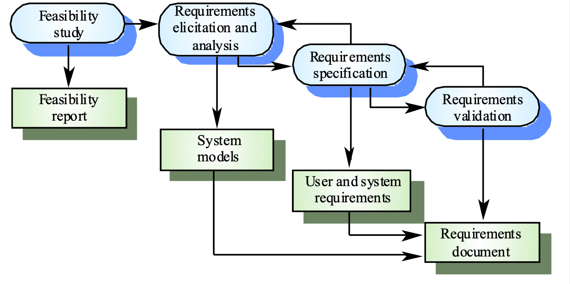
The requirements engineering process

Slide 5
Feasibility studies
A feasibility study decides whether or not the proposed system is worthwhile
A short focused study that checks
  If the system contributes to organisational
  objectives
  If the system can be engineered using current technology and within budget
  If the system can be integrated with other systems that are used

Slide 6
Feasibility study implementation
Based on information assessment (what is required), information collection and report writing
Questions for people in the organisation
  What if the system wasn’t implemented?
  What are current process problems?
  How will the proposed system help?
  What will be the integration problems?
  Is new technology needed? What skills?
  What facilities must be supported by the proposed system?

Slide 7
Requirements Elicitation and analysis
Sometimes called requirements elicitation or requirements discovery
Involves technical staff working with customers to find out about the application domain, the services that the system should provide and the system’s operational constraints
May involve end-users, managers, engineers involved in maintenance, domain experts, trade unions, etc. These are called stakeholders

Slide 8
Problems of requirements analysis
Stakeholders don’t know what they really want
Stakeholders express requirements in their own terms
Different stakeholders may have conflicting requirements
Organisational and political factors may influence the system requirements
The requirements change during the analysis process. New stakeholders may emerge and the business environment change

Slide 9
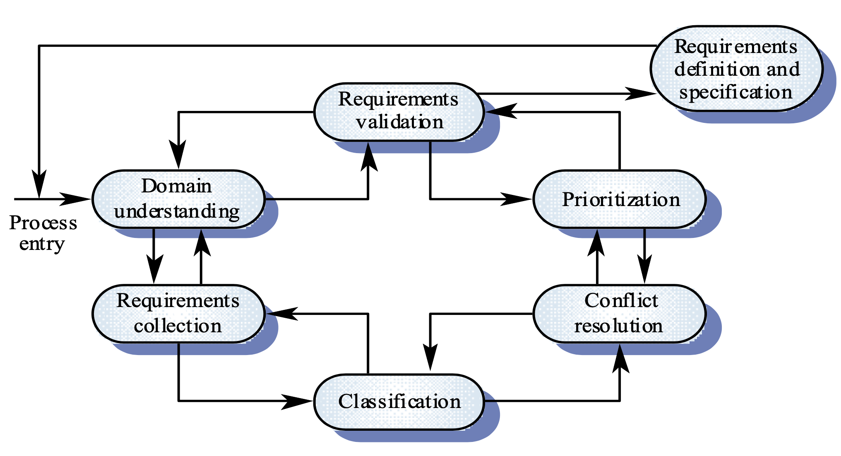
Requirements Elicitation and Analysis process

Slide 10
Requirements elicitation and analysis process activities
Domain understanding
Requirements collection
Classification
Conflict resolution
Prioritisation
Requirements Validation
Requirements definition and specification

Slide 11
System models
Different models may be produced during the requirements analysis activity
Requirements analysis may involve three structuring activities which result in these different models
  Partitioning: Identifies the structural (part-of) relationships between entities
  Abstraction: Identifies generalities among entities
  Projection: Identifies different ways of looking at a problem

Slide 12
Requirements elicitation and analysis techniques
Viewpoint-oriented elicitation
Scenario Based
Ethnography

Slide 13
Viewpoint-oriented elicitation
Stakeholders represent different ways of looking at a problem or problem viewpoints
This multi-perspective analysis is important as there is no single correct way to analyse system requirements

Slide 14
Banking ATM system
The example used here is an auto-teller system which provides some automated banking services
Simplified system which offers some services to customers of the bank who own the system and a narrower range of services to other customers
Services include cash withdrawal, message passing (send a message to request a service), ordering a statement and transferring funds

Slide 15
Auto teller viewpoints
Bank customers
Representatives of other banks
Hardware and software maintenance engineers
Marketing department
Bank managers and counter staff
Database administrators and security staff
Communications engineers
Personnel department

Slide 16
Method-based analysis
Widely used approach to requirements analysis. Depends on the application of a structured method to understand the system
Methods have different emphases. Some are designed for requirements elicitation, others are close to design methods
A viewpoint-oriented method (VORD) is used as an example here. It also illustrates the use of viewpoints

Slide 17
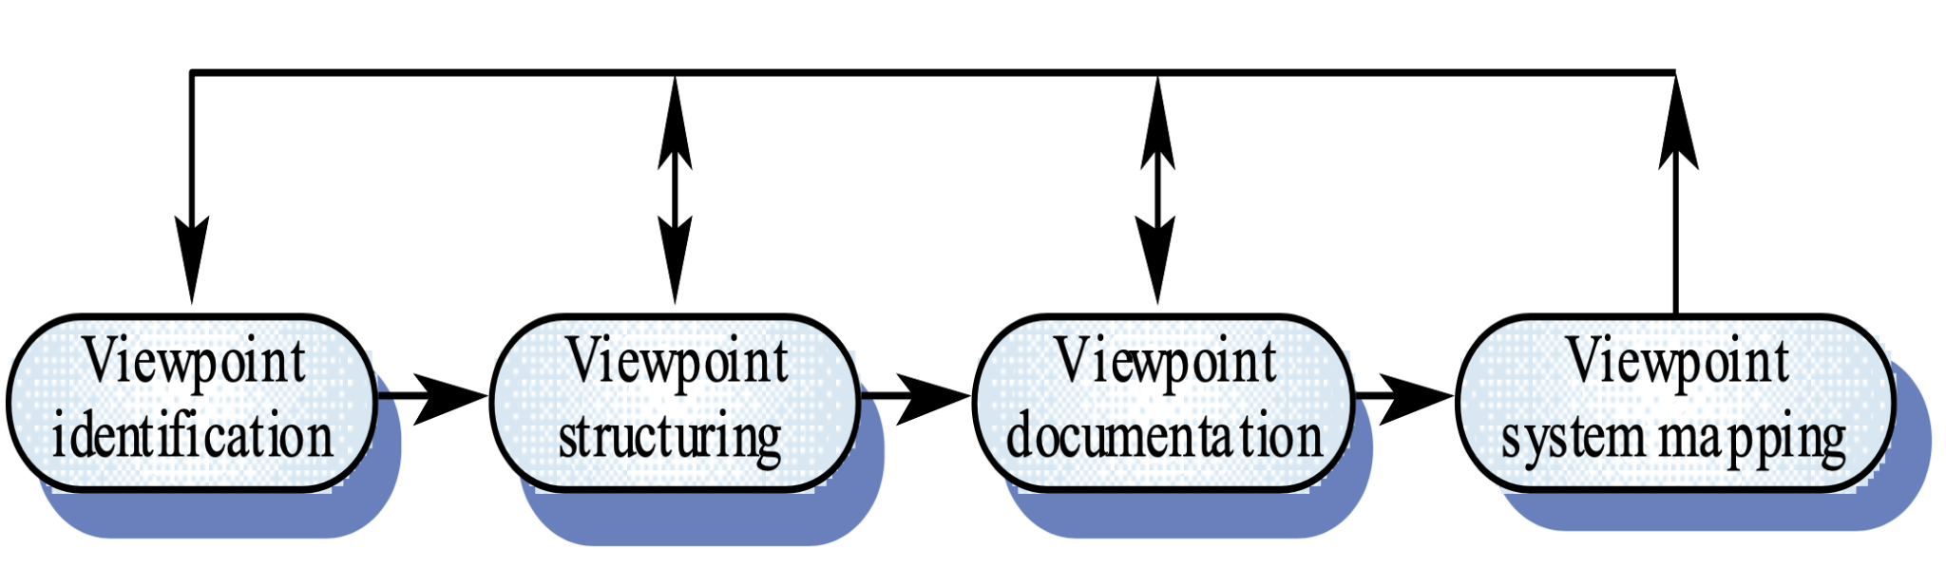
The VORD method

Slide 18
VORD process model
Viewpoint identification
  Discover viewpoints which receive system services and identify the services provided to each viewpoint
Viewpoint structuring
  Group related viewpoints into a hierarchy. Common services are provided at higher-levels in the hierarchy
Viewpoint documentation
  Refine the description of the identified viewpoints and services
Viewpoint-system mapping
  Transform the analysis to an object-oriented design

Slide 19
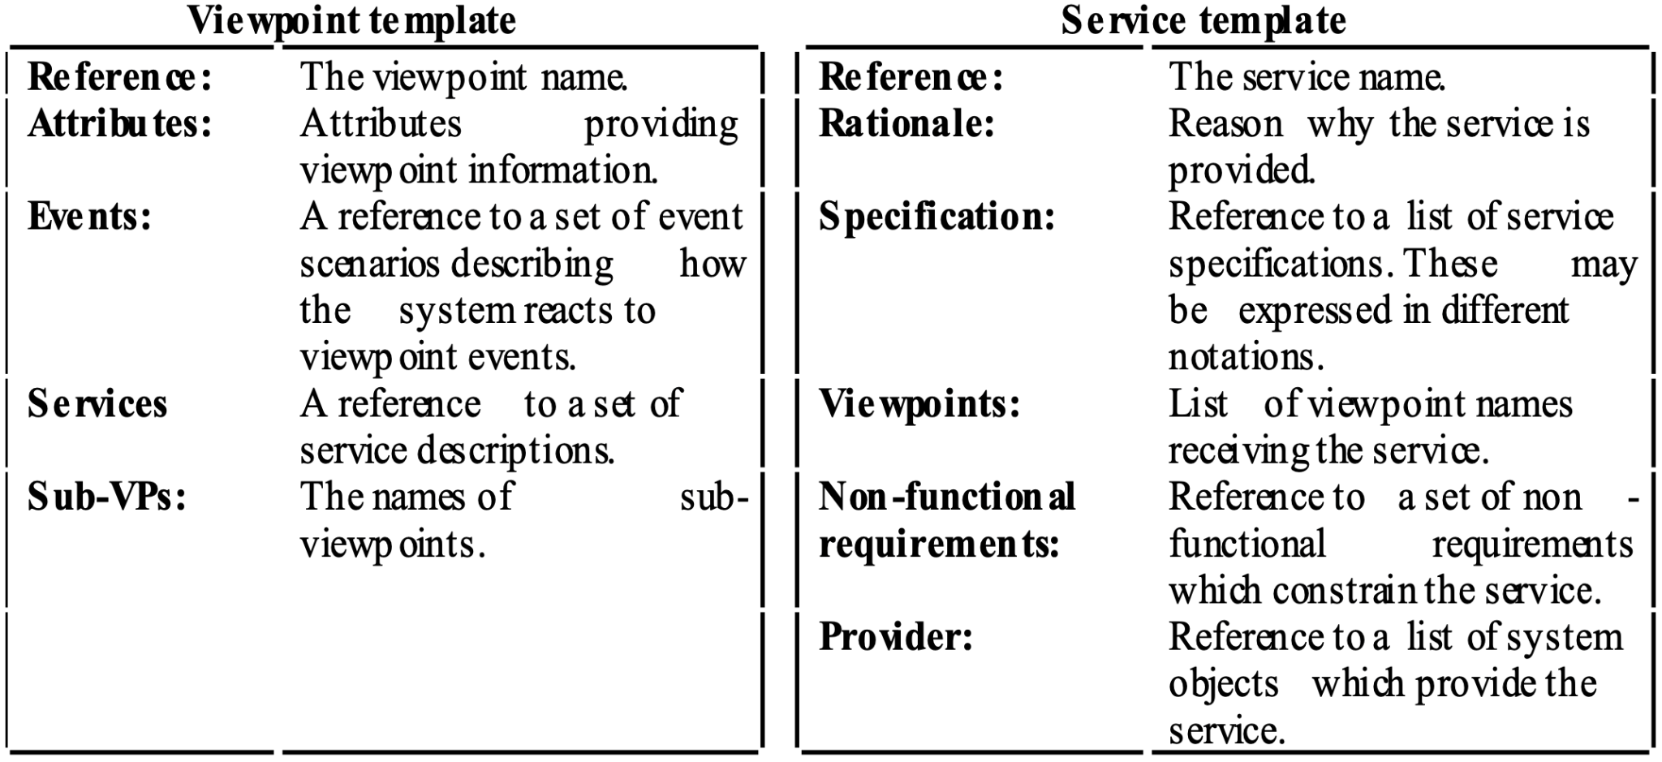
VORD standard forms

Slide 20
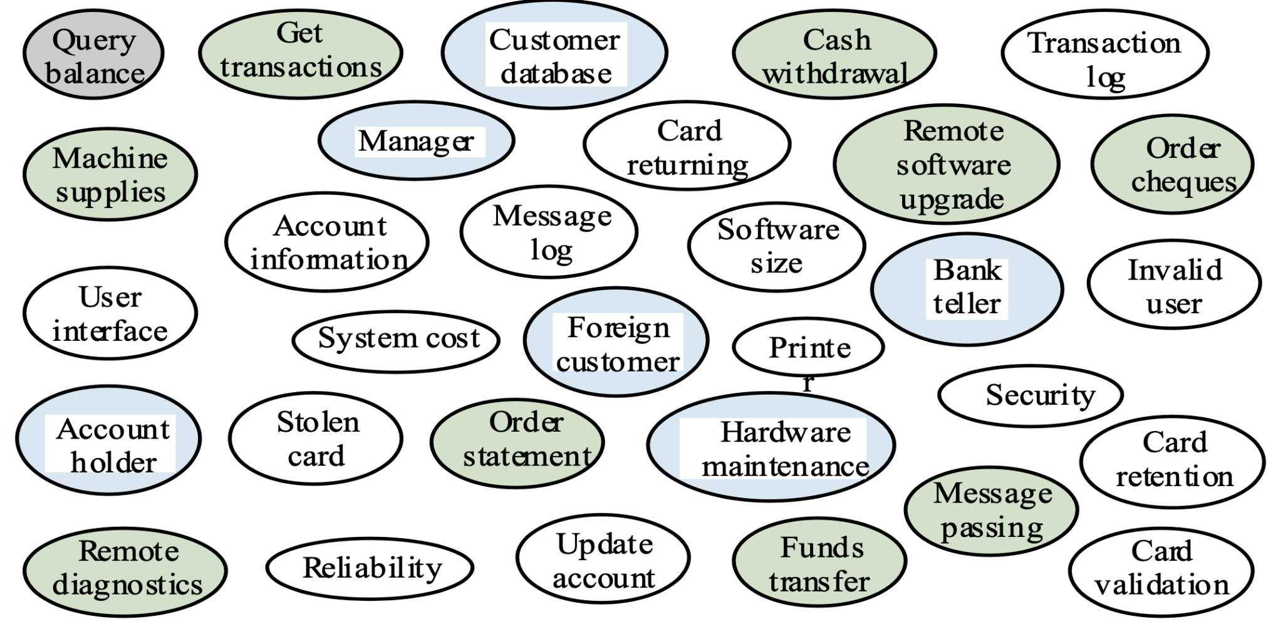
Viewpoint identification

Slide 21
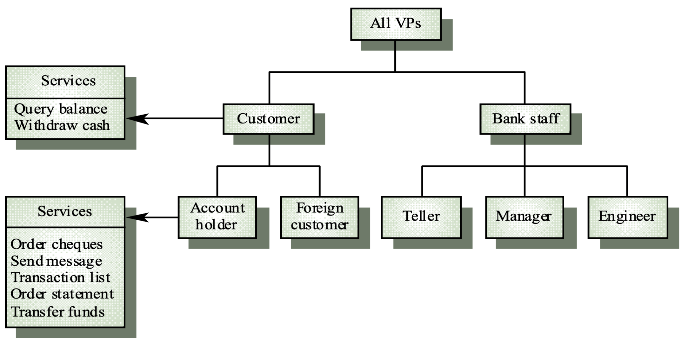
Viewpoint hierarchy

Slide 22
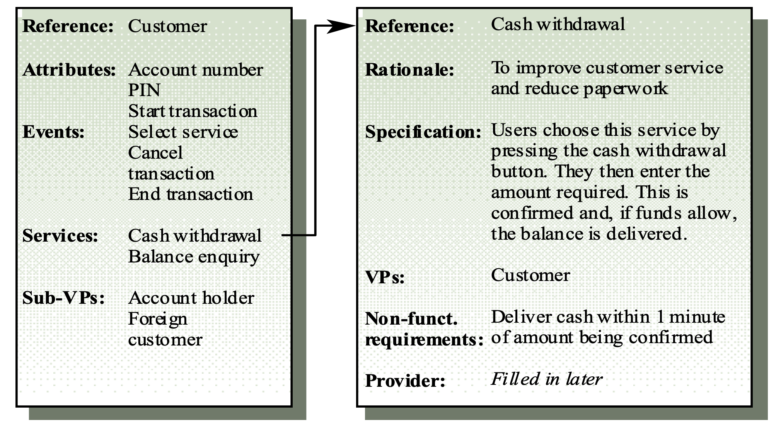
Customer/cash withdrawal templates

Slide 23
System requirements
More detailed specifications of user requirements
Serve as a basis for designing the system
May be used as part of the system contract
System requirements may be expressed using system models

Slide 24
Scenario Based
Scenarios are descriptions of how a system is used in practice
They are helpful in requirements elicitation as people can relate to these more readily than abstract statement of what they require from a system
Scenarios are particularly useful for adding detail to an outline requirements description

Slide 25
Use cases
Use-cases are a scenario based technique in the UML which identify the actors in an interaction and which describe the interaction itself
A set of use cases should describe all possible interactions with the system
Sequence diagrams may be used to add detail to use- cases by showing the sequence of event processing in the system

Slide 26
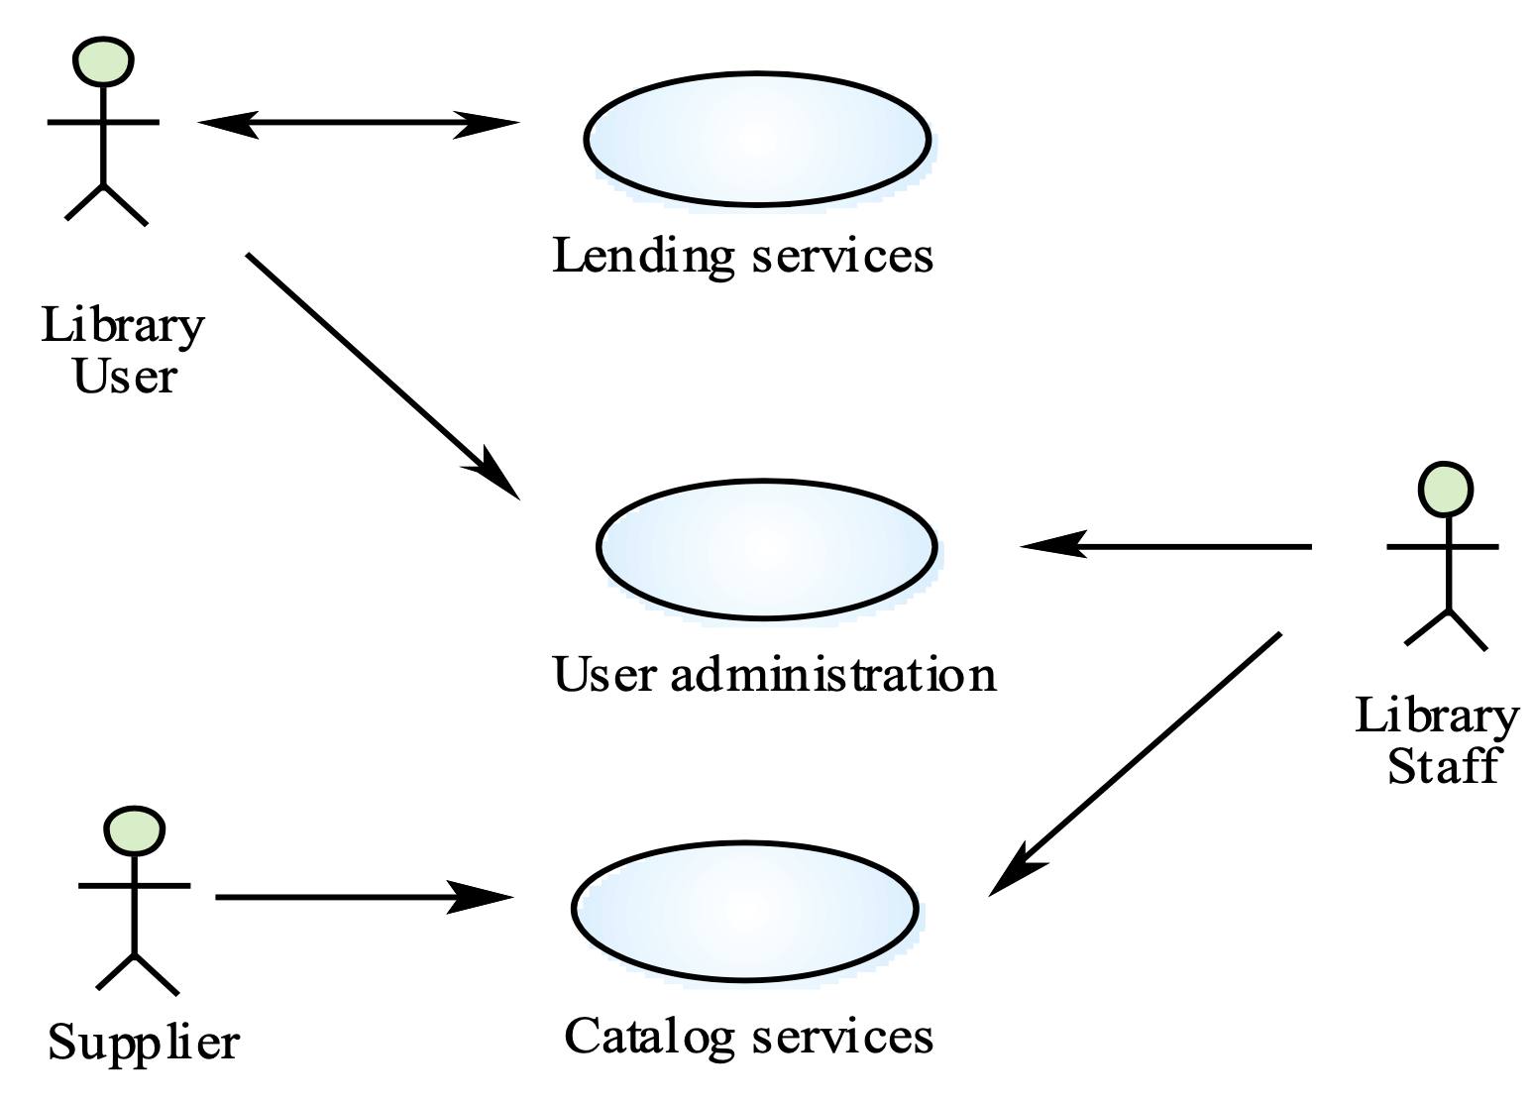
Library use-cases

Slide 27
Ethnography
Ethnography is an observational technique that can be used to understand social and organizational requirements.
A social scientists spends a considerable time observing and analysing how people actually work
People do not have to explain or articulate their work
Social and organisational factors of importance may be
observed
Ethnographic studies have shown that work is usually richer and more complex than suggested by simple system models

Slide 28
Requirements validation
Concerned with demonstrating that the requirements define the system that the customer really wants
Requirements error costs are high so validation is very important
  Fixing a requirements error after delivery may cost up to 100 times the cost of fixing an implementation error

Slide 29
PDL-based requirements definition
Requirements may be defined operationally using a language like a programming language but with more flexibility of expression
Most appropriate in two situations
  Where an operation is specified as a sequence of actions and the order is important
  When hardware and software interfaces have to be specified

Slide 30
PDL disadvantages
PDL may not be sufficiently expressive to express the system functionality in an understandable way
Notation is only understandable to people with programming language knowledge
The requirement may be taken as a design specification rather than a model to help understand the system

Slide 31
Interface specification
Most systems must operate with other systems and the operating interfaces must be specified as part of the requirements
Three types of interface may have to be defined
  Procedural interfaces
  Data structures
  Data representations
Formal notations are an effective technique for interface specification

Slide 32
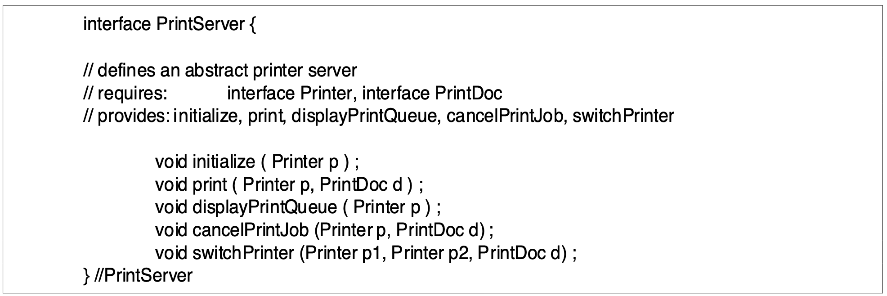
PDL interface description

Slide 33
The Requirements Document
The requirements document is the official statement of what is required of the system developers
Should include both a definition and a specification of requirements
It is NOT a design document. As far as possible, it should set of WHAT the system should do rather than HOW it should do it

Slide 34
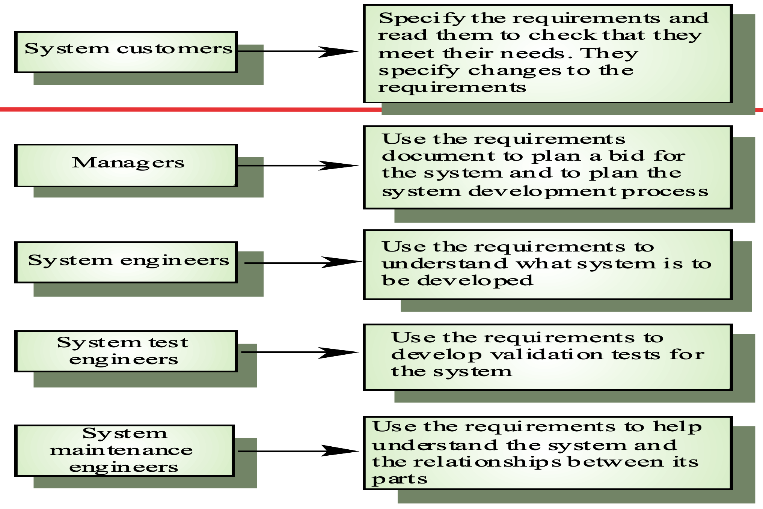
The Requirements Document

Slide 35
Requirements document requirements
Specify external system behaviour
Specify implementation constraints
Easy to change
Serve as reference tool for maintenance
Record forethought about the life cycle of the system i.e. predict changes
Characterise responses to unexpected events

Slide 36
Requirements Document Structure
Preface
Introduction
Glossary
User requirements definition
System architecture
System requirements specification
System models
System evolution
Appendices
Index

Slide 37
Any questions?

Slide 38
Thank you

Slide 39

Scan The QR for More Info

