Slide 1
Elements Of Computer Science and Engineering

Slide 2
Elements Of Computer Science and Engineering
Course Outcomes:
Know the working principles of functional units of a basic Computer.
Understand program development, the use of data structures and algorithms in problem solving
Know the need and types of operating system, database systems.
Understand the significance of networks, internet, WWW and cyber security.
Understand Autonomous systems, the application of artificial intelligence.

Slide 3
Elements Of Computer Science and Engineering
UNIT – I: Basics of a Computer – Hardware, Software, Generations of computers. Hardware - functional units, Components of CPU, Memory – hierarchy, types of memory, Input and output devices. Software – systems software, application software.
UNIT – II: Software development – waterfall model, Agile, Types of computer languages – Programming, markup, scripting Program Development – steps in program development, flowcharts, algorithms, data structures – definition, types of data structures.
UNIT – III Operating systems: Functions of operating systems, types of operating systems, Device & Resource management. Database Management Systems: Data models, RDBMS, SQL, Database Transactions, data centers, cloud basics & services.
UNIT – IV Computer Networks: Advantages of computer networks, LAN, WAN, MAN, internet, WiFi, sensor networks, 5G communication. World Wide Web – Basics, role of HTML, CSS, XML, Tools for web designing, Social media, Online social networks.
UNIT – V Autonomous Systems: IoT, Robotics, Drones, Artificial Intelligence – Learning, Game Development,image and video processing.

Slide 4
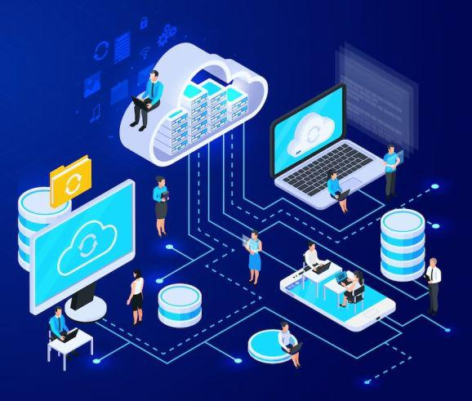
Elements Of Computer Science and Engineering
COMPUTER NETWORKS: What is it? Computer network is a system that connects numerous independent computers in order to share information (data) and resources. The integration of computers and other different devices allows users to communicate more easily. computer network is a collection of two or more computer systems that are linked together. A network connection can be established using either cable or wireless media. Hardware and software are used to connect computers and tools in any network.
A computer network consists of various kinds of nodes. Servers, networking hardware, personal computers, and other specialized or general-purpose hosts can all be nodes in a computer network. Host names and network addresses are used to identify them.

Slide 5
Elements Of Computer Science and Engineering
COMPUTER NETWORKS: Advantages of computer Network Data Exchange: Enables communication between 2 or many computers which are connected to network Resource sharing: Sharing of resource like printers, scanners. This enables reusability and optimizes the use of costlier peripherals. Better connectivity and communication: Networks allow users to easily connect and communicate with each other. Internet access: With the invention of the Internet, the word computer network has become synonymous with the Internet. Entertainment: Many games and entertainment options are readily available on the Internet.
Inexpensive system: Sharing of costlier hardware equipment and peripherals and sharing of expensive software through a computer network, normally with a client-server configuration, can cut down costs and make systems inexpensive. Flexible access and availability: The deployment of a computer network ensures a centralized system.

Slide 6
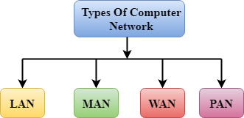
Elements Of Computer Science and Engineering
COMPUTER NETWORKS: Types of computer Network: A computer network is a group of computers linked to each other that enables the computer to communicate with another computer and share their resources, data, and applications. A computer network can be categorized by their size. A computer network is mainly of four types: 1. LAN(Local Area Network) 2. PAN(Personal Area Network) 3. MAN(Metropolitan Area Network) 4. WAN(Wide Area Network)

Slide 7
Elements Of Computer Science and Engineering
COMPUTER NETWORKS: Types of computer Network: LAN(Local Area Network): 1. Local Area Network is a group of computers connected to each other in a small area such as building, office. 2. LAN is used for connecting two or more personal computers through a communication medium such as twisted pair, coaxial cable, etc. 3. It is less costly as it is built with inexpensive hardware such as hubs, network adapters, and ethernet cables. 4. The data is transferred at an extremely faster rate in Local Area Network. 5. Local Area Network provides higher security.

Slide 8
Elements Of Computer Science and Engineering
COMPUTER NETWORKS: Types of computer Network: LAN(Local Area Network): What is in a LAN: A LAN comprises cables, access points, switches, routers, and other components that enable devices to connect to internal servers, web servers, and other LANs via wide area networks. The rise of virtualization has also fueled the development of virtual LANs, which enable network administrators to logically group network nodes and partition their networks without a need for major infrastructure changes. For example, in an office with multiple departments, such as accounting, IT support, and administration, each department's computers could be logically connected to the same switch but segmented to behave as if they are separate..

Slide 9
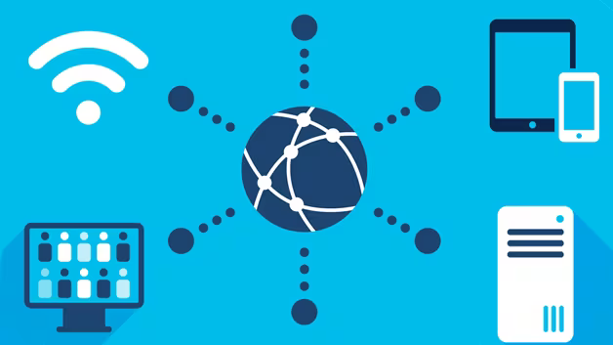
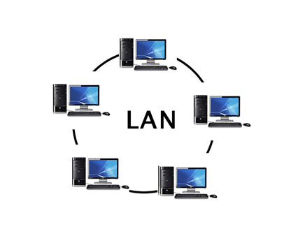
Elements Of Computer Science and Engineering
COMPUTER NETWORKS: Types of computer Network: LAN(Local Area Network):

Slide 10
Elements Of Computer Science and Engineering
COMPUTER NETWORKS: Types of computer Network: LAN(Local Area Network): Advantages of LAN: The advantages of a LAN are the same as those for any group of devices networked together. The devices can use a single Internet connection, share files with one another, print to shared printers, and be accessed and even controlled by one another. LANs were developed in the 1960s for use by colleges, universities, and research facilities (such as NASA), primarily to connect computers to other computers. It wasn't until the development of Ethernet technology (1973, at Xerox PARC), its commercialization (1980), and its standardization (1983) that LANs started to be used widely. While the benefits of having devices connected to a network have always been well understood, it wasn't until the wide deployment of Wi-Fi technology that LANs became commonplace in nearly every type of environment. Today, not only do businesses and schools use LANs, but also restaurants, coffee shops, stores, and homes. Wireless connectivity has also greatly expanded the types of devices that can be connected to a LAN. Now, nearly everything imaginable can be "connected," from PCs, printers, and phones to smart TVs, stereos, speakers, lighting, thermostats, window shades, door locks, security cameras--and even coffeemakers, refrigerators, and toys.

Slide 11
Elements Of Computer Science and Engineering
COMPUTER NETWORKS: Types of computer Network: LAN(Local Area Network): Are there different types of LAN: In general, there are two types of LANs: client/server LANs and peer-to-peer LANs. A client/server LAN consists of several devices (the clients) connected to a central server. The server manages file storage, application access, device access, and network traffic. A client can be any connected device that runs or accesses applications or the Internet. The clients connect to the server either with cables or through wireless connections. Typically, suites of applications can be kept on the LAN server. Users can access databases, email, document sharing, printing, and other services through applications running on the LAN server, with read and write access maintained by a network or IT administrator. Most midsize to large business, government, research, and education networks are client/server-based LANs. A peer-to-peer LAN doesn't have a central server and cannot handle heavy workloads like a client/server LAN can, and so they're typically smaller. On a peer-to-peer LAN, each device shares equally in the functioning of the network. The devices share resources and data through wired or wireless connections to a switch or router. Most home networks are peer-to-peer.

Slide 12
Elements Of Computer Science and Engineering
COMPUTER NETWORKS: Types of computer Network: WAN(Wide Area Network): What is WAN: In its simplest form, a wide-area network (WAN) is a collection of local-area networks (LANs) or other networks that communicate with one another. A WAN is essentially a network of networks, with the Internet the world's largest WAN.
Today, there are several types of WANs, built for a variety of use cases that touch virtually every aspect of modern life. What is a WAN Router?
A WAN router, also known as an edge router or border router is a device that routes data packets between WAN locations, giving an enterprise access to a carrier network. Several WAN protocols have been developed over time, including Packet over SONET/SDH (PoS), Multi protocol Label Switching (MPLS), ATM, and Frame Relay.

Slide 13
Elements Of Computer Science and Engineering
COMPUTER NETWORKS: Types of computer Network: WAN(Wide Area Network): How did it start : The first known WAN was created by the U.S. Air Force in the late 1950s to interconnect sites in the Semi-Automatic Ground Environment (SAGE) radar defense system. An enormous network of dedicated phone lines, telephones, and modems linked the sites together. The foundation of the IP-based Internet started with the Advanced Research Projects Agency Network (ARPANET), the first wide-area packet-switching network with distributed control and the first network to implement TCP/IP protocol suite.
ARPANET initially interconnected the University of California, Los Angeles (UCLA), the Stanford Research Institute (now SRI International), the University of California, Santa Barbara (UCSB), and the University of Utah.

Slide 14
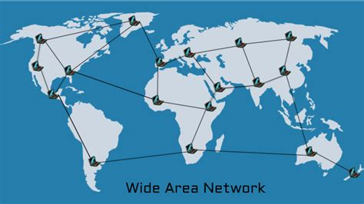
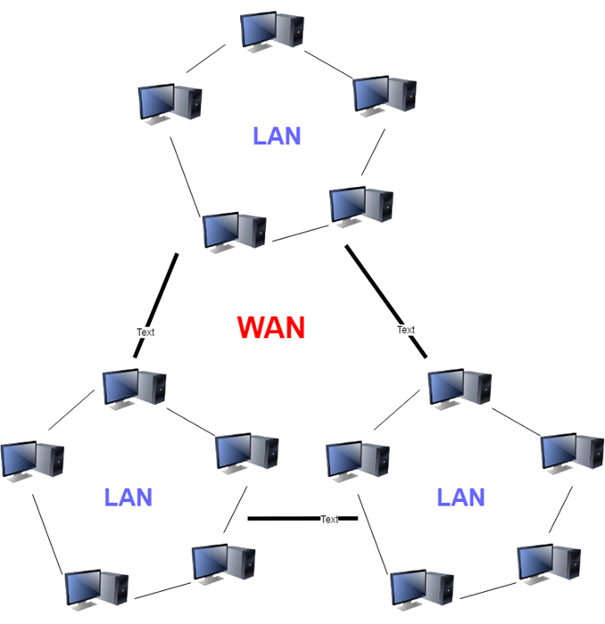
Elements Of Computer Science and Engineering
COMPUTER NETWORKS: Types of computer Network: WAN(Wide Area Network):

Slide 15
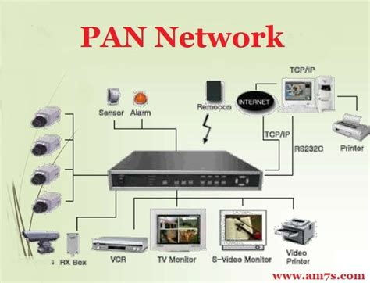
Elements Of Computer Science and Engineering
COMPUTER NETWORKS: Types of computer Network: PAN(Personal Area Network): A personal area network is a network enabled for a person, usually within a range of 10 meters PANs are used to connect personal computing devices. Thomas Zimmermann was the first researcher to propose the idea of PAN. CP devices used in the development of PANs are laptops, mobile phones, media players and game stations. This is now evolving as the Internet of Things(loT)network. For example,the network of a professor in a university department; they can connect all the devices in their classroom, lab, research centre, etc.

Slide 16
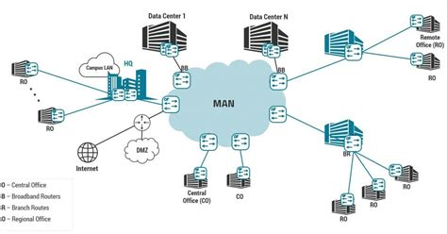
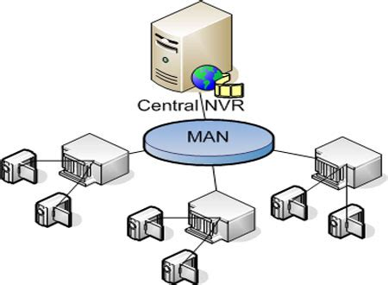
Elements Of Computer Science and Engineering
COMPUTER NETWORKS: Types of computer Network: MAN(Metropolitan Area Network): A metropolitan area network (MAN) is a computer network that connects computers within a metropolitan area, which could be a single large city, multiple cities and towns, or any given large area with multiple buildings. A MAN is larger than a local area network (LAN) but smaller than a wide area network (WAN). MANs do not have to be in urban areas; the term "metropolitan" implies the size of the network, not the demographics of the area that it serves.

Slide 17
Elements Of Computer Science and Engineering
COMPUTER NETWORKS: INTERNET:
The Internet is a global network of billions of computers and other electronic devices. It allows us to access almost any information and communicate with everyone in the world. This is achieved by connecting a computer to the Internet. Connecting to the internet is called an online connection.
The Internet is called the network of networks. It is a global communication system that links together thousands of individual networks. In other words, the Internet is a collection of interlinked computer networks, connected by copper wires, fiber optic cables, wireless connections, etc. As a result, a computer can virtually connect to other computers in any network. These connections allow users to interchange messages, to communicate in real time (getting instant messages and responses), to share data and programs and to access limitless information.
Internet architecture is a meta-network (network of networks), which refers to a congregation of thousands of distinct networks interacting with a common protocol. In simple terms, it is referred to as an inter network that is connected using protocols. The protocol used is TCP/IP. This protocol connects any two networks that differ in hardware, software and design.

Slide 18
Elements Of Computer Science and Engineering
COMPUTER NETWORKS: WI-FI:
A Wi-Fi network is a wireless local area network(W-LAN) that uses Wi-Fi. The Wi-Fi standard has gained near universal acceptance to support wireless networks and provide Internet access in residential, business and public environments.
A Wireless network is a flexible data communications system, which uses wireless media such as radio frequency technology to transmit and receive data over the air, minimizing the need for wired connections
Wireless networks use electromagnetic waves to communicate information from one point to another without relying on any physical connection.

Slide 19
Elements Of Computer Science and Engineering
COMPUTER NETWORKS: WI-FI: Advantages of Wireless Network
Mobility: A wireless network provides mobile users with access to real-time information so that they can roam without getting disconnected from the network. Installation speed and simplicity: Is fast and easy as it requires less number of cables Reach of the network: The Network can be extended in the places where physical connection cannot be wired. More flexibility: They are more flexible and easy to adapt. Reduced cost of ownership: Less CAPEX(Capital Expenditure) Scalability: Can be configured on various topologies.

Slide 20
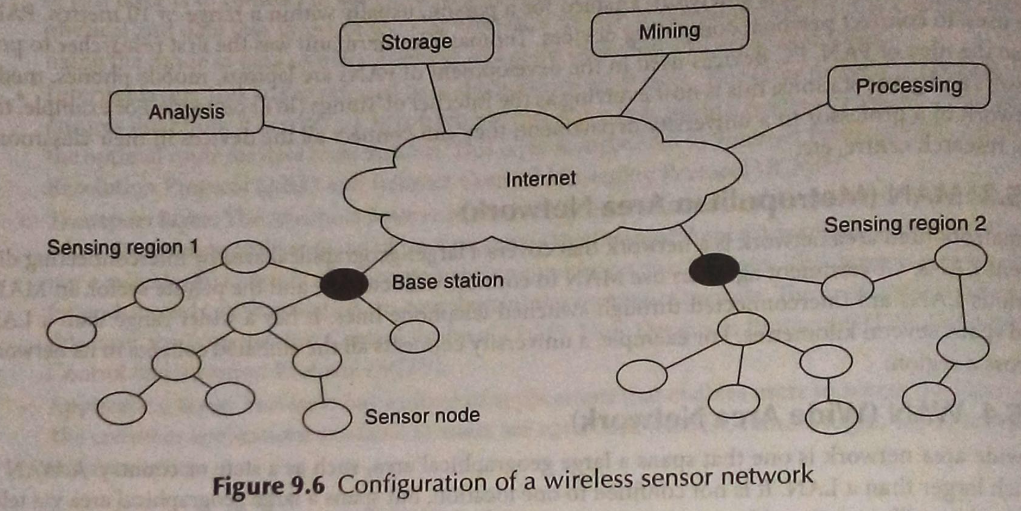
Elements Of Computer Science and Engineering
COMPUTER NETWORKS: WIRELESS SENSOR NETWORK (WSN) Sensor nodes are used in WSNs with onboard processors to manage and monitor the environment in a specific area.
A typical sensor network consists of sensors,controller and a communication system.

Slide 21
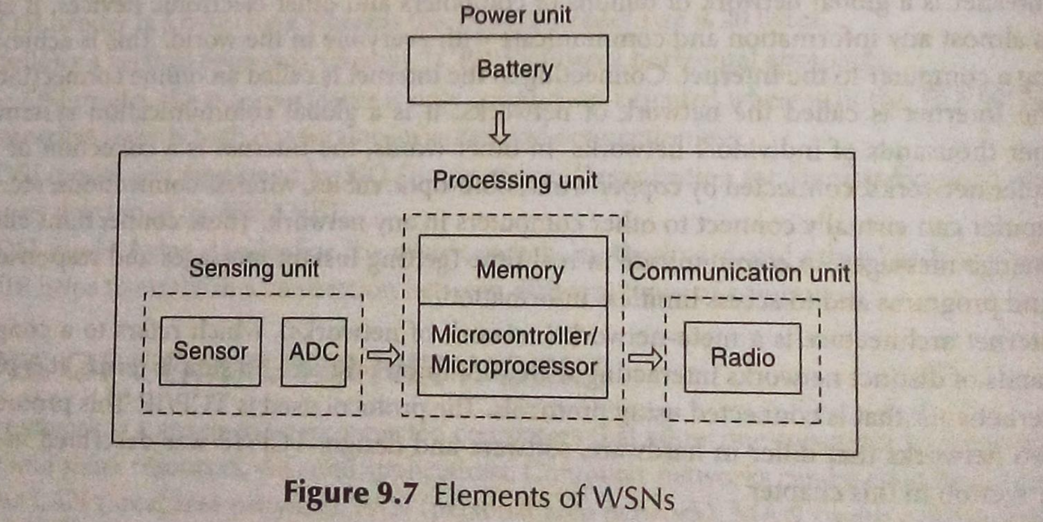
Elements Of Computer Science and Engineering
COMPUTER NETWORKS: WIRELESS SENSOR NETWORK (WSN) Elements of WSN:

Slide 22
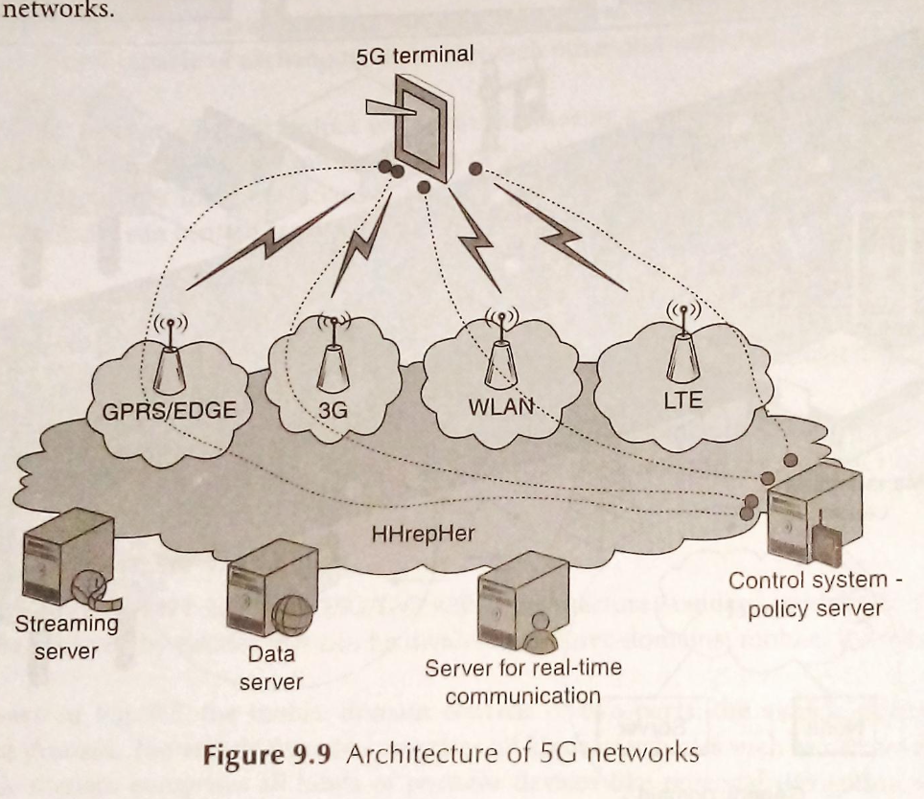
Elements Of Computer Science and Engineering
COMPUTER NETWORKS: 5G Network A 5G network is a cellular network whose coverage area is divided into smaller geographical areas called cells. Al 5G wireless devices within a cell are connected to the Internet and telephone network via radio waves through local antennas within the cel. The main advantage of 5G networks is higher bandwidth and faster downloads speeds, which can be up to 10 gigabits per second.

Slide 23
Elements Of Computer Science and Engineering
Any questions?

Slide 24
Thank you

