Slide 1
Elements Of Computer Science and Engineering

Slide 2
Elements Of Computer Science and Engineering
Course Outcomes:
Know the working principles of functional units of a basic Computer.
Understand program development, the use of data structures and algorithms in problem solving
Know the need and types of operating system, database systems.
Understand the significance of networks, internet, WWW and cyber security.
Understand Autonomous systems, the application of artificial intelligence.

Slide 3
Elements Of Computer Science and Engineering
UNIT – I: Basics of a Computer – Hardware, Software, Generations of computers. Hardware - functional units, Components of CPU, Memory – hierarchy, types of memory, Input and output devices. Software – systems software, application software.
UNIT – II: Software development – waterfall model, Agile, Types of computer languages – Programming, markup, scripting Program Development – steps in program development, flowcharts, algorithms, data structures – definition, types of data structures.
UNIT – III Operating systems: Functions of operating systems, types of operating systems, Device & Resource management. Database Management Systems: Data models, RDBMS, SQL, Database Transactions, data centers, cloud basics & services.
UNIT – IV Computer Networks: Advantages of computer networks, LAN, WAN, MAN, internet, WiFi, sensor networks, 5G communication. World Wide Web – Basics, role of HTML, CSS, XML, Tools for web designing, Social media, Online social networks.
UNIT – V Autonomous Systems: IoT, Robotics, Drones, Artificial Intelligence – Learning, Game Development,image and video processing.

Slide 4
Elements Of Computer Science and Engineering
OPERATING SYSTEM:
It lies in the category of system software.
It basically manages all the resources of the computer.
An operating system acts as an interface between the software and different parts of the computer or the computer hardware.
The operating system is designed in such a way that it can manage the overall resources and operations of the computer.

Slide 5
Elements Of Computer Science and Engineering
OPERATING SYSTEM:
What happens when you on a computer: When we power on a computer, the switch sends electricity to the motherboard. If the power supply is adequate, the BIOS (Basic Input/Output System) chip takes over. It checks for the proper functioning of basic input and output devices and the system is booted. The process of loading the operating system into main memory is called booting.

Slide 6
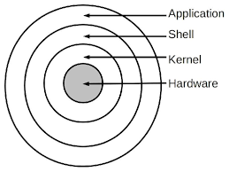
Elements Of Computer Science and Engineering
OPERATING SYSTEM ARCHITECTURE :

Slide 7
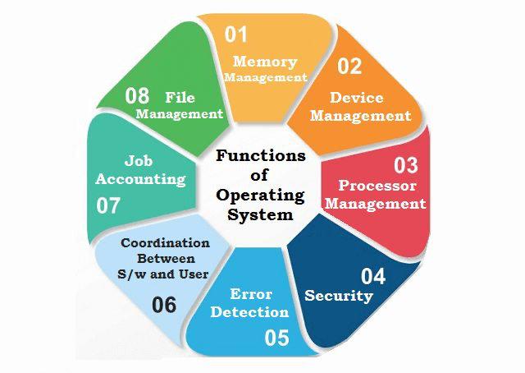
Elements Of Computer Science and Engineering
Operating System functions:

Slide 8
Elements Of Computer Science and Engineering
OPERATING SYSTEM:
Functions of os: Process management: 1. A process is a program in execution. A process requires some amount of memory, storage, computing(CPU) etc.. Creation , Execution and termination of process is required to carry out user actions. 2. Checking which process are triggering which other process. Ensures that no 2 process request same resource. 3. Managing all these user process is a essential thing to run all user programs and computer in a efficient and reliable way.

Slide 9
Elements Of Computer Science and Engineering
OPERATING SYSTEM:
Functions of os: Memory management: 1. Allocate and de-allocate memory before and after process execution. 2. To keep track of used memory space by processes. 3. To minimize fragmentation issues. 4. To proper utilization of main memory. 5. To maintain data integrity while executing of process.

Slide 10
Elements Of Computer Science and Engineering
OPERATING SYSTEM:
Functions of os: File management: 1. Allows users to modify, create, and delete files on the computer system. 2. Operates on and manages a file’s permissions for different users and groups. 3. Enables improved visualization by structuring the files like a tree. 4. Interface for I/O operations is provided. 5. Protects data from hackers and unwanted access.

Slide 11
Elements Of Computer Science and Engineering
OPERATING SYSTEM:
Functions of os: Device and resource management: 1. Allows users to manage input and output devices. 2. Receiving interrupt requests and prioritizing them for transmission ot hte CPU are handled by a unique device known as the interrupt controller . 3. Device management: It keeps track of all device connected to the system, provide a program to keep track of all devices connected to system.

Slide 12
Elements Of Computer Science and Engineering
OPERATING SYSTEM:
Functions of os: Security and protection: 1. The os employs password protection and other similar mechanisms to safeguard user data. 2. Malware protection software or anti-virus software must be installed for external operation.

Slide 13
Elements Of Computer Science and Engineering
OPERATING SYSTEM:
Functions of os: User Interface: 1. Command Line Interface(CLI): The user enters the command or strikers the shortcut keys on the keyboard in command line Interface. 2. Graphical user interface(GUI): GUI allows the user to interact with computer through graphical icons and interactive menus.

Slide 14
Elements Of Computer Science and Engineering
OPERATING SYSTEM:
Type of operating system: An Operating system is careful arranged group of applications that controls the hardware of a computer. There are many of operating systems. 1. Batch Systems 2. Multi Programming Systems 3. Time Shared Systems 4. Parallel Systems 5. Distributed Systems 6. Client-server Systems 7. Clustered Systems 8. Real time Systems 9. Handheld Systems

Slide 15
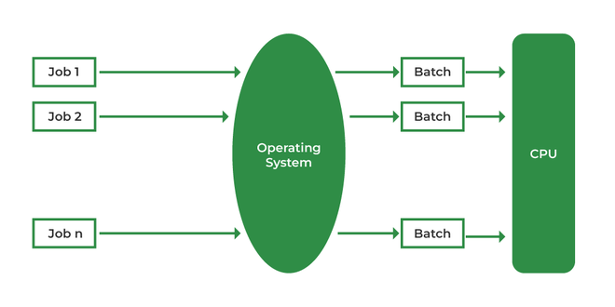
Elements Of Computer Science and Engineering
OPERATING SYSTEM:
Type of operating system: 1. Batch System: Batch processing is a process that is used in many industries to improve efficiency. It is a type of operating system that is used to manage multiple tasks and processes in a sequence. It is a type of operating system that is used to improve the efficiency of a business by allowing it to run multiple tasks at the same time.

Slide 16
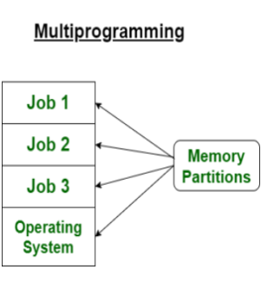
Elements Of Computer Science and Engineering
OPERATING SYSTEM:
Type of operating system: 2. Multi programing System: The major task of multiprogramming is to maximize the utilization of resources. High Performance Context switch between process. Need Single CPU for implementation.

Slide 17
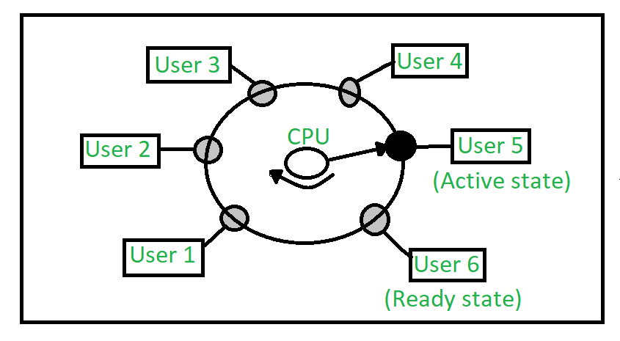
Elements Of Computer Science and Engineering
OPERATING SYSTEM:
Type of operating system: 3. Time sharing System: This is logical extension of multiprogramming There are 3 states waiting state, active state and ready state. Each task gets an equal opportunity. Fewer chances of duplication of software. CPU idle time can be reduced.

Slide 18
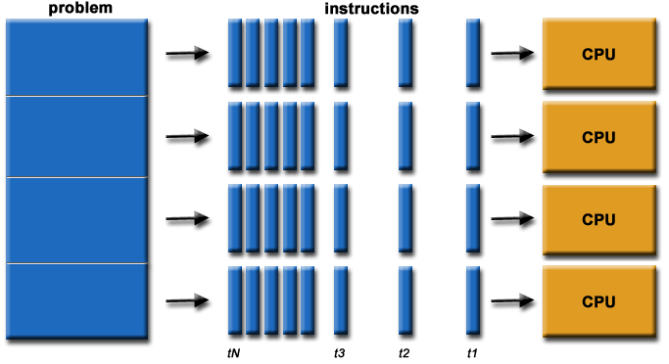
Elements Of Computer Science and Engineering
OPERATING SYSTEM:
Type of operating system: 4. Parallel System: There are with more than one cpu(processor) Tasks are performed with a more speedy process. It is also known as a tightly coupled system. E.g:- Hadoop, MapReduce, Apache Cassandra

Slide 19
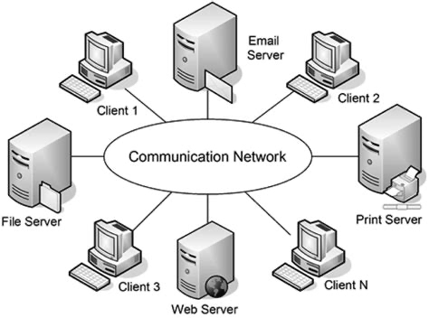
Elements Of Computer Science and Engineering
OPERATING SYSTEM:
Type of operating system: 5. Distributed System: In Distributed Systems, each processor has its own memory. These systems do not share memory or clock in contrast to parallel systems. In this there is no global clock in distributed computing, it uses various synchronization algorithms. Distributed systems can be easily scaled by adding more computers to the network. Distributed systems can be geographically distributed, allowing for better performance and resilience.

Slide 20
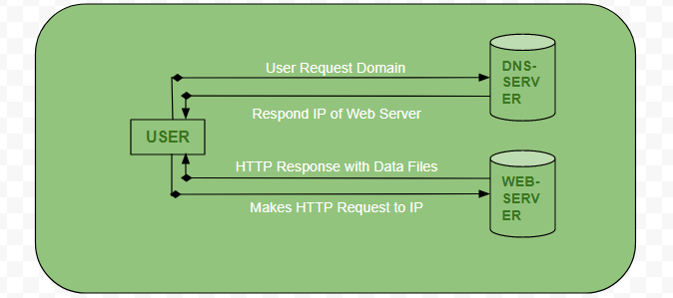
Elements Of Computer Science and Engineering
OPERATING SYSTEM:
Type of operating system: 5. Client Server System: 1. Centralized system with all data in a single place. 2. Has 2 components Client and Server. 3. Requires less maintenance. 4. The client and server can be scaled separately.

Slide 21
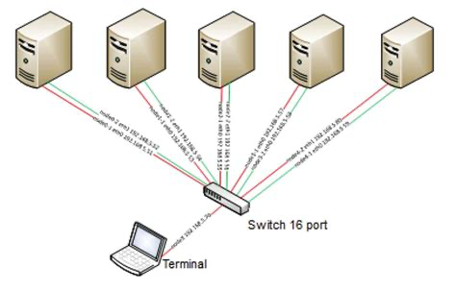
Elements Of Computer Science and Engineering
OPERATING SYSTEM:
Type of operating system: 5. Cluster System: 1. Cluster is defined as collection of items(In this case computers). 2. Has 2 components Client and Server. 3. There are 2 forms of clustering asymmetric and symmetric Cluster .

Slide 22
Elements Of Computer Science and Engineering
OPERATING SYSTEM:
Device and Resource management: Device controllers are motherboard elements that serve as an interface between the CPU and the real device. Communication With Device controller takes place through device drivers, which are operating system software components. Receiving interrupt requests and prioritizing them for transmission to the CPU are handled by a unique device known as the interrupt controller. If two or more processes have control of I/O resources and if they are unwilling to give up the resources that are needed by other processes, deadlock can occur. The operating system offers a mechanism for handling and avoiding deadlocks, and it also carries out the following tasks for device management: it keeps reverting connected to the system,provides a program called I/O controller that controls of all devices al I/O devices, and determines which processes are allowed to access to a certain device and for how long.

Slide 23
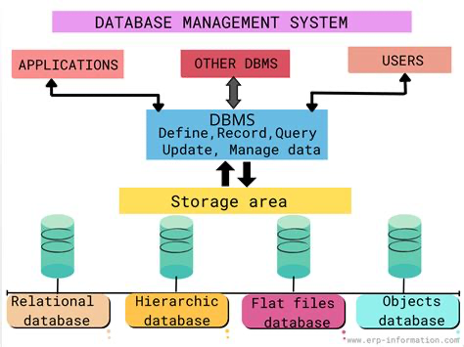
Elements Of Computer Science and Engineering
Database Management System :
Definition: Database management system (DBMS), system for quick search and retrieval of information from a Database. The DBMS determines how data is stored and retrieved. It address problems such as security, accuracy, consistency among different records, response time, and memory requirements. These issues are most significant for database systems on Computer Network. Relational DBMSs, in which data are organized into a series of tables (“relations”) that are easily reorganized for accessing data in different ways, are the most widely used.

Slide 24
Elements Of Computer Science and Engineering
Database Management System :
Data Models: Database Management systems can be classified using several different factors, including the data model, database distribution and user count. 1.Relational model 2. Distributed model 3. Hierarchical model 3. Object-oriented model 4. Network model are the most popular database models

Slide 25
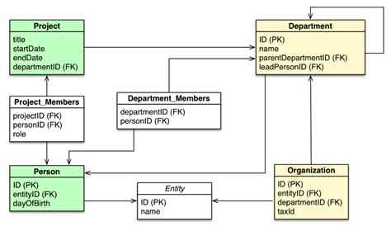
Elements Of Computer Science and Engineering
Database Management System :
Data Models: Database Management systems can be classified using several different factors, including the data model, database distribution and user count. 1.Relational model Relational databases became dominant in the 1980s. Items in a relational database are organized as a set of tables with columns and rows. Relational database technology provides the most efficient and flexible way to access structured information.

Slide 26
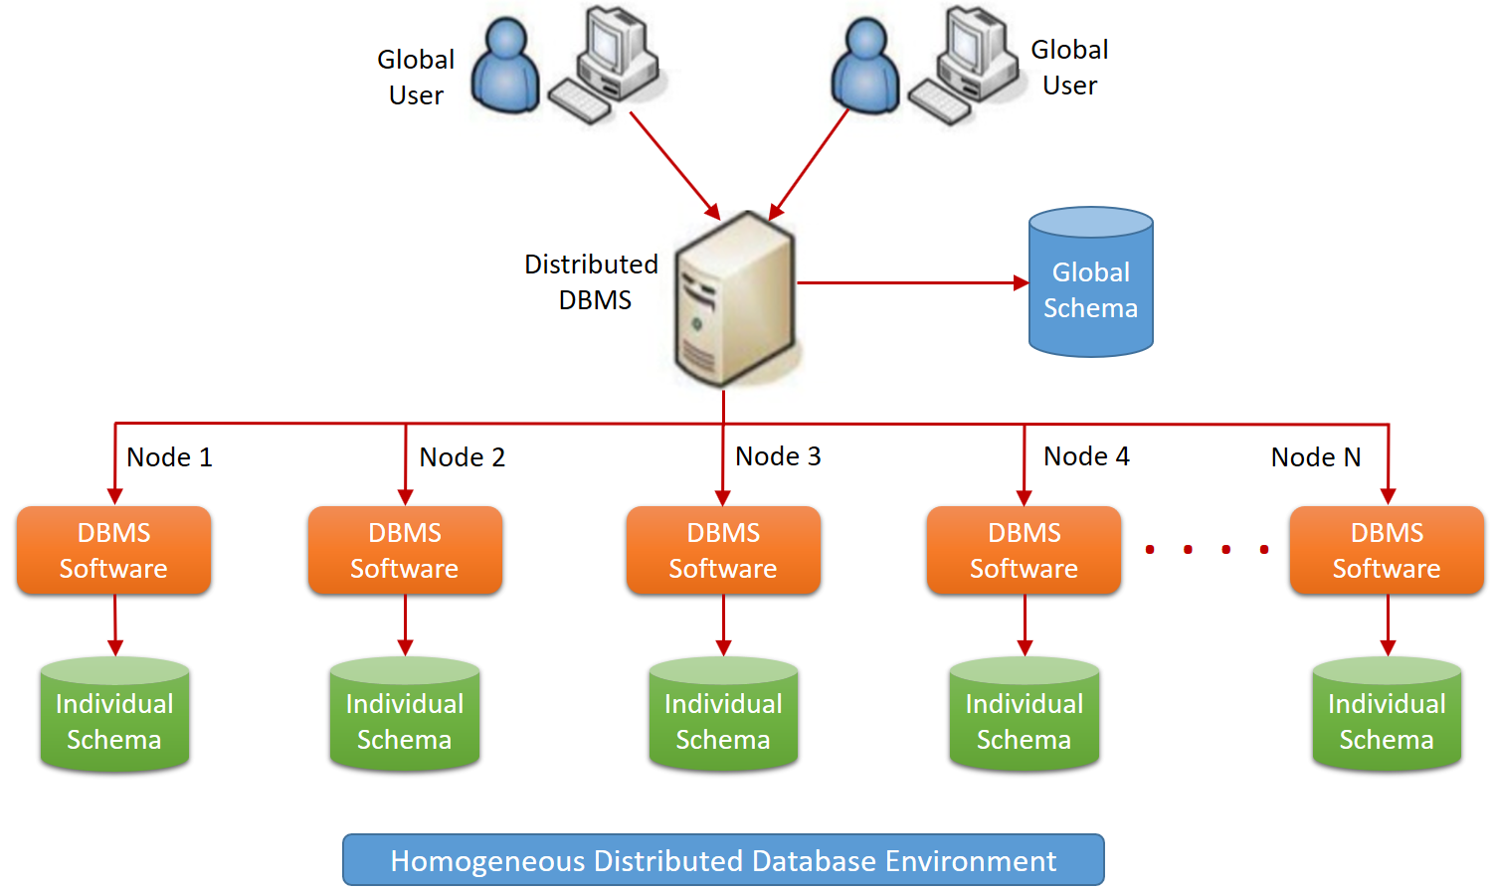
Elements Of Computer Science and Engineering
Database Management System :
Data Models: Database Management systems can be classified using several different factors, including the data model, database distribution and user count. 1.Distributed model A distributed database consists of two or more files located in different sites. The database may be stored on multiple computers, located in the same physical location, or scattered over different networks.

Slide 27
Elements Of Computer Science and Engineering
Database Management System :
Data Models: Database Management systems can be classified using several different factors, including the data model, database distribution and user count. 1.Distributed model A distributed database consists of two or more files located in different sites. The database may be stored on multiple computers, located in the same physical location, or scattered over different networks.

Slide 28
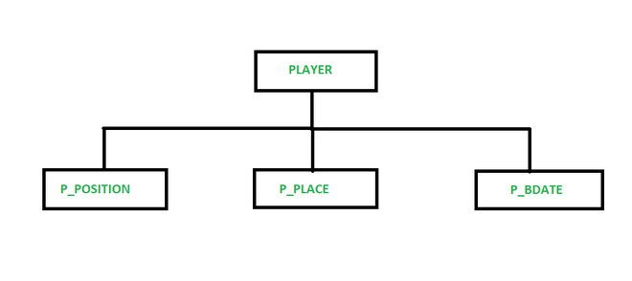
Elements Of Computer Science and Engineering
Database Management System :
Data Models: Database Management systems can be classified using several different factors, including the data model, database distribution and user count. 1.Hierarchical model This was developed by IBM in the 1950s, and it is one of the oldest data models. In a hierarchical model, data is organised as an inverted tree. Each entity has only one parent but it can have several children. At the top of the hierarchy, there is one entity, which is called the root.

Slide 29
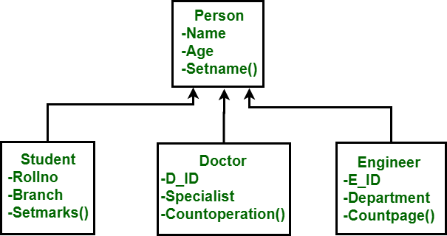
Elements Of Computer Science and Engineering
Database Management System :
Data Models: Database Management systems can be classified using several different factors, including the data model, database distribution and user count. 1.Object-oriented model This model is based on actual events. These events are depicted as objects with various attributes. These objects are all connected to one another with relations. The object-oriented data model comprises objects, attributes and methods.

Slide 30
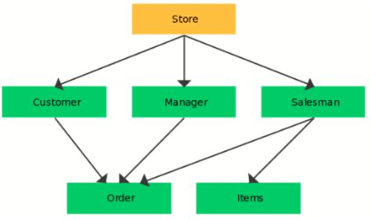
Elements Of Computer Science and Engineering
DataBase Management System :
Data Models: Database Management systems can be classified using several different factors, including the data model, database distribution and user count. 1.Network model This model is based on actual events. These events are depicted as objects with various attributes. These objects are all connected to one another with relations. The object-oriented data model comprises objects, attributes and methods.

Slide 31
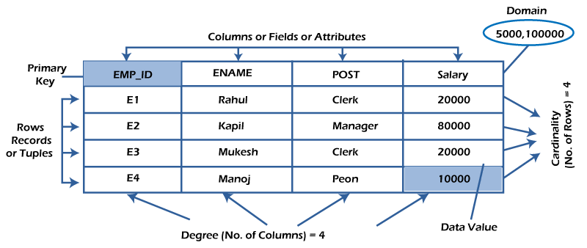
Elements Of Computer Science and Engineering
Database Management System :
Relational Database Management System(RDBMS): A relational database is a type of database that stores and provides access to data points that are related to one another. Relational database. are based on the relational model, an intuitive, straightforward way of representing data in tables. In a relational database, each row in the table is a record with a unique ID called the key. The columns of the table hold attributes of the data, and each record usually has a value for each attribute, making it easy to establish the relationships among data points.

Slide 32
Elements Of Computer Science and Engineering
Database Management System :
Relational Database Management System(RDBMS): Advantages: Each table can be altered independently without disturbing the others.
Data can be updated at a single location without making changes to several fields.
It allows for client side architecture that stores numerous users together.
It supports SQL language.
It makes it easier to store and retrieve massive amounts of data.
Disadvantages: When more data is added, more servers are needed, along with more power and memory.
A large amount of data creates complexity in understanding relationships and can affect performance.

Slide 33
Elements Of Computer Science and Engineering
Database Management System :
SQL(Structured Query Language) SQL stands for Structured Query Language SQL lets you access and manipulate databases SQL will help you to Interact with Tables.

Slide 34
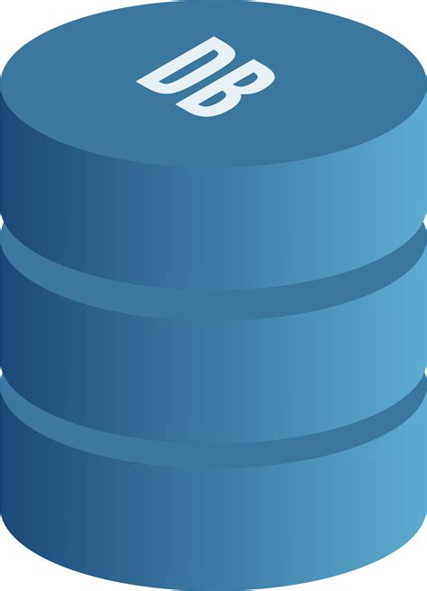
Elements Of Computer Science and Engineering
Database Management System :
SQL(Structured Query Language): SQL create database: A database is an organized collection of structured information SQL Query: The CREATE DATABASE statement is used to create a new SQL database Syntax: CREATE DATABASE databasename;
Example: CREATE DATABASE mydatabase;
mydatabase

Slide 35
Elements Of Computer Science and Engineering
Database Management System :
SQL(Structured Query Language): SQL create Table: A database table is a structure that organizes data into rows and columns – forming a grid. SQL Query: The CREATE TABLE statement is used to create a new SQL database. Syntax: CREATE TABLE table_name ( column1 datatype, column2 datatype, column3 datatype, .… );

Slide 36
Elements Of Computer Science and Engineering
Database Management System :
SQL(Structured Query Language): SQL create Table: Example: CREATE TABLE Persons ( PersonID int, LastName varchar(255), FirstName varchar(255), Address varchar(255), City varchar(255) );
PersonID | LastName | FirstName | Address | City

Slide 37
Elements Of Computer Science and Engineering
Database Management System :
SQL(Structured Query Language): Select: The SELECT statement is used to select data from a database. The data returned is stored in a result table, called the result-set. Syntax: SELECT column1, column2, … FROM table_name;
Example: SELECT * FROM table_name;

Slide 38
Elements Of Computer Science and Engineering
Database Management System :
SQL(Structured Query Language): UPDATE: The UPDATE statement is used to modify the existing records in a table. Syntax: UPDATE table_name SET column1 = value1, column2 = value2, … WHERE condition;
Example: UPDATE Customers SET ContactName = 'Alfred Schmidt', City= 'Frankfurt' WHERE CustomerID = 1;

Slide 39
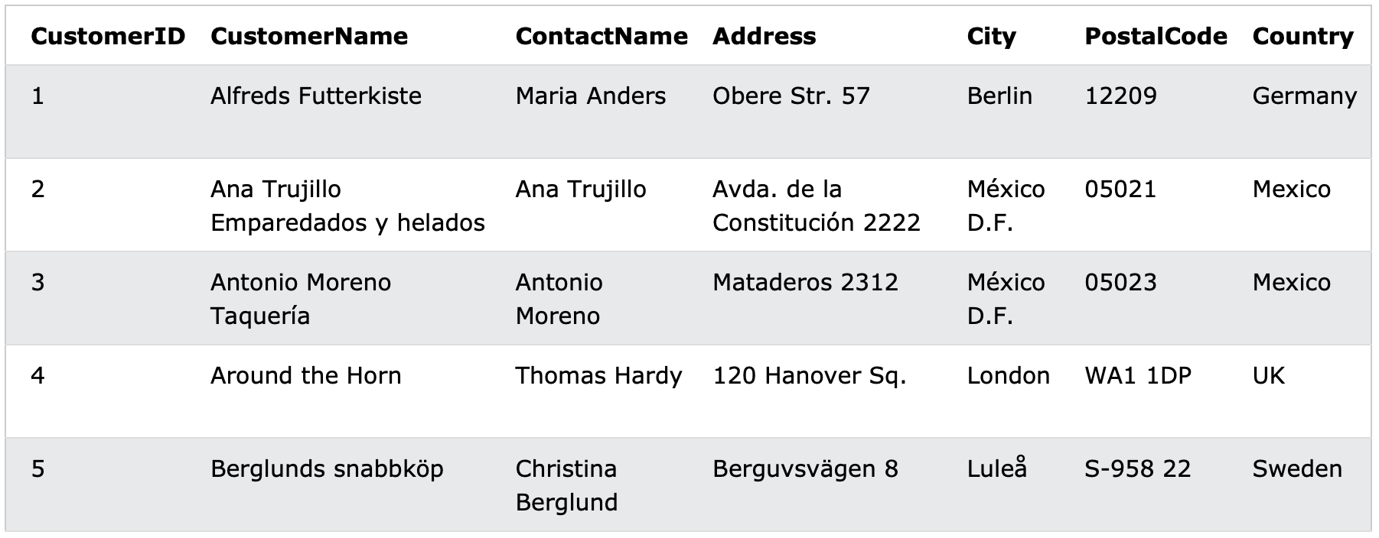
Elements Of Computer Science and Engineering
Database Management System :
SQL(Structured Query Language): UPDATE: The UPDATE statement is used to modify the existing records in a table. Before UPDATE performed;

Slide 40
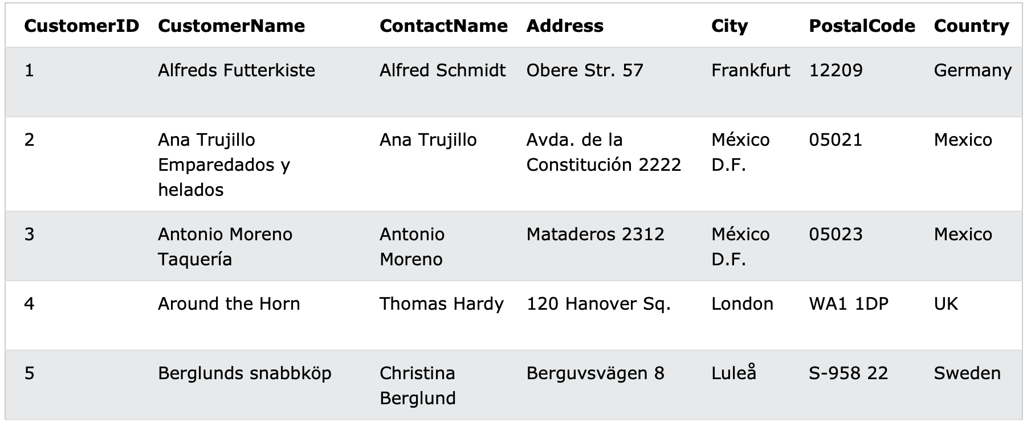
Elements Of Computer Science and Engineering
Database Management System :
SQL(Structured Query Language): UPDATE: The UPDATE statement is used to modify the existing records in a table. After UPDATE performed:

Slide 41
Elements Of Computer Science and Engineering
Database Management System :
SQL(Structured Query Language): DELETE: The DELETE statement is used to delete existing records in a table. Syntax: DELETE FROM table_name WHERE condition;
Example: DELETE FROM Customers WHERE CustomerName='Alfreds Futterkiste';

Slide 42
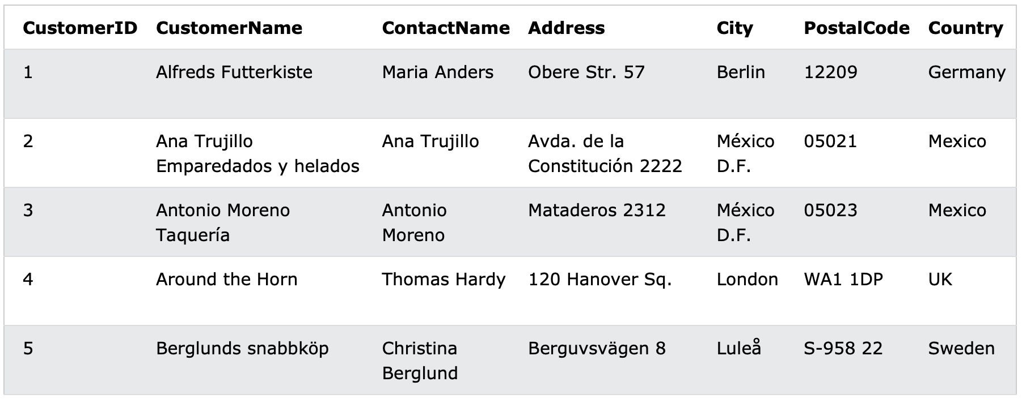
Elements Of Computer Science and Engineering
Database Management System :
SQL(Structured Query Language): DELETE: The DELETE statement is used to delete existing records in a table. Before DELETE performed:

Slide 43
Elements Of Computer Science and Engineering
Database Management System :
SQL(Structured Query Language): DELETE: The DELETE statement is used to delete existing records in a table. After DELETE performed:

Slide 44
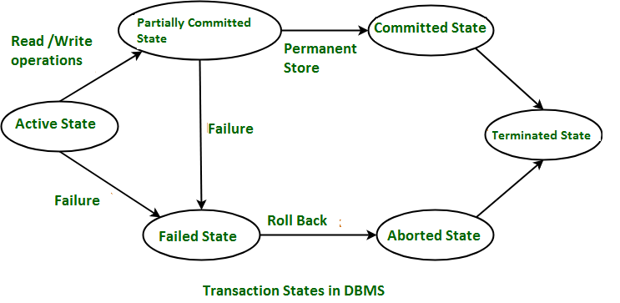
Elements Of Computer Science and Engineering
Database Management System :
Database Transactions: Why need it: Technical problems such as power failures, hardware malfunction and network instability are unavoidable. A transaction ensures that the outcome would be reliable by bringing back the original state in case of technical problems.

Slide 45
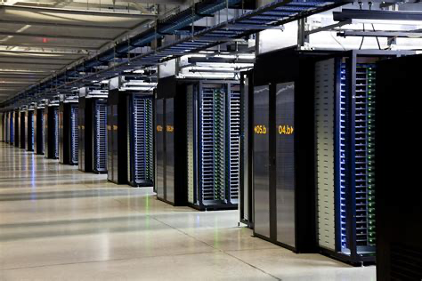
Elements Of Computer Science and Engineering
Database Management System :
DATA CENTRE: Any Organization stores and accesses its data from multiple locations,leading to inconsistency in the data. Hence, It is essential to keep the data in a centralized repository, and a data center does exactly this. A data center is a facility that centralizes an organization's shared IT operations and equipment for the storage, processing and distribution of data and applications. Data centers are essential to continuity of day to day operations. Hence the Security and reliably of Data centers is always a top priority for for any organization.

Slide 46
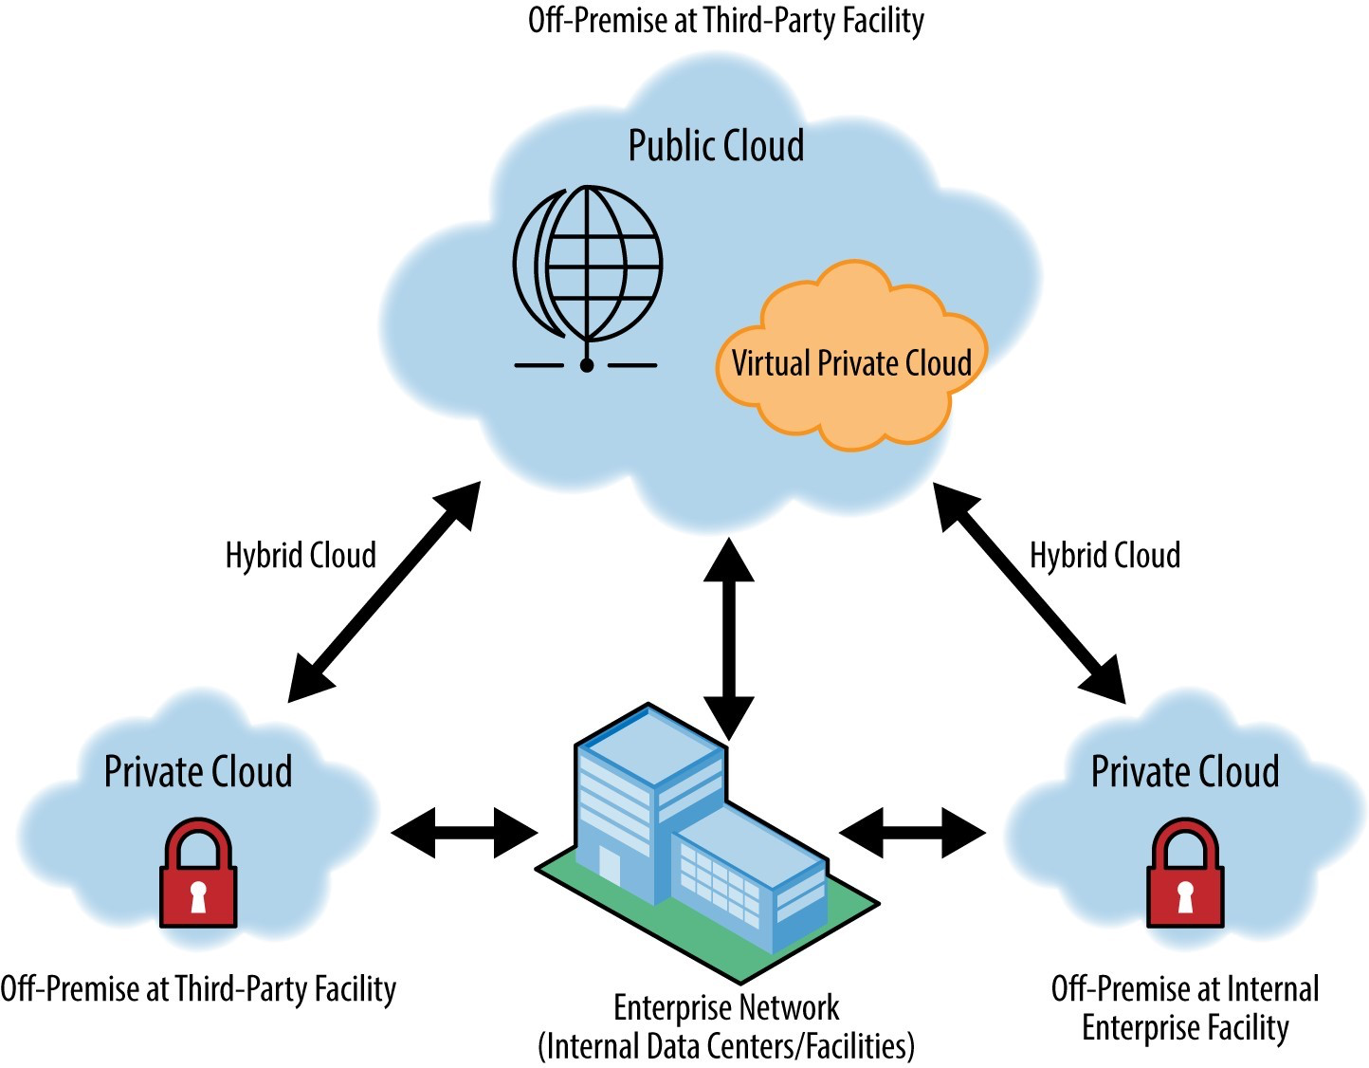
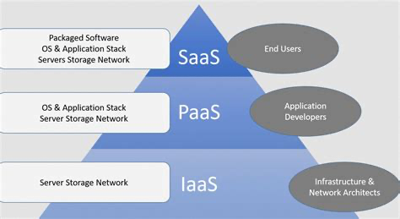
Elements Of Computer Science and Engineering
Database Management System :
CLOUD SERVICES: A cloud database service is built and accessed through a cloud platform> It servers many of the same function as a traditional database with added flexibility of cloud computing.

Slide 47
Elements Of Computer Science and Engineering
Any questions?

Slide 48
Thank you

