Slide 1
Elements Of Computer Science and Engineering

Slide 2
Elements Of Computer Science and Engineering
Course Outcomes:
Know the working principles of functional units of a basic Computer.
Understand program development, the use of data structures and algorithms in problem solving
Know the need and types of operating system, database systems.
Understand the significance of networks, internet, WWW and cyber security.
Understand Autonomous systems, the application of artificial intelligence.

Slide 3
Elements Of Computer Science and Engineering
UNIT – I: Basics of a Computer – Hardware, Software, Generations of computers. Hardware - functional units, Components of CPU, Memory – hierarchy, types of memory, Input and output devices. Software – systems software, application software.
UNIT – II: Software development – waterfall model, Agile, Types of computer languages – Programming, markup, scripting Program Development – steps in program development, flowcharts, algorithms, data structures – definition, types of data structures.
UNIT – III Operating systems: Functions of operating systems, types of operating systems, Device & Resource management. Database Management Systems: Data models, RDBMS, SQL, Database Transactions, data centers, cloud basics & services.
UNIT – IV Computer Networks: Advantages of computer networks, LAN, WAN, MAN, internet, WiFi, sensor networks, 5G communication. World Wide Web – Basics, role of HTML, CSS, XML, Tools for web designing, Social media, Online social networks.
UNIT – V Autonomous Systems: IoT, Robotics, Drones, Artificial Intelligence – Learning, Game Development,image and video processing.

Slide 4
Elements Of Computer Science and Engineering
SOFTWARE DEVELOPMENT:
The terms software and engineering combine to form the term software and engineering.
Software is a collection of integrated programs
Engineering is the use of scientific and practical knowledge to create, plan, design, build, maintain and enhance systems, procedures and other elements.
Companies use computers for inventory, sales, marketing, pay processing and communication.
Software engineering is an engineering branch related to the process of analyzing user needs and then building a software product using well-defined scientific principles, techniques and procedures.
The result of software engineering is an effective and reliable software product.

Slide 5
Elements Of Computer Science and Engineering
SOFTWARE DEVELOPMENT:
A software project is made up of a series of phases and most software projects comprise the following phases
1. Requirements gathering
2. Planning
3. Design
4. Development or coding
5. Testing
6. Deployment and maintenance

Slide 6
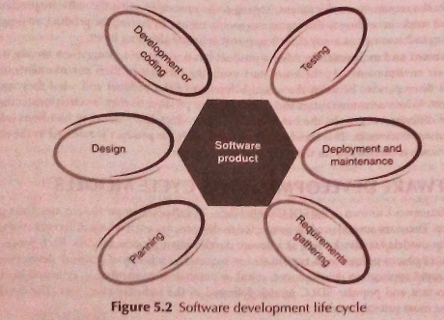
Elements Of Computer Science and Engineering
SOFTWARE DEVELOPMENT:

Slide 7
Elements Of Computer Science and Engineering
SOFTWARE DEVELOPMENT:
Waterfall model:
1. Waterfall is a very simple, easy-to-understand and universally accepted SDLC model.
2. The waterfall approach divides the project into a number of phases.Each phase is different, meaning that there are distinct boundaries(limits) between each phase
3. The project goes through a requirements gathering phase. A System Requirement Specification (SRS)document 4. is created at the end.
5. During design phase detailed design is produced in the form of a System Design Description
6. The development or coding phase where programs required to fulfill the design.
7. In the testing phase, testing is done so that there are no crashes and bugs before the project is released. This approach may be effective if there are no issues in a particular phase, moving in one direction (like a waterfall).

Slide 8
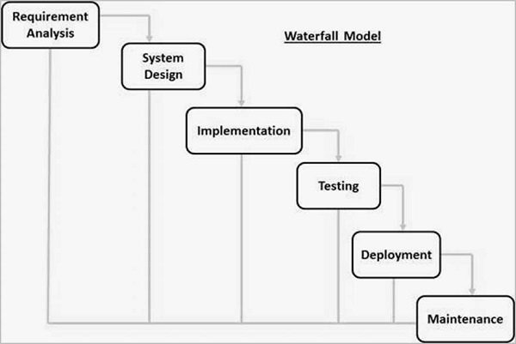
Elements Of Computer Science and Engineering
SOFTWARE DEVELOPMENT:
Waterfall model:

Slide 9
Elements Of Computer Science and Engineering
SOFTWARE DEVELOPMENT:
Waterfall model:
Though the waterfall method is easy to understand and enables requirement stability,the problem with this model is that any phase in the development process begins only if the previous phase is complete. In this model,the phases do not overlap. Another flaw in the waterfall approach is the ineffectiveness of the verification and validation processes due to the delay in feedback between phases.

Slide 10
Elements Of Computer Science and Engineering
SOFTWARE DEVELOPMENT:
Agile model:
1. The Agile development model is also a type of incremental model.
2. Software develops in incremental, rapid cycles. 3. In English, Agile means ‘the ability to move quickly and easily’ and respond to change rapidly
4. ‘the ability to move quickly and easily’ is and important aspect of Agile software development.

Slide 11
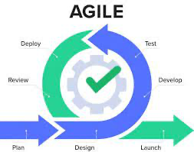
Elements Of Computer Science and Engineering
SOFTWARE DEVELOPMENT:
Agile model:

Slide 12
Elements Of Computer Science and Engineering
SOFTWARE DEVELOPMENT:
Agile model: 1. Agile come with own cons.
2. In Agile methodology the documentation is less.
3. Sometimes in Agile methodology the requirement is not very clear hence it’s difficult to predict the expected result.
4. In few of the projects at the starting of the software development life cycle it’s difficult to estimate the actual effort required.
5. Because of the ever-evolving features, there is always a risk of the everlasting project.

Slide 13
Elements Of Computer Science and Engineering
SOFTWARE DEVELOPMENT:
Types of Computer language: 1. Low level language. 2. Assembly level language. 3. High level language.

Slide 14
Elements Of Computer Science and Engineering
SOFTWARE DEVELOPMENT:
Types of Computer language: 1. Low level language. i. Written on only 0’s and 1’s. ii. Only Processor can understand it. iii. It has 2 parts operation part and data part. iv. Operation part represents the operation like addition, multiplication etc.. v. Data part represents the data part.

Slide 15
Elements Of Computer Science and Engineering
SOFTWARE DEVELOPMENT:
Types of Computer language: 2. Assembly level language: i. Uses Symbolic representation ii. It is simpler and easy to understand when compared with machine level language iii .Uses english based symbols like ADD-for addition, SUB-subtraction etc..

Slide 16
Elements Of Computer Science and Engineering
SOFTWARE DEVELOPMENT:
Types of Computer language: 3. High level language: i. Written in various languages like c, python , Java , Rust etc.. ii. It is simpler and easy to understand when compared with machine level language and assembly level language iii. Uses syntax and grammar based rules to to perform operation

Slide 17
Elements Of Computer Science and Engineering
SOFTWARE DEVELOPMENT:
Program Development: Steps in program development i. Problem definition:Understanding the problem and how to solve it. ii. Problem analysis: Logic implementation, what is input and expected output iii. Algorithm development: Flow chart are used to break down the problem iv. Coding: Use of any programing language to implement logic v. Testing and debugging: finding errors and correcting them vi. Documentation and maintenance: Internal documentation to explain how was the problem solved

Slide 18
Elements Of Computer Science and Engineering
SOFTWARE DEVELOPMENT:
Program Development: Flow chart : They are nothing but the graphical representation of the data or the algorithm for a better understanding of the code visually. It displays step-by-step solutions to a problem, algorithm, or process.

Slide 19
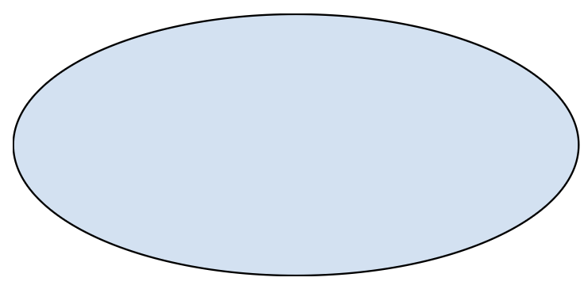
Elements Of Computer Science and Engineering
SOFTWARE DEVELOPMENT:
Program Development: Flow chart :
Name | Symbol
Terminal Box -start /End
Input / Output

Slide 20
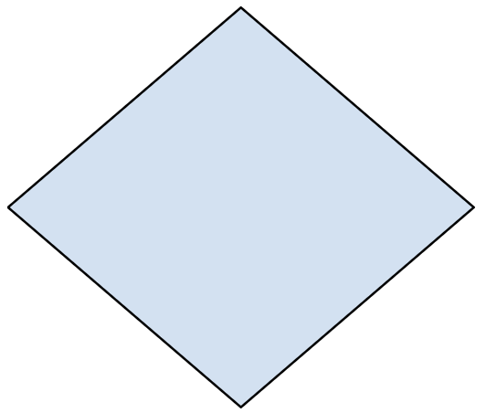
Elements Of Computer Science and Engineering
SOFTWARE DEVELOPMENT:
Program Development: Flow chart :
Name | Symbol
Process / Instruction
Decision
Connector / Arrow

Slide 21
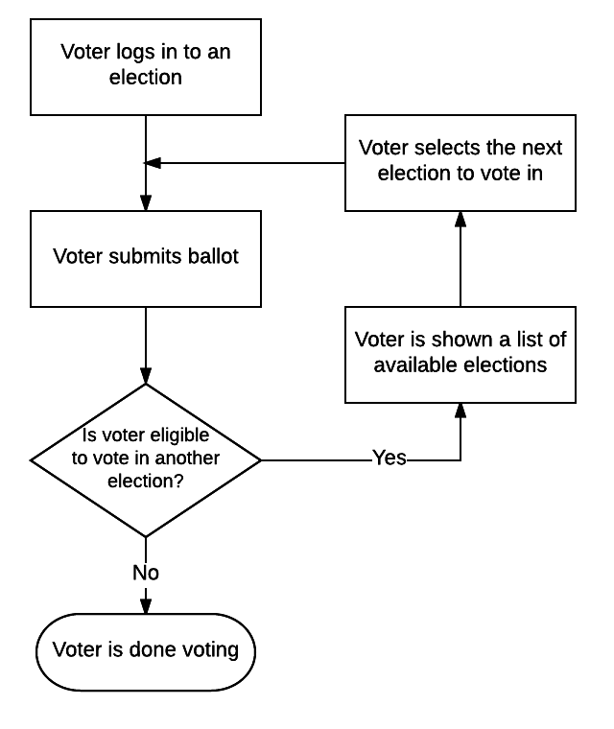
Elements Of Computer Science and Engineering
SOFTWARE DEVELOPMENT:
Program Development: Flow chart : Flowchart to find if a person is eligible to vote or not.

Slide 22
Elements Of Computer Science and Engineering
SOFTWARE DEVELOPMENT:
Program Development: Algorithm: The word Algorithm means ” A set of finite rules or instructions to be followed in calculations or other problem-solving operations ” Or ” A procedure for solving a mathematical problem in a finite number of steps that frequently involves recursive operations”.

Slide 23
Elements Of Computer Science and Engineering
SOFTWARE DEVELOPMENT:
Program Development: Data Structure : Data structures are building blocks of a program or software. A program is created by combining algorithms and data structure. A data structure is a method of systematically storing data so that it can be easily created, accessed , and managed. This collects data values, their relationship and the operations that can be performed on the data.

Slide 24
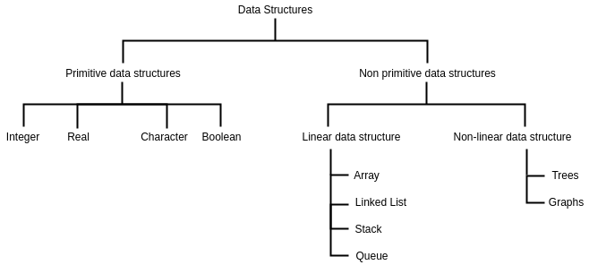
Elements Of Computer Science and Engineering
SOFTWARE DEVELOPMENT:
Program Development: Types of Data Structure :

Slide 25
Elements Of Computer Science and Engineering
Any questions?

Slide 26
Thank you

