Slide 1
Chapter -4 Cloud Licensing & Major Players

Slide 2
Topics:
Introduction
Cloud Data Centre
Moving into the Cloud
Issues in Cloud
Know Your Software License
Service Levels for Cloud Applications
Major Players in Cloud Computing
Eucalyptus
Nimbus
Open Nebula
Cloud Sim

Slide 3
4.1 INTRODUCTION
Cloud computing is the liberation of computing as a service instead as a product.
In this distributed resources, software as well as information provided to computers and several other devices as a utility over a network.
Public, private and hybrid are the different types of cloud. Supervising licenses is not an easy task.

Slide 4
Continue…
It demands administrators to analyze simultaneous licensing models, user accounts, and different levels of licensing for a particular product as well as upgrade paths for further software packages.
Once Cloud computing is on the site, technology has altered drastically when compared to other licensing structures.

Slide 5
4.2 CLOUD DATA CENTER
A data center is a service used for residential computer systems as well as its associated elements such as storage systems and telecommunications.
It usually comprises of backup power supplies, environmental controlling factors like fire suppression and air conditioning and different security devices.
Data centers used for Cloud computing are known as Cloud Data Centers (CDCs).

Slide 6
4.2.1 Requirements
Self service on need
Resource pooling
Quick elasticity
Precise usage
Broad Network Access

Slide 7
4.2.2 Comparing Traditional and Cloud Data Center
In case of traditional data center, servers are co-located and dependent failure where as in case of Cloud servers are integrated and fault-tolerant.
Resources in traditional data center are partitioned and performance interrelated but in Cloud they are unified and performance isolated
Management in traditional data center is segregated and manual where as in case of Cloud the management is centralized full control with automation.

Slide 8
Continue…
Scheduling is plan ahead and over provisioning in traditional data center, but in case of Cloud it is flexible and scalable.
Renting in traditional data center is based on per physical machine where as in case of Cloud we observe renting is per logical usage.
Applications and services are fixed on designated servers in traditional data center where as in case of Cloud, it executes and moves across all virtual machines.

Slide 9
4.3 MOVING IN TO THE CLOUD
Technology is not a silver bullet as it needs execution of project basics such as business alignment, requirements, technical requirements and user acceptance.
Technology demands focus for highest benefits such as process improvement, change management, solid leadership as well as best practices expertise.
In case of traditional IT delivery, business feels restricted by IT. But in case of Cloud focused IT delivery business and IT craft value together, distributed focus and goals along with new business models.

Slide 10
4.3.1 Comparison of Traditional Computing and Cloud Computing
In traditional computing, we can purchase assets and build technical architecture where as in Cloud computing, we can purchase service and architecture is included.
In traditional computing, we can pay for assets and high admin functions, whereas in Cloud computing, we can pay for use and decreased admin functions.

Slide 11
Continue…
Single tenant, non distributed and static environment is observed in traditional computing, where as in Cloud computing multiple tenant, scalable, elastic and dynamic environment is observed in Cloud computing.
Deployments in traditional computing are costly and lengthy where as in Cloud computing reduced deployment time is found.

Slide 12
4.3.2 Benefits of Cloud Computing
Cloud increases the focus on business issues and allows for scalable, enterprise-class complexity.
Cloud computing offers a rich ecosystem of vendors and service providers.
Cloud platforms are scalable, secure and enterprise.
Cloud web services focus creates powerful integrations.
Since Cloud computing has the above advantages over traditional computing, the entire businesses are transforming to Cloud computing.

Slide 13
4.4 ISSUES IN CLOUD COMPUTING
Cloud computing is a technology which allows the user to access resources by means of front end machines, there is no requirement to install any software.
There are several challenges related to Cloud computing, which are discussed as follows:
Security issues
Data issues
Performance issues
Design issues
Reliability
Legal issues

Slide 14
4.4.1 Security Issues
Security is usually alleged as a big issue for the Cloud.
There is a risk where a malicious user can pierce the Cloud by imitating a legitimate user, thereby contaminating the whole Cloud thus affects several customers who are distributing the infected Cloud.

Slide 15
Continue…
Some of the security risks faced by the Cloud computing are discussed as follows:
Data integrity
Data theft
Security on vendor level
Security on user level
Information security

Slide 16
4.4.2 Data Issues
Some of the problems faced by data are as follows:
Data loss
Data location
Data lock-in
Data Segregation
Data confidentiality and audit ability
Data integrity and theft
Data deletion
Data restitution
Service level agreements

Slide 17
4.4.3 Performance Issues
Bad application performance leads companies to deplete its customers, decreases employee productivity as well as it reduces bottom line profits.
Application clashes due to bad performance. If applications cannot effectively perform due to rise in traffic, businesses and loss of customers.

Slide 18
Continue…
The following are the performance issues:
Poor application performance
Slow access to applications and data
Horizontal and vertical scalability
Administrative and geographical scalability

Slide 19
4.4.4 Energy Related Issues
Cloud computing is rapidly increasing in significance as growing numbers of enterprises as well as individuals are moving their workloads to Cloud service providers.
Services presented by Cloud providers, i.e. Microsoft, Google and IBM are executed on thousands of servers extend across several geographically shared data centers.

Slide 20
4.4.5 Fault Tolerance
Fault tolerance is one of the significant challenges of cloud computing.
Fault tolerance is related to all the techniques required to allow a system to bear software defects.

Slide 21
4.5 KNOW YOUR SOFTWARE LICENSES
Software licensing is motivated by the vendors like Amazon. Licensing models in the Cloud are frequently pay-as-you-go as well as subscription based licenses.
The well known case is the Salesforce.com which is licensed, based on the number of users on a subscription point of view.
This model proceeds well for a complete integrated service or when restoring an existing software output.

Slide 22
Continue…
If the organization has shifted to Cloud environment, then it must know the applications and licensing models that are used in the Cloud computing environment.
Microsoft has built a committed software license model for Cloud service providers depending on the PL i.e Processor License, or SAL i.e Subscription Access License depending on the number of end users associated.

Slide 23
Continue…
Both PL and SAL are approved on a periodical basis to service providers.
IBM presents a long term or an hourly payment billing plan.
The following factors are considered when several licensing models are offered in the Cloud:
The amount of users using the software.
The processors count of the device hosting the application
Products accessing rights are restricted to particular vendors for Cloud computing platforms. For example, Oracle possesses its specific set of rules.

Slide 24
4.6 SERVICE LEVELS OF CLOUD APPLICATIONS
A service Level Agreement (SLA) is an element of a service agreement in which a service is properly described.
In general, the word SLA is used to denote the contracted delivery period.
SLA is a contract between two or more parties, in which customer and service providers are included.
This includes formal and informal contracts.

Slide 25
Continue…
Agreements between service providers and other parties are frequently called as SLAs because the service level has been placed by the customer, there can be no contract between third parties.
These kind of agreements is simply known as “contracts”.

Slide 26
4.6.1 Common Metrics
Metrics commonly arranged to in these cases are as follows:
ABA (Abandonment Rate): proportion of calls discarded while waiting to be responded.
ASA (Average Speed to Answer): Average time it takes for a call to be replied by the service desk.
TSF (Time Service Factor): Fraction of calls answered within a particular timeframe, e.g., 90% in 25 seconds.
FCR (First-Call Resolution): Fraction of incoming calls that can be resulted without the use of a call back to finish resolving the case.
TAT (Turn-Around Time): Time taken to finish a particular task.
MTTR (Mean Time To Recover): Time taken to recuperate after an outage of service.

Slide 27
4.6.2 Cloud Computing
The primary advantage of cloud computing distributes resources, which is maintained by the basic nature of a distributed infrastructure platform.
Thus, SLAs spread across the Cloud and are presented by service providers as a service oriented contract than a customer oriented agreement.
Calculating, examining as well as reporting on Cloud performance depends upon the user practice or ability to utilize resources.

Slide 28
Continue…
The drawback of Cloud computing, comparative to SLAs, is the complexity in finding the basic cause for service intrusions due to the difficult nature of the environment.
SLAs for Cloud services concentrate on features of the data center as well as the network characteristics to maintain end-to-end SLAs.
In case of SLA management approach, two well differentiated stages are involved.

Slide 29
Continue…
One is the contract negotiation and the other is the monitoring of its execution in real-time.
Therefore, SLA management covers the SLA contract definition, SLA negotiation, SLA monitoring and SLA implementation based on the defined policies.
The objective is to construct a new layer upon the grid and Cloud which is capable of creating a negotiation mechanism between service providers and consumers.

Slide 30
4.6.3 Service Levels
The following are the service levels of Cloud computing.
SaaS:
The highest level of software applications is only available in Software-as-a-service (SaaS).
E-mail is a simple example for SaaS.
If you have an IP (Internet Provider), then you will require a desktop or mobile app to access the e-mail, if not host it on the individual servers.
The client has a limited control of user specific application configuration settings.

Slide 31
Continue…
PaaS:
In between SaaS and IaaS, Platform-as-a-Service is included.
In this service level, the merchant takes responsibility of the underlying infrastructure by providing the platform with which we have to build and host the application.
Some industries feel that PaaS service level is the most powerful among the three levels.
The client has the control over the deployed apps as well as possibly configuration settings for the application hosting platform.

Slide 32
Continue…
IaaS:
On the contrary end of the spectrum, Infrastructure-as-a-service is present, where you can outsource the hardware.
It is not just the machine power that you lease, it also posses power, networking as well as cooling.
In general, Iaas is the blend of compute and Cloud storage.
The client has power over operating systems, storage space, deployed apps as well as possibly restricted power of select networking elements.

Slide 33
4.7 MAJOR PLAYERS IN CLOUD COMPUTING
Cloud computing is being encouraged by several big companies.
In Cloud computing, an application can be executed on various computers.
Cloud has become the vital technology to overcome the market needs which is the reason for many of the companies to shift towards the Cloud.

Slide 34
Continue…
The following are the major players of the Cloud computing environment.
Google
Microsoft
Amazon
Apple
Adobe
Cisco
Others

Slide 35
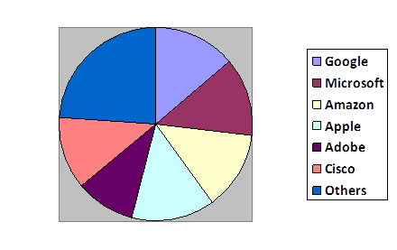

Slide 36
4.8 EUCALYPTUS
Eucalyptus is an open source and unrestricted computer software for constructing Amazon Web Services (AWS).
Eucalyptus is well-suited for private and hybrid cloud computing environments which is promoted by the Eucalyptus Systems.
Eucalyptus allows pooling storage, computations and network properties, which are dynamically scaled up or down as application assignments alters.
Eucalyptus Systems maintains an official agreement with AWS in March 2012 to sustain compatibility.

Slide 37
Continue…
In the word EUCALYPTUS, the letter E stands for Elastic, U for Utility, C for Computing, A for Architecture, L for Linking, Y for Your, P for Programs, T for To, U for Useful, S for Systems.
At this point, we have to be familiar about Amazon Web Services (AWS).
AWS is a pool of remote computing facilities or web services that forms a cloud computing platform.

Slide 38
Continue…
AWS is accessible over the internet through Amazon.com which is officially launched in 2006.
Amazon EC2 (Elastic Compute Cloud) and Amazon S3 (Simple Storage Service) are the fundamental services of Amazon.
These services offer huge computing servers more rapidly and inexpensively than constructing a server farm or cluster.

Slide 39
4.8.1 History
The advancement of software begins with the origin of the project i.e. virtual grid application development at Rice University and additional institutions from the year 2003 to 2008.
Eucalyptus software was integrated with the Ubuntu 9.04 version in the year 2009.
The company was developed in 2009 with $5.5 million to commercialize the software.

Slide 40
Continue…
Eucalyptus 3.3 presents innovative features for AWS compatibility.
It includes resource tagging, which permits application architect and administrator of the cloud to allocate customizable metadata tags to resources like load balancers, firewalls, web servers and distinct workloads in order to distinguish them.
Eucalyptus 3.3 maintains a wide set of instance types to directly align instance types in Amazon EC2.

Slide 41
Continue…
Eucalyptus 3.3 consists of a new maintenance mode that permits cloud administrators to execute maintenance on.
Eucalyptus clouds without any downtime to instances or applications in the cloud.
Eucalyptus 3.3 includes new user console structures such as a magic search bar and a straight forward option to allow users to alter their password.

Slide 42
Continue…
Eucalyptus 3.4, released on 24th October 2013, includes latest features forms an improved image management and migration tools, capability for warm upgrades, user console of a hybrid cloud to accomplish AWS resources and Eucalyptus, IAM (Identity and Access Management) responsibilities and enhanced High Availability (HA) experiences.

Slide 43
4.8.2 Release History
Eucalyptus 1.6 released on November 2009.
Eucalyptus 2.0 released on August 2010.
Eucalyptus 3.0 released on February 8, 2012.
Eucalyptus 3.1 released on June 27, 2012.
Eucalyptus 3.2 released on December 19, 2012.
Eucalyptus 3.3 released on June 18, 2013.
Eucalyptus 3.4 released on October 24, 2013.

Slide 44
4.8.3 Overview
Eucalyptus is an explanation that permits the installation of a private and hybrid cloud infrastructure.
It's coded in Java, Python and C languages with a central Storage Controller walrus and controllers on each node.
The network is directed by the component i.e. Cloud Controller. Each controller is authenticated by SSH key files and authenticates the transactions.
Eucalyptus scalability is restricted, when compared to the huge scalability.
The Amazon version EC2 works on the Eucalyptus platform.

Slide 45
4.8.4 Goals of Eucalyptus
Promote greater understanding and uptake of cloud computing.
Testing the vehicle, prior to buying commercial services.
Standardize local IT environment with public cloud.
Provide a fundamental software development environment for the open source community.

Slide 46
4.8.5 Eucalyptus Architecture
Eucalyptus commands deal with either Amazon or Eucalyptus instances.
Users can navigate instances between a Eucalyptus private cloud and the Amazon Elastic Compute Cloud (EC2) to build a hybrid cloud.
Hardware virtualization segregates applications from computer hardware.

Slide 47
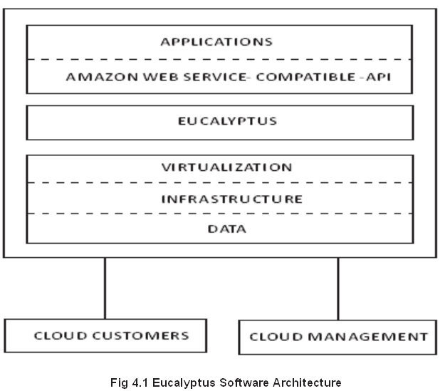

Slide 48
4.8.6 Eucalyptus Terminology
Images:
An image is a static collection of application software, system software, configuration information and software components that are initiated from an identified baseline which is permanent or unchangeable.
The image changes to an EMI (Eucalyptus Machine Image), when the image is packed and uploaded to the Eucalyptus cloud.

Slide 49
Continue…
Instances:
When an image is set to use, then it is known as an instance.
The configuration is computed at runtime and the Cloud Controller determines the location where the image will execute and networking along with storage is prompted in order to meet resource requirements.

Slide 50
Continue…
IP addressing:
Instances of Eucalyptus can acquire private and public IP addresses.
An IP address is allocated to an instance, as soon as the instance is formed from an image.
Eucalyptus supplies elastic IP addresses for instances that need a constant IP address, for example a web-server.
The Eucalyptus cloud pre-allocates the elastic IP addresses and can be reallocated to an executing instance.

Slide 51
Continue…
Security:
TCP/IP security clusters distribute a general set of firewall rules.
This is a technique to lock a firewall in an instance by means of IP address and ports allow or block functionality.
At TCP/IP layer two instances are isolated.
If the two layers are not available, then the user can control the networking of instances and get access to adjacent instances by disobeying the fundamental cloud principle of instance segregation.

Slide 52
Continue…
Networking:
There are three modes of networking.
In a managed mode, Eucalyptus supervises a local network of instances, which comprises of IP addresses and security groups.
In a system mode, Eucalyptus allocates a MAC address.
Through the bridge of Node Controller, Eucalyptus appends the interface of the instance network to the physical network.
It does not provide VM isolation, elastic IP addresses or security groups.
In a static mode, Eucalyptus allocates IP addresses to instances.
This mode does not present security groups, VM isolation, or elastic IP addresses.

Slide 53
Continue…
Access Control:
The user of Eucalyptus is allotted an identity.
These identities can be clustered collectively for access control.

Slide 54
4.8.7 Eucalyptus Components
To know about the Eucalyptus components.
observe the following figure 4.2. Eucalyptus contains six components:
CLC (Cloud Controller):
CLC is a Java program that provides EC2 compatible interfaces and a web interface to the external world.
Besides managing incoming requests, the CLC performs like the administrative interface for cloud maintenance and executes great level of resource scheduling and accounting of the system.

Slide 55
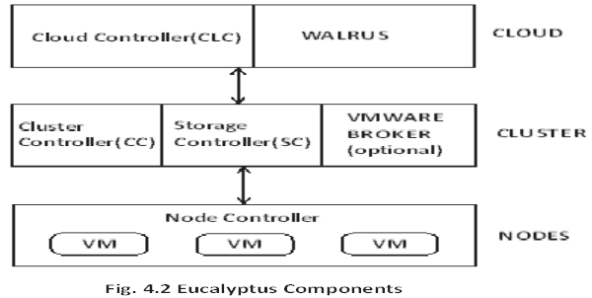

Slide 56
Continue…
The CLC recognizes user API requests from command line interfaces such as GUI based tools like the Eucalyptus user console or Euca tools, which controls the underlying storage, compute and network resources.
There exists one CLC per cloud which handles accounting, authentication, quote management and reporting.

Slide 57
Continue…
Walrus:
Walrus is the Eucalyptus equivalent to AWS S3 (Simple Storage Service).
It is also coded in Java.
Walrus provides persistent storage to all the virtual machine components in the Eucalyptus cloud.
This persistent storage can be utilized as a simple HTTP get or put storage space as a service solution.
There are no limitations to the data types of Walrus which contains application data, volume snapshots and images i.e.
the elementary block used to initiate virtual machines.
There exists only one Walrus for each cloud.

Slide 58
Continue…
Cluster Controller (CC):
The CC is coded in C language.
It works as the front end for a Eucalyptus cloud cluster and converses with the Storage Controller along with Node Controller.
It supervises SLAs (Service Level Agreements) and instance (i.e. virtual machines) execution for each cluster.
The subsequent figure 4.3 shows eucalyptus VM instance.

Slide 59
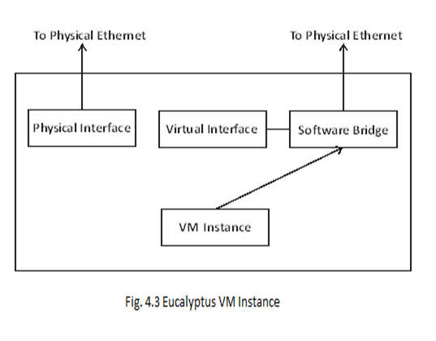

Slide 60
Continue…
Storage Controller (SC):
The Storage Controller (SC) Walrus, is the Eucalyptus equivalent to AWS EBS and is written in Java.
It interacts with the Cluster Controller along with Node Controller (NC) and supervises Eucalyptus snapshots and block volumes to the instances within its particular cluster.
If an instance needs scripting persistent data to the cluster external memory, it must notify to Walrus, which is accessible to every instance in any cluster.

Slide 61
Continue…
VMware Broker:
The VMware Broker is a component which is optional that offers an AWS compatible interface for VMware platforms.
It actually executes on the Cluster Controller. The VMware Broker covers existing ESX/ESXi hosts and converts Eucalyptus Machine Images to VMware virtual disks.
The VMware Broker decides the interactions between the Cluster Controller and VMware. The VMware Broker can associate directly to either vCenter Server or ESX/ESXi hosts.

Slide 62
Continue…
Node Controller (NC):
The Node Controller hosts the virtual machine instances and supervises the virtual network endpoints.
It is coded in ‘C’ language. In addition to creating and caching instances, NC also downloads and caches images.
Performance limits exist, although the hypothetical limit to the quantity of Node Controllers for each cluster does not exist.

Slide 63
4.8.8 Mechanism
The cloud components, such as Cloud Controller (CLC) and Walrus, interact with cluster controllers such as cluster and storage units.
The cluster components sequentially connect with the Node Controllers (NCs).
The networks between the machines hosting the components must be capable of allowing TCP connections between them.

Slide 64
Continue…
If the Cluster Controllers are on individual network interfaces, then the Cluster Controllers will work as software routers between these networks in various network configurations.
Therefore, every cluster can utilize an interior private network for its NCs and the Cluster Controllers will direct traffic from that network to another network distributed by the components.
Virtual Machines (VMs) work on the machines that host Node Controllers.

Slide 65
Continue…
The Cluster Controllers can act as software routers for traffic between the client exterior to the Eucalyptus and VMs.
The VMs can utilize the routing framework without Cluster Controller software routers. Based on the layer-2 segregation features of the existing network, it is possible to implement all the security features maintained by Eucalyptus.

Slide 66
4.8.9 Compatibility of Eucalyptus with Amazon EC2
Eucalyptus is a private cloud computing environment that employs the Amazon specifications for Amazon EC2 i.e.
Elastic Compute Cloud and Amazon S3 i.e. Simple Storage Service.
Eucalyptus satisfies the Amazon API syntax and tool suite with minor exceptions.
Eucalyptus is compatible with Amazon Web Services by providing interfaces such as REST and SOAP.
For the purpose of management and maintenance, Eucalyptus performs administrative functionalities such as user storage, network maintenance, configuration, hypervisor and user management.

Slide 67
Continue...
The main goal is to present an open source software tool for community sharing which is highly scalable and extensible.
Eucalyptus 3.3 was released in June, 2013. Eucalyptus 3.3 includes a new series of AWS compatible tools which are as follows:
Auto scaling:
Auto scaling permits developers of the application to level up or down the Eucalyptus cloud resources in order to sustain performance and meet Service Level Agreements (SLAs).

Slide 68
Continue…
Through auto scaling, developers can include instances and virtual machines, based on the requirements.
Eucalyptus auto scaling policies are determined using Amazon EC2 suitable APIs and tools.

Slide 69
Continue…
Elastic Load Balancing:
It is a service that shares incoming traffic of the application and service calls across several Eucalyptus workload instances by providing greater application fault tolerance.

Slide 70
Continue…
Cloud Watch:
Cloud watch is a monitoring tool analogous to Amazon cloud watch that supervises resources and applications in Eucalyptus clouds.
Through cloud watch, application developers can position the alarms, recognize the trends which may endanger workload functions and take action to make sure that their application continues to work smoothly.

Slide 71
Continue…
Eucalyptus 3.3 is the foremost private cloud environment to support Netflix open source tools which include Edda, Asgard and Chaos Monkey by means of its API reliability with Amazon Web Service (AWS).

Slide 72
4.8.10 Functionality
The Eucalyptus user console presents an interface for users to compute and configure.
Testing teams and development teams can supervise virtual instances using encryption abilities and built-in key management.
Remote Desktop (RDP) mechanism is used to access the virtual machines.
Eucalyptus can perform several versions of operating system virtual machine images such as Linux

Slide 73
Continue…
Users are capable of constructing Eucalyptus Machine Image (EMI) libraries with application metadata.
Amazon Machine Images are well suited for Eucalyptus clouds. VMware apps and images are transformed to execute on Eucalyptus cloud and Amazon Web Service public clouds.
Eucalyptus user identity maintenance is incorporated with the existing Microsoft LDAP (Light weight Directory Access Protocol) or Active Director (AD) systems.

Slide 74
Continue…
Eucalyptus maintains storage area network devices to get benefit of storage arrays to develop performance and consistency.
EMI can be supported by Elastic Block Storage (EBS) such as persistent storage volumes, developing the performance of image initiating time and allowing complete persistent virtual machine instances.
It also supports direct attached storage.

Slide 75
4.9 NIMBUS
Nimbus is a toolkit, if installed once on a cluster, it offers an IaaS Cloud to its client through Amazon EC2 web service Application Programming Interfaces (APIs).
It is a free as well as an open source software, focus on the needs of the Apache license, version2.
Nimbus maintains both the hypervisors and virtual machine schedulers.

Slide 76
Continue…
It permits setting up of self-configured virtual clusters through contextualization
Nimbus is organized in such a way of supporting scheduling, network renting as well as utilization accounting

Slide 77
4.9.1 Goals
It should allow providers to construct Clouds.
It should allow users to access Cloud computing.
It should allow developers to experiment with Nimbus

Slide 78
4.10 OPEN NEBULA
Open Nebula is an alternative cloud solution and open source software under Apache license version2.
It is coded in C++, Ruby and Shell programming languages.
The network is actually directed by the administrator. It maintains authentication through LDAP (Light weight Directory Access Protocol).
Open Nebula, which is the suggested platform in Europe, is developed by a Spanish company and is feasible for data centers and private clouds.

Slide 79
4.10.2 History
Open Nebula 1.0 for data center and cloud solutions, released on 24th, July, 2008.
Open Nebula 1.2 released on 16th, February, 2009.
Open Nebula 1.4 released on 16th, December, 2009.
Open Nebula 2.0 released on 24th, October, 2009.
Open Nebula 2.2 released on 28th, March, 2011.

Slide 80
Continue…
Open Nebula 3.0 released on 3rd, October, 2011.
Open Nebula 3.2 released on 17th, January, 2012.
Open Nebula 3.4 released on 10th, April, 2012.
Open Nebula 3.6 released on 9th, July, 2012.
Open Nebula 3.8 released on 22nd, October, 2012.
Open Nebula 4.0 released on 8th, May, 2013.
Open Nebula 4.2 released on 27th, August, 2013.

Slide 81
4.10.3 Objectives
The Open Nebula follows specific objectives in order to achieve advancement in the cloud data centre management of an enterprise class.
The objectives of Open Nebula are as follows:
Develops the most sophisticated, highly extensible and flexible solution for constructing and maintaining virtualized data centres along with enterprise clouds.
Presents cloud builders as well as integrators with a modular system that can perform a diversity of cloud architectures.
Capable of interfacing with any of the data centre services.

Slide 82
Continue…
Presents cloud developers and users with an option of a system and cloud interfaces in order to support the formation of a top level component ecosystem.
Guarantees the software distribution stability and quality.
Collaborate with the most challenging cloud users and management tools of data centre.
Extends the awareness of the project.
Maintains the users and developers community related to the project.

Slide 83
Continue…
Maintains the open source component ecosystem which is formed around the project.
Works together with innovative open source projects and communities.
Works together with the major research projects in the arena of advanced cloud computing.

Slide 84
4.10.4 Key Features of Open Nebula
The fundamental features of Open Nebula allow private, public and hybrid clouds for the entire management of virtualized data centres. Open Nebula functionalities include:
Consistency.
Effectiveness.
Immense scalability.
Simple integration and extensions.
Well established CLIs (Command Line Interfaces) and web interfaces for cloud administrators.

Slide 85
Continue…
Shared resource optimization.
Centralized management of several zones.
Greater availability.
Multiple tier application maintenance.
Gain approach to cloud applications.
Hybrid cloud computing and bursting.
Several deployment alternatives.
Active user security maintenance.

Slide 86
Continue…
Sophisticated multi-tenancy with group maintenance.
Supply of virtual data centres based on requirement.
Progressive control and monitoring of virtual framework and physical infrastructure.
Configuration of the entire virtual machine, extensive commodity and enterprise environment support.

Slide 87
Continue…
Some of the features are explained as follows:
Service catalog and management:
Open Nebula maintains standard installation, configuration of application platform, secure distribution with new cloud users and general execution along with the balancing of multi-tiered applications.
Interfaces for cloud consumers:
Open Nebula maintains interfaces such as Amazon Web Service Elastic Cloud Compute (EC2) and Amazon Elastic Block Store (EBS) APIs, Open Grid Forum (OGF) Open Cloud Computing Interface (OCCI) APIs and cloud consumer self-service portal.

Slide 88
Continue…
Interfaces for advanced users and administrators:
Open Nebula provides a powerful Command Line Interface (CLI) that reminds distinct UNIX commands.
Marketplace:
Open Nebula market place is a record of fundamental applications organized to execute in the Open Nebula platform and deployment of individual centralized record of cloud applications to distribute virtual applications over Open Nebula instances which are completely united with sun stone of Open Nebula.

Slide 89
Continue…
Chargeback:
Open Nebula maintains mild monitoring, accounting and simple assimilation with any of the billing systems.
Performance and capacity management:
Active creation of clusters acts as host pools that distribute data stores and virtual networks for high accessibility, immense computing performance and greater availability.

Slide 90
Continue…
Greater availability and business continuity:
Open Nebula provides an architecture of high availability, database back end persistency and support for greater available configurations.
Virtual orchestration and infrastructure management:
Open Nebula maintains a virtual framework management accustomed to enterprise data centres, total life cycle management of virtual resources, fine-grained multi-tenancy, potent hooking system, complete controlling, monitoring and accounting of virtual framework resources.

Slide 91
Continue…
Exterior cloud connector:
Open Nebula maintains a local support for hybrid cloud computing through connectors for Amazon Web Services (AWS).
Platform:
Open Nebula is completely a platform independent, extensive support for commodity, networking, storage and monitoring.

Slide 92
4.10.5 Design Principles of Open Nebula Model
Open source (open architecture, interfaces and code).
Interoperable (OCCI, AWS, EC2).
Adaptable (Modular architecture).
Highly efficient.
Platform independent.
Enterprise ready (diverse platform support).
Verified.
Powerful.

Slide 93
4.10.6 Open Nebula Architecture
Open Nebula maintains monitoring, storage, network, virtualization and security knowledge to set up multi-tier services as virtual machines on distributed infrastructures
By integrating both the data centre and remote cloud resources in accordance with allocation policies.
Based on the European Commission 2010 statement, only scanty numbers of cloud committed research projects have been commenced.
Among those cloud projects, the most prominent cloud project is Open Nebula.

Slide 94
Continue…
The Open Nebula toolkit contains functions for integration, security, accounting and scalability management.
It maintains portability, standardization and interoperability by supporting cloud users and administrators with an option of numerous cloud interfaces such as Amazon EC2 and Cloud which can accommodate several hardware along with software integration in a data centre.
Open Nebula is implemented by hosting providers, research laboratories, telecom operators and IT service providers.
In some cloud research projects, Open Nebula acts as a cloud engine or kernel service.
The architecture of Open Nebula is as observed below in figure 4.4.

Slide 95
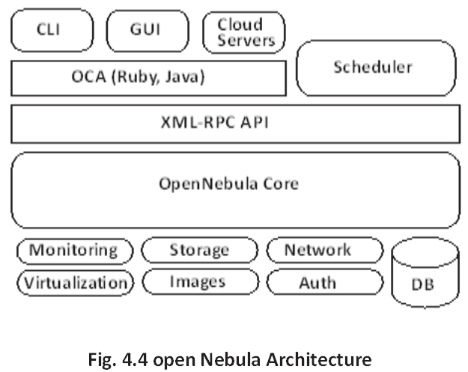

Slide 96
Continue…
The elements of Open Nebula are explained as follows:
Drivers
Virtualization driver: It translates the Open Nebula Virtual Machine life cycle management into specific hypervisor operations.
Monitoring Driver: It gathers the data about the physical host and hypervisor status.
Image and Storage Drivers: Create or import new images in to image repository. It manages the file between the image repository and physical hosts.

Slide 97
Continue…
XML-RPC API: It is a straightforward and high-speed cloud that supports all the languages.
Open Nebula Cloud API (OCA): It maintains high level bindings and complete functionality. It is coded in Ruby, Java and Python.
Scheduler: The scheduler is the administrator for assigning work between virtual machines and hosts. In Open Nebula architecture, the scheduler is highly adaptable and replaceable by third parties.

Slide 98
Continue…
CLI: Open Nebula offers a collection of commands to communicate with the system. Som0e of the interfaces are mentioned as follows:
Oneacct: Gets accounting data from Open Nebula.
Oneacl: Manages Open Nebula ACLs.
Onecluster: Manages Open Nebula clusters.
Onedatastore: Manages Open Nebula data stores.
Onedb: Open Nebula database migration tool.
Onegroup: Manages Open Nebula groups.

Slide 99
Continue…
Onehost: Manages Open Nebula hosts.
Oneimage: Manages Open Nebula images.
Onetemplate: Manages Open Nebula templates.
Oneuser: Manages Open Nebula users.
Onevdc: Manages Open Nebula Virtual Data Centers.
Onevm: Manages Open Nebula virtual machines.
Onevnet: Manages Open Nebula networks.
Onezone: Manages Open Nebula zone.

Slide 100
4.10.7 Open Nebula Computing Platform
The Open Nebula cloud presents a virtual computing platform through the cloud interfaces such as OCCI and EC2 and web interfaces such as Open Nebula Sunstone and self-service.
The Open Nebula computing platform is as shown in the figure 4.5.

Slide 101
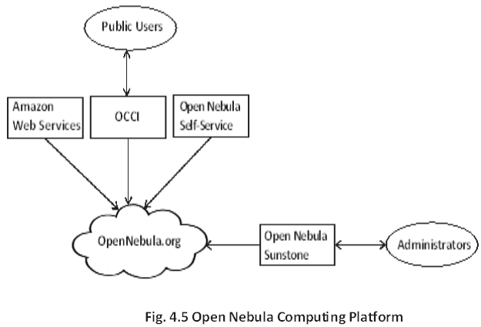

Slide 102
4.11 CLOUDSIM
At present, cloud computing comes out as the chief technology for distributing reliable, safe, fault tolerant, feasible and expandable computational services which are offered as a Software as a Service, Infrastructure as a Service and Platform as a Service.
Additionally, these services may be presented in private clouds which may be commercially presented for public clouds or still it is likely possible that, public as well as private clouds are combined in hybrid clouds.

Slide 103
Continue…
Cloud computing is a latest advancement wherein IT infrastructure as well as applications are offered as ‘services’ to the users based on a usage-dependent payment model.
The application services hosted beneath the Cloud computing model have compound provisioning, composition and deployment needs.
Estimating the performance of Cloud provisioning policies as well as resource performance models in a repetition mode under altering system as well as configurations along with requirements are difficult to achieve.

Slide 104
Continue…
To defeat this challenge, CloudSim, which is an extensible simulation toolkit that facilitates modeling as well as simulation of Cloud computing systems as well as application provisioning platforms.
The CloudSim toolkit maintains both systems as well as behavior modeling of Cloud system elements such as data centers, Virtual Machines (VMs) as well as resource provisioning policies.
It executes general application provisioning techniques that can be prolonged with no difficulty and restricted effort.
Recently, it has maintained modeling as well as simulation of Cloud computing platforms consisting of both single as well as inter-networked Clouds.

Slide 105
Continue…
Furthermore, it depicts custom interfaces for executing policies as well as provisioning techniques for distribution of Virtual Machines beneath inter networked Cloud computing situations.
Many researchers from institutes, such as HP Labs in U.S, are using CloudSim in their study on Cloud resource provisioning as well as energy effective management of data center resources.
The effectiveness of CloudSim is determined by an example relating application services having dynamic provisioning in the hybrid federated Cloud platform.

Slide 106
RECAPITULATION
Cloud computing is the liberation of computing as a service instead as a product.
In this distributed resources, software as well as information provided to computers and several other devices as a utility over a network.
A data center is a service used for residential computer systems as well as its associated elements such as storage systems and telecommunications.

Slide 107
Continue…
In case of traditional data center, servers are co-located and dependent failure where as in case of Cloud servers are integrated and fault-tolerant.
Reasons for moving from traditional computing to Cloud computing were discussed along with the benefits of Cloud computing.
Cloud computing is a technology which allows the user to access resources by means of front end machines, there is no requirement to install any software.
Several challenges related to Cloud computing are Security issues, Data issues, Performance issues, Design issues, Reliability, Legal issues.

Slide 108
Continue…
Software licensing is motivated by the vendors like Amazon. Licensing models in the Cloud are frequently pay-as-you-go as well as subscription based licenses.
The well known case is the Salesforce.com which is licensed, based on the number of users on a subscription point of view.
A service Level Agreement (SLA) is an element of a service agreement in which a service is properly described.

Slide 109
Continue…
The primary advantage of cloud computing distributes resources, which is maintained by the basic nature of a distributed infrastructure platform.
Cloud computing is being encouraged by several big companies.
In Cloud computing, an application can be executed on various computers.
The major players of the Cloud computing environment are Google, Microsoft, Amazon, Apple, Adobe, Cisco and others.

Slide 110
Continue…
Eucalyptus is an open source and unrestricted computer software for constructing Amazon Web Services (AWS).
Eucalyptus is well-suited for private and hybrid cloud computing environments which is promoted by the Eucalyptus Systems.
Eucalyptus 3.4, released on 24th October 2013, includes latest features. Release history of Eucalyptus was discussed.

Slide 111
Continue…
Eucalyptus is an explanation that permits the installation of a private and hybrid cloud infrastructure.
The Amazon version EC2 works on the Eucalyptus platform.
Eucalyptus goals and architecture was discussed. Nimbus is a toolkit, if installed once on a cluster, it offers an IaaS Cloud to its client through Amazon EC2 web service Application Programming Interfaces (APIs).

Slide 112
Continue…
The Open Nebula is a toolkit of cloud computing for organizing varied and distributed data center architectures.
It supports data center virtual infrastructure to construct private, public along with hybrid implementations of IaaS.
The fundamental features of Open Nebula allow private, public and hybrid clouds for the entire management of virtualized data centers.
The CloudSim toolkit maintains both systems as well as behavior modeling of Cloud system elements such as data centers, Virtual Machines (VMs) as well as resource provisioning policies.

Slide 113
BIBILIOGRAPHY
Zaigham Mahmood, Richard Hill,Cloud Computing for Enterprise Architectures, Springer Science & Business Media, 01-Dec-2011.
William Y. Chang, Hosame Abu-Amara, Jessica Feng Sanford, Transforming Enterprise Cloud Services, Springer Science & Business Media, 15-Nov-2010.
Jerry Crasnick, License to Deal,Rodale, 25-May-2005.
Lippoldt Douglas, Stryszowski Piotr, Innovation in the Software Sector, OECD Publishing, 23-Nov-2009.

Slide 114
Continue…
Robin Hastings, Making the Most of the Cloud: How to Choose and Implement the Best Services for Your Library, Scarecrow Press, 26-Nov-2013.
Ian E. Maxwell, Managing Sustainable Innovation: The Driver for Global Growth, Springer Science & Business Media, 21-Apr-2009.
Stephen C. Rogers, The Supply-Based Advantage: How to Link Suppliers to Your Organization's Corporate Strategy , AMACOM Div American Mgmt Assn, 26-Feb-2009.

Slide 115
Continue…
Gerd Leonhard, Friction Is Fiction: the Future of Content, Media and Business, Lulu.com, 05-Dec-2009.
Ulrich Bäumer, Peter Kreutter, Wolfgang Messner, Globalization of Professional Services: Innovative Strategies, Successful Processes, Inspired Talent Management, and First-Hand Experiences, Springer Science & Business Media, 05-Jun-2012.
Tom Laszewski, Prakash Nauduri, Migrating to the Cloud: Oracle Client/server Modernization, Elsevier, 2012.

